Slide 1
Quarter 1 Coalition Meeting
January 18, 2023

Slide 2
Mission Statement | Strategic Focus
The MCYVPC convenes community stakeholders, conducts research, provides leadership, and empowers people to create opportunities that build more peaceful homes, schools, neighborhoods, and workplaces.
The MCYVPC activates community partners to prevent youth violence in Indianapolis through 2 strategic initiatives: (1) Advocate for system-level change, and (2) Champion direct support for youth and families.

Slide 3
Steering team
Elected Co-chair: Tiffany Davis
Appointed Co-chair: Corey Davis
Member-at-Large: Anthony Beverly
Crisis Response Task Force Lead: Della Brown
Family Care Task Force Co-Leads: Brian Shobe, Carey Haley Wong
Policy Task Force Lead: Jake Brosius
Trauma Task Force Lead: Beatrice Beverly
Youth Employment Task Force Co-Leads: LaShauna Triplett, Rodney Francis
Youth Voices Task Force Lead: Mickey Carrothers

Slide 4
New Business / Agenda
Coalition Meeting Structure – Outward focus; organization spotlights
Task Force Meeting Structure
Member Engagement Surveys
Elevation Grant
MCYVPC Conference
Strategic Planning 2024-2027
Legislative Session & Bills We’re Following
Member Announcements

Slide 5
Elevation Grant
The coalition received funding from The Indianapolis Foundation.
The funding will support:
Coalition Coordinator
Interns (12 HS Youth x $1,500 stipend, 6 Supervisor (18 – 25) x $2,500 stipend)
Firearm Safety Campaign
Educational Opportunities
“Love Is” Campaign
Fiscal partnership with Marion County Commission on Youth, Inc. (MCCOY)

Slide 6
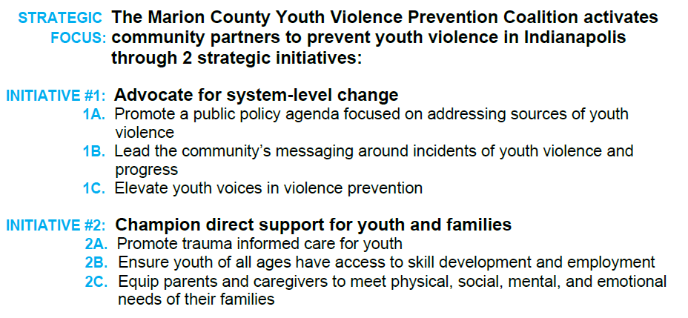
Strategic Planning 2024-2027

Slide 7
2023 Legislative Session

Slide 8
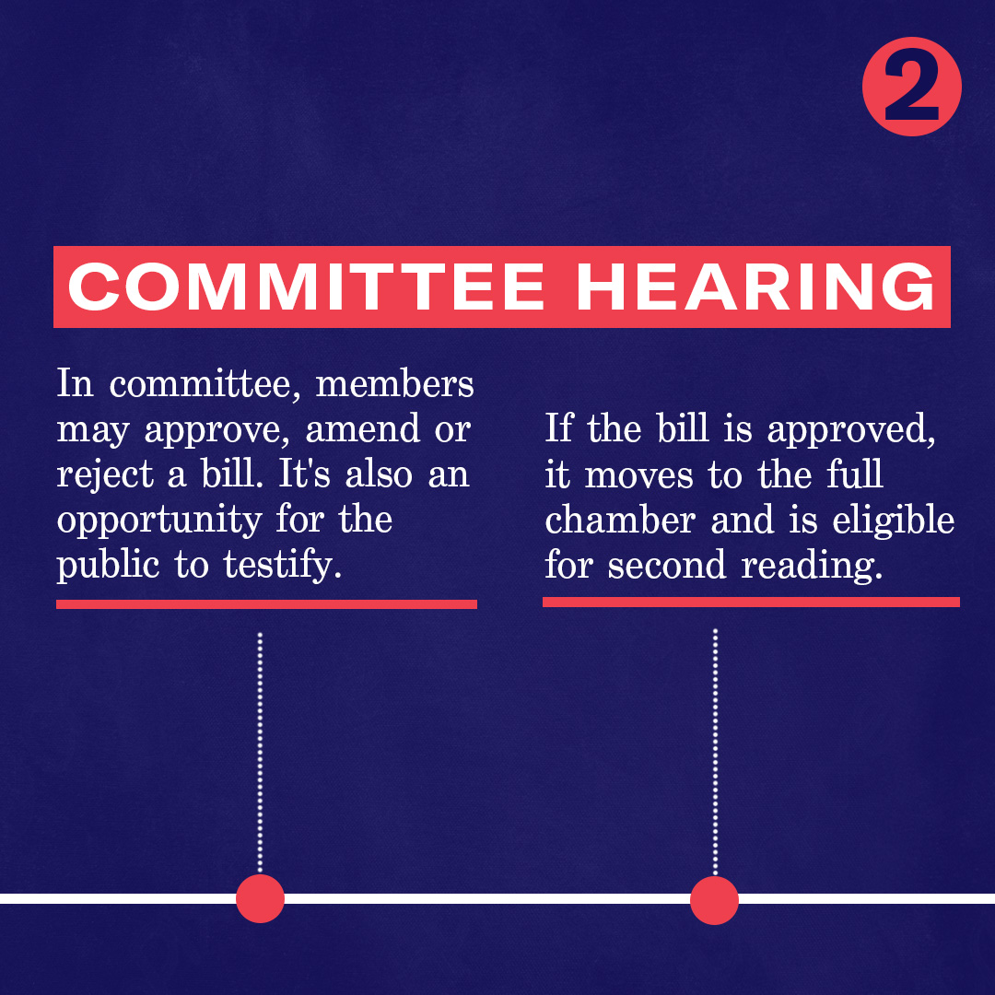
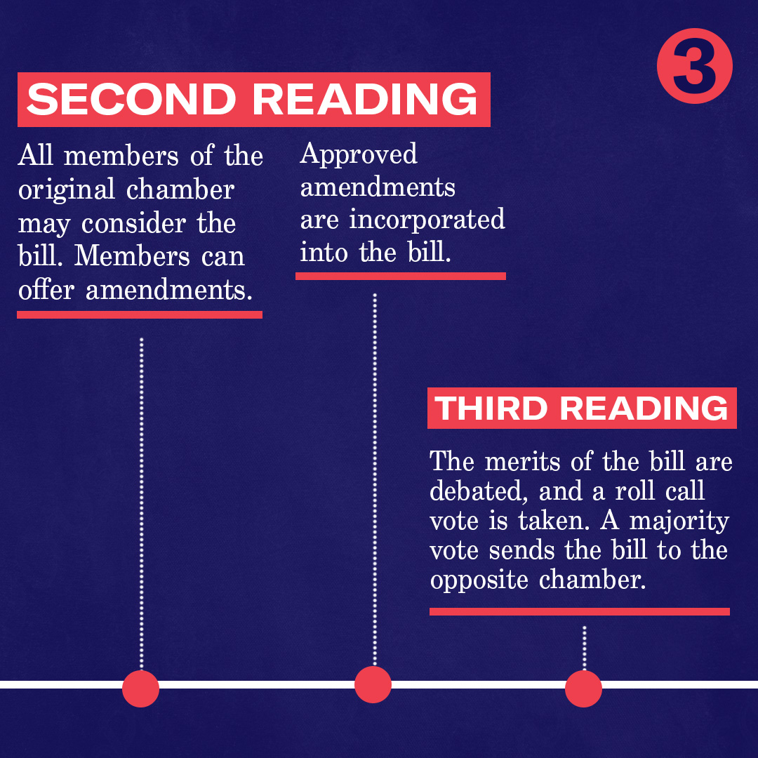
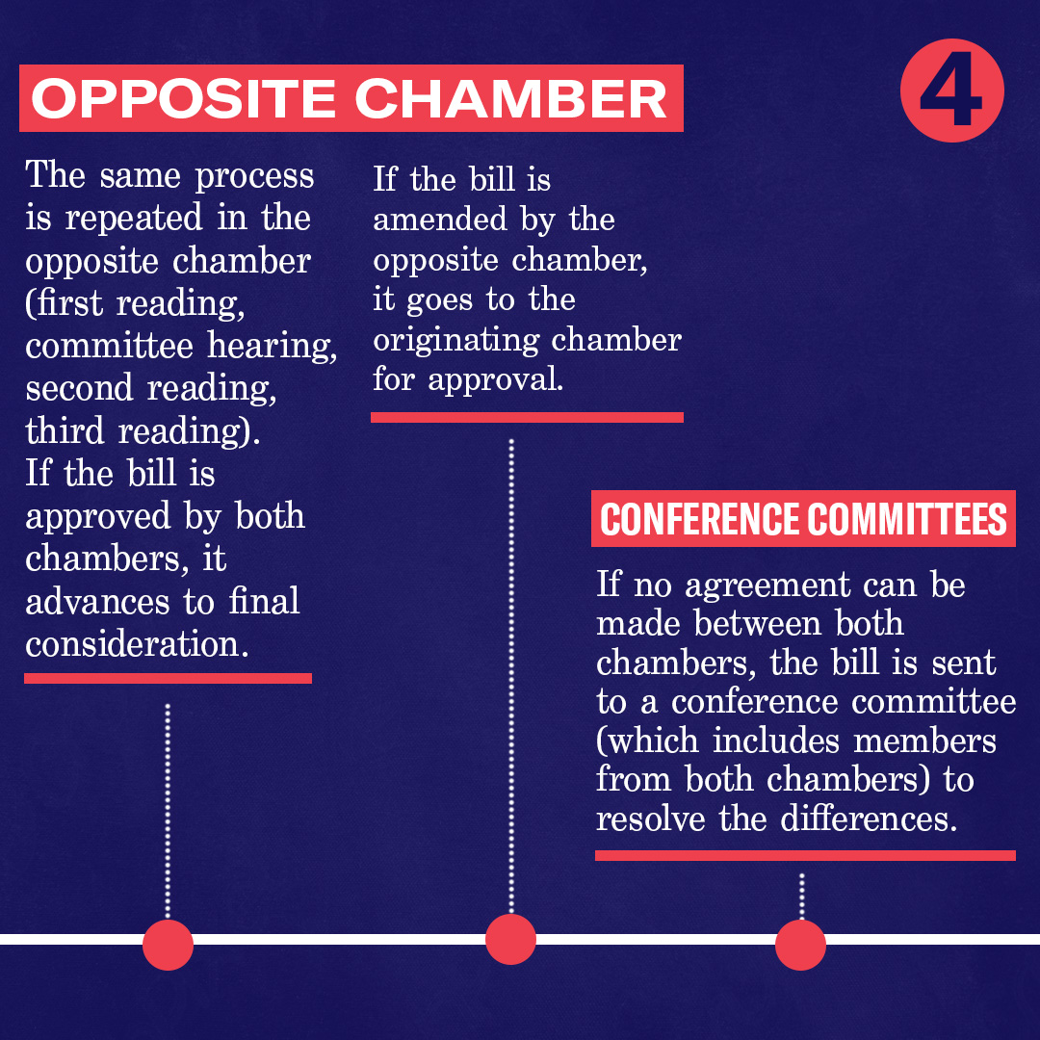
2023 Legislative Session

Slide 9
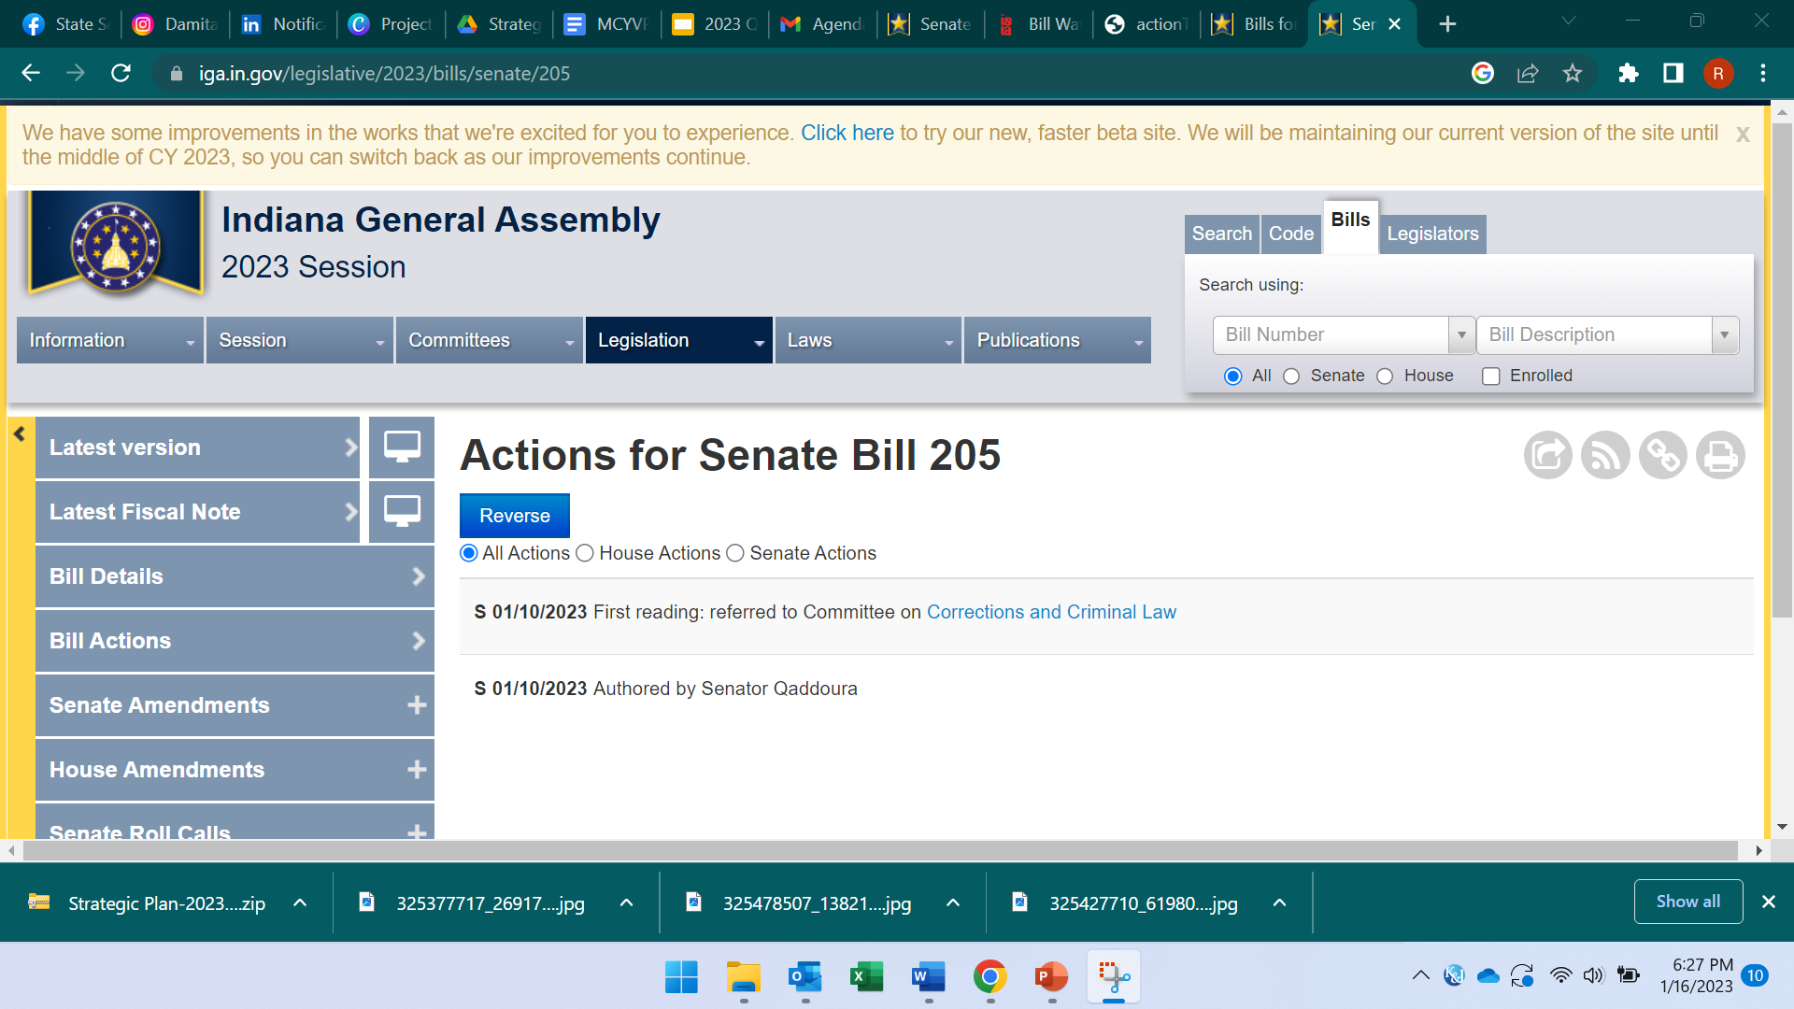
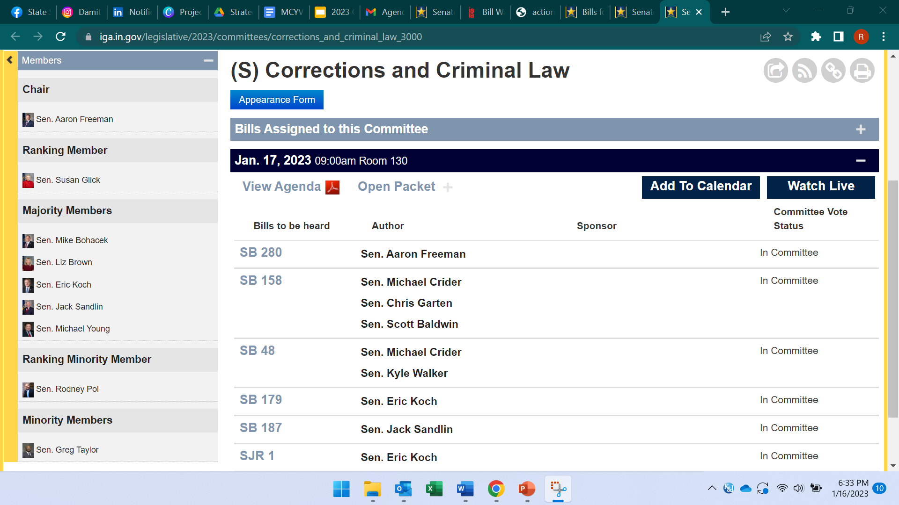
Find bill information
Go to iga.in.gov
Look to the right side, click “Bills” and type the bill #.
Click the bill.
Click Bill Actions
Click the Committee link for members and the Committee agenda
Deadlines
January 20: Last day Senate bills may be assigned to committees.
February 27: Last day for 3rd reading of House bills in House.
February 28: Last day for 3rd reading of Senate bills in Senate.
April 17: Last day for 3rd reading of Senate bills in House.
April 18: Last day for 3rd reading of House bills in the Senate.
April 29: Last day for adjournment of both houses.

Slide 10
Support Communities: Housing
SB202 VARIOUS HOUSING MATTERS.
Allows a city, county, or town to bring a nuisance action against a tenant or other person responsible for a nuisance. Requires a landlord to repair or replace an essential system not later than 24 hours after being notified by a tenant that the tenant's rental unit is without essential services under certain circumstances. Allows for certain remedies to the tenant for the landlord's noncompliance…
HB1242 PUBLIC HEALTH REPORTING FOR RENTAL HOUSING.
Allows tenants to report unsafe rental housing conditions to the local health department
HB1265 HOUSING ISSUES.
Makes appropriations to the Indiana housing and community development authority and the office of the secretary of family and social services to fund programs for housing and other supportive services for individuals experiencing homelessness.

Slide 11
Support Communities: Education
SB39 EQUAL EDUCATIONAL OPPORTUNITY
Extends certain antidiscrimination educational rights statutes to prohibit discrimination based on sexual orientation and gender identity.
SB305 INDIANA EDUCATION SCHOLARSHIP ACCOUNT PROGRAM.
“Under the bill, any parent, no matter their income level, would be eligible to receive their community public school's tuition support grant averaging nearly $7,000.” Indiana State Teachers Association
HB1090 PREKINDERGARTEN PILOT PROGRAM EXPANSION
Requires the office of family and social services to, for the state fiscal years beginning after June 30, 2023, award twice the number of prekindergarten pilot program grants in Marion County as are awarded in Marion County in the state fiscal year ending June 30, 2023.
HB1123, HB1203, HB1255 ELIMINATION OF TEXTBOOK FEES
Requires each public school to provide curricular materials at no cost to each student enrolled in the public school

Slide 12
Support Communities: Food
HB1161 HUNGER-FREE CAMPUS GRANT PROGRAM
Establishes the hunger-free campus grant program (grant program) to provide grants to state educational institutions for purposes of addressing food insecurity among students enrolled in state educational institutions
SB231 PARTICIPATION IN COMMUNITY ELIGIBILITY PROVISION.
Requires an eligible school corporation to elect to participate in the federal community eligibility provision to provide universal free school breakfast and lunch to all students.

Slide 13
Student Mental Health
HB1094 COMPREHENSIVE STUDENT SUPPORT PROGRAM
Establishes the comprehensive student support program for the purposes of: (1) funding the formation and staffing of school based and district level comprehensive student support teams; (2) improving staffing ratios for student support personnel; (3) supporting the creation, expansion, and work of multidisciplinary school teams to address the school environment, school safety, school improvement, and crisis intervention and emergency preparedness; and (4) professional development for student…
SB229 CHARTER SCHOOL REQUIREMENTS
Provides that provisions regarding the following apply to charter schools: (1) Access to financial data for local schools. (2) Bullying prevention training for employees and volunteers. (3) Child suicide awareness and prevention policy requirements. (4) …
SB197 STUDENT HEALTH
Requires the governing body of a school corporation or chief administrative officer of a nonpublic school system to authorize the absence and excuse of a student due to the student's mental or behavioral health concerns.

Slide 14
Firearm Access / Safety
SB360 FIREARMS MATTERS
Repeals the offense of unlawful carrying of a handgun.
SB144 MINIMUM AGE TO CARRY A HANDGUN
Changes the minimum age required to carry a handgun to 21 years of age.
SB358 FIREARM SAFETY
Establishes the firearm safety and suicide prevention fund for the purpose of providing funds to a school or not-for-profit organization to provide training concerning: (1) firearm safety in the home…
HB1227 SCHOOL DISTRIBUTION OF FIREARM SAFETY INFORMATION
Requires the department of education, in collaboration with the state police department, to identify a set of best practices and develop a set of educational materials concerning the safe possession and storage of a firearm in a home with a child.

Slide 15
Other Bills We’re Following
SB205 Task force for the reduction of violent crime
Establishes the task force for the reduction of violent crime (task force). Requires the task force to study potential statutory changes to reduce violent crime and submit a report for distribution to the general assembly.

Slide 16
Other Bills We’re Following
HB1177 HANDGUN TRAINING FOR TEACHERS
Creates a specialized firearms safety, education, and training curriculum (curriculum) for teachers, school staff, and school employees. Specifies curriculum requirements. Authorizes funds from the: (1) Indiana safe schools fund; (2) Indiana secured schools fund; and (3) school corporation and charter school safety advance program; to be used for the purpose of providing specialized firearms instruction to certain teachers, school staff, and school employees, and for providing counseling services to students, teachers, school staff, and school employees in the event of a school shooting. Requires a charter school, nonpublic…
HB1180 EDUCATION MATTERS
Requires reporting concerning students injuring teachers and training for teachers in de-escalation, prevention, and intervention strategies. Requires information concerning the following to be presented to a school corporation's governing body: (1) Responsibilities and nature of employment of the superintendent. (2) Commencement of an internal investigation. (3) Legal expenditure of more than $1,000 in an adjudicative action. Provides that the superintendent must certify under penalties of perjury that the legal expenditure…

Slide 17
Member Announcements (1/5)
Lashauna Triplett, MLT Outreach
Egg distribution
April Bridging The Gap Event – Organizations can adopt a street
Nickolas Hogan, Riley Hospital for Children
Safety fairs
Looking at community outreach on violence against children
Sheryl Richardson, Indy Parks and Recreation
$80 million from Lilly
Broad Ripple Park ribbon cutting tomorrow; Open House from 9 a.m. to 5 p.m. on Saturday, Jan. 21
Indy Parks Summer Day Camp registration is now open
Indy Parks is now hiring
Free Lifeguard Training
Wes Montgomery park basketball court upgrade and skate surface
Jennifer Zuker, Marion County Public Health Department (MCPHD)
Public Health Day at the Statehouse – Thursday, January 26, 2023, 11am to 1pm

Slide 18
Member Announcements (2/5)
Anthony Beverly, Stop the Violence Indianapolis
#teamupforpeace, in partnership with Hoosiers For Good, changing the narrative around gun violence-free schools
High School teams wearing Stop the Violence shirts
Engaging communities, churches is next phase
Della Brown, Office of Public Health and Safety (OPHS)
Meet the Peacemakers Tour in the works
Share their strategy, get feedback
Looking for hosts (churches)
Starting in March
Currently 19 outreach workers, 22 life coaches, 7 violence interrupters / hiring
Immanuel Ivey & Kernest Russell, Edna Martin Christian Center
Providing mentorship in detention centers
Youth employment readiness program: February 6

Slide 19
Member Announcements (3/5)
Drew Neddo, Big Brothers Big Sisters of Central Indiana (BBBS)
January is National Mentoring Month
Looking for mentors
Coffee, Collab, & Convo: Fri, January 20, 2023, 9:00 AM – 10:30 AM EST at 1433 N Meridian
Jake Brosius, Marion County Prosecutor's Office (MCPO)
Prosecutor Mears re-elected
Second Chance Workshops ongoing – reach out if someone needs driver's license reinstatement
In-person date not selected yet
Working with Neighborhood Christian Legal Clinic to help with expungements
Youth Violence Prevention Fellowship is a paid opportunity this summer for high school students
Mickey Carrothers, Mission Makai
Environmental Art Advocacy Contest / Cash prize
Trying to get into galleries

Slide 20
Member Announcements (4/5)
Chris Toliver, YMCA of Greater Indianapolis
College Tour (March 26 - 31)
Indiana YMCA Youth and Government (March 10 – 12)
Certified Nursing Aide (CNA) Certification Training Program
Chris Ponti, Reach For Youth
Volunteers (12 – 22-year-olds) are needed for Teen Court
Blakney Brooks & Iwandra Gardner, Eskenazi Health
29th Annual Trauma & Surgical Critical Care Symposium Friday, Feb. 17, 2023, 7 a.m. – 4:30 p.m.
Trauma support group: Wednesdays, 5 - 7 p.m.
Brian Shobe, Shiloh Missionary Baptist Church
April 16: Love our Neighbor Day (Neighbors host events in their neighborhood
Jan 31, Feb 1, Feb 2 (6:30 pm): Conference to equip people to engage in their neighborhood
Feb 11, 12:30 PM: Faith in Indiana Rally for Care at New Direction Church (demand our state legislators fully fund mental health crisis response this legislative session)
Feb 23: Town Hall - healthcare barriers (trust, access, transportation, financial)

Slide 21
Member Announcements (5/5)
LaMarr Davis, Marion County Commission on Youth (MCCOY)
Leading Mayor’s Youth Leadership Council
Unhoused Youth Group: May 6, 6 – 8pm
Looking to partner with more leadership councils
Impact Team for youth (12 – seniors in high school) to get 30 hours of community service: Send opportunities to LaMarr
Beatrice Beverly, Genesys Solutions
Skating For Self – March 14 (First 200 shatters get in free)
Block Party Peace Party (conversations around mental health)
Going into schools to do assessments and need more people certified

Slide 22
E-mail: mcyvpc@gmail.com – “Coalition Connection”
Website: saferindy.com
Social Networks
@mcyvpc
@mcyvpc
@mcyvpc
This Photo by Unknown Author is licensed under CC BY-SA
This Photo by Unknown Author is licensed under CC BY-SA

Slide 23
Attendees (1/2)
Anthony Beverly, Stop the Violence Indianapolis
Beatrice Beverly, Genesys Solutions
Mary Boggs, Congregations United to Reduce Violence (CURV)
Blakney Brooks, Eskenazi Health
Jake Brosius, Marion County Prosecutor's Office (MCPO)
Della Brown, Office of Public Health and Safety (OPHS)
Karla Brown, Boys & Girls Clubs of Indianapolis
Mickey Carrothers, Mission Makai
Corey Davis, Marion County Public Health Department (MCPHD)
LaMarr Davis, Marion County Commission on Youth (MCCOY)
Tiffany Davis, IU Health Methodist Hospital
Candra Dixon, Edna Martin Christian Center
Iwandra Gardner, Eskenazi Health
Lisa Harvey, Lawrence Police Department

Slide 24
Attendees (2/2)
Nickolas Hogan, Riley Hospital for Children
Rosie Houff
Rebecca McCracken, Marion County Youth Violence Prevention Coalition
Drew Neddo, Big Brothers Big Sisters of Central Indiana (BBBS)
Chris Ponti, Reach For Youth
Sheryl Richardson, Indy Parks and Recreation
Immanuel Ivey, Edna Martin Christian Center
Kernest Russell, Edna Martin Christian Center
Brian Shobe, Shiloh Missionary Baptist Church
Cheryl Shockley, Warriors 4 Peace
Chris Toliver, YMCA of Greater Indianapolis
Lashauna Triplett, MLT Outreach
Cecelia Whitfield, Use What You've Got Prison Ministry
Jennifer Zuker, Marion County Public Health Department (MCPHD)

