Slide 2
Mission Statement | Strategic Focus
The MCYVPC convenes community stakeholders, conducts research, provides leadership, and empowers people to create opportunities that build more peaceful homes, schools, neighborhoods, and workplaces.
The MCYVPC activates community partners to prevent youth violence in Indianapolis through 2 strategic initiatives: (1) Advocate for system-level change, and (2) Champion direct support for youth and families.

Slide 3
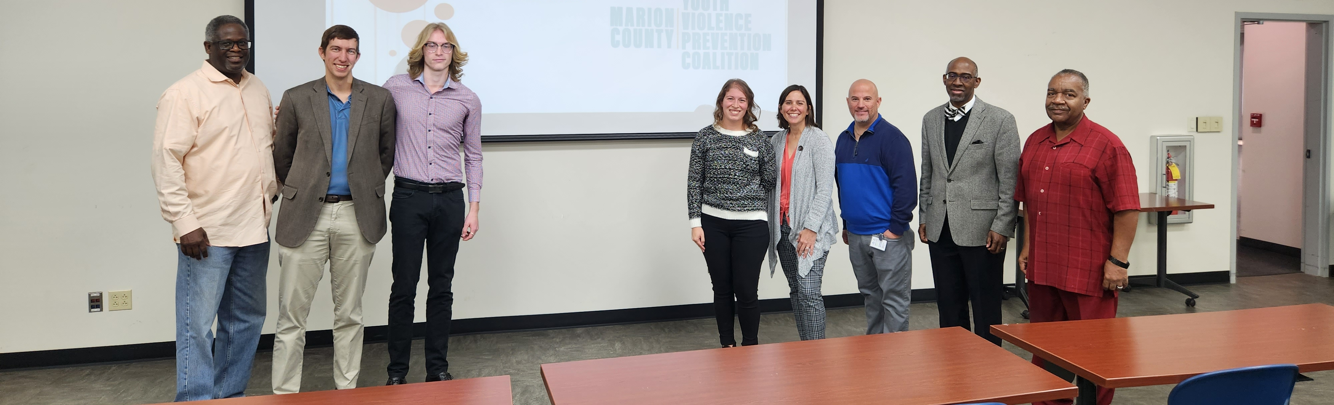
Steering team
Elected Co-chair: Tiffany Davis
Appointed Co-chair: Corey Davis
Member-at-Large: Anthony Beverly
Crisis Response Task Force Lead: Della Brown
Family Care Task Force Co-Leads: Brian Shobe, Carey Haley Wong
Policy Task Force Lead: Jake Brosius
Trauma Task Force Lead: Beatrice Beverly
Youth Employment Task Force Co-Leads: LaShauna Triplett, Rodney Francis
Youth Voices Task Force Lead: Mickey Carrothers

Slide 4
New Business / Agenda
Organization spotlights
Drew Neddo, Big Brothers Big Sisters of Central Indiana
DeAndra Dycus, IMPD Non-Fatal Advocacy and Support Program
Member Engagement Survey
Strategic Planning 2024-2027 – 3-5 coalition members needed
Indiana Black Expo: July 14, 15 & 16 – Organizations participating?
Legislative Updates
Sarah Kumfer, Public Policy and Advocacy Director at MCCOY
STOP the BLEED training (10-11am)

Slide 5
Drew Neddo- Mentoring Relationships Manager
SUBHEAD

Slide 6
Notes:
Big Brothers Big Sisters exists to create positive change in our community. We are a national organization with more than 300 local affiliates across the country, and for more than 100 years, we have operated under the belief that inherent in every child there is potential. Big Brothers Big Sisters of Central Indiana serves kids ages eight to 18, who live in Marion, Hamilton, or Johnson County.
We do not create potential, we are here to defend it and kids right here in Central Indiana are waiting for someone who will stand with them to defend, ignite, and empower their potential.
The core of our mission and programming is 1:1 youth mentoring. Meaning, we pair one young person with 1-2 mentors, and they embark on their own mentoring relationship in the community with support from our agency behind the scenes.
We ask for a 12-month commitment from our families and mentors and ask that Bigs and Littles see each other 4-6 hours per month at minimum. Most of our mentoring relationships, or matches, end up staying together for several years with many graduating from the program when the Little graduates high school or turns 18 (whichever comes later).
This year alone, our agency will serve over 1100 kids in our community.
After today, we hope you will join us in our mission.

Slide 7
Notes:
Why is mentorship important? At Big Brothers Big Sisters, we’ve had the honor of seeing, firsthand, the difference one mentor can have for a young person’s life.
Mentors guide a young person, give them another accountability partner, and support them through the ups and downs that just come with growing up. Through research, we’ve seen that having a mentor can:
Increase the young person’s academic performance
Help the young person grow socially and emotionally
Help the young person avoid risky behaviors
We’ve talked about WHY mentoring matters, now let’s talk about the demand for mentors in central Indiana.
[Pause for questions]

Slide 8
Alignment with MCYVPC
Notes:
Our agency is purposeful in our support for children who are facing adversities or have experienced some kind of trauma.
Over 35% of the youth we serve have a parent or caregiver who have been incarcerated
85% are living at an economic level that makes them eligible to receive free or reduced lunch
And over 70% live in a single parent home.
But putting a consistent, caring adult role model in these kids lives helps keep them on the path to a successful future.

Slide 9
Notes:
Welcome and thank you for hosting Big Brothers Big Sisters of Central Indiana. My name is NAME and I am the ROLE at Big Brothers Big Sisters of Central Indiana. [Let them get to know you.]
I am excited to be here with you today to share some more about what we do, and how you can get involved to defend the potential of kids right here in your community.
I have lots of information to go over with you, but I want to start by sharing a quick video to just introduce our organization and what we’re about.

Slide 10
Notes:
Questions from the chat or from guests

Slide 11
BEBIGFORKIDS.ORG
dneddo@bbbsci.org
317-402-4383
Notes:
Make the Ask, tell them the next steps.
If you have any questions about volunteering with Big Brothers Big Sisters, supporting the agency, or attending an event, now is the time to ask! Again, we hope you will consider beginning the process to becoming a Big by filling out the inquiry form in front of you.
Thank you for helping us defend the potential of more kids right here in Central Indiana!

Slide 12
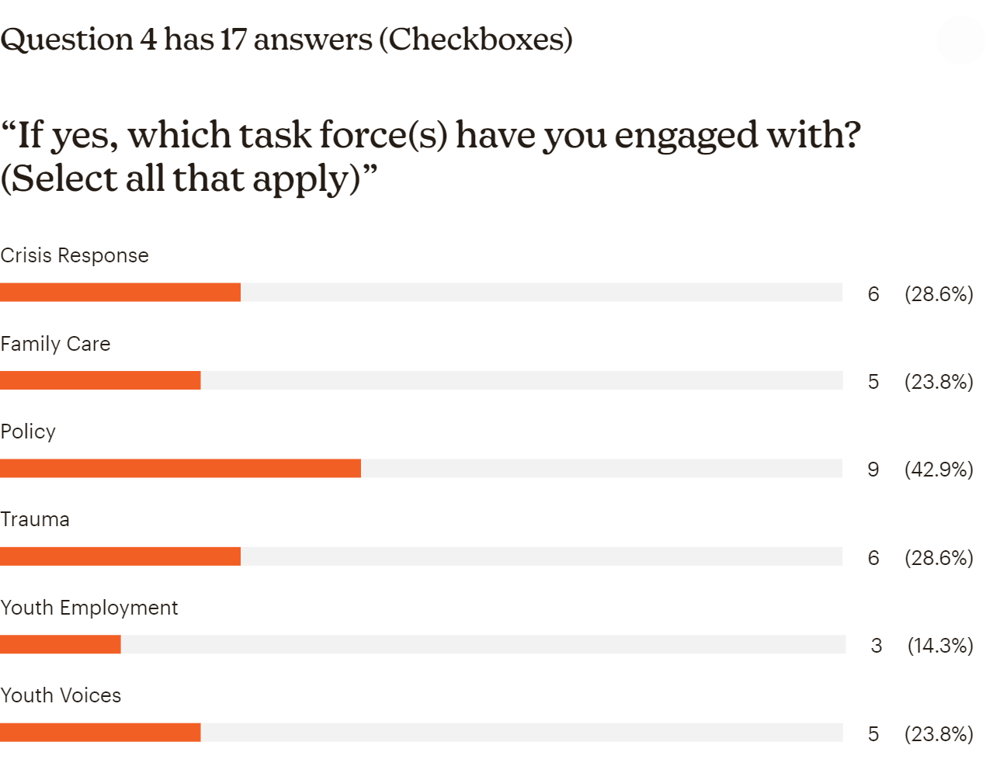
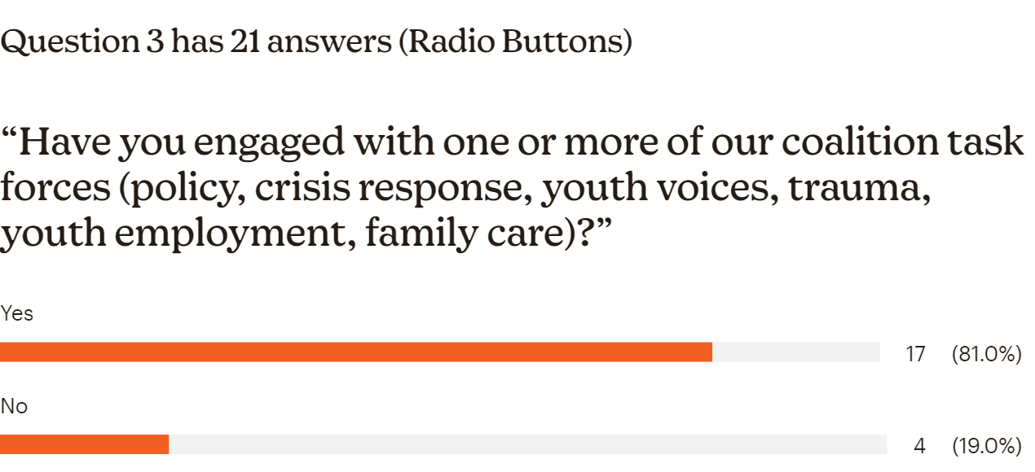
Member Engagement Survey
“If no, what is preventing you from getting engaged?”
"I reached out to the youth employment task force but didn't geta response."
"I just joined the coalition this month and have not attended my first meeting yet."
"My current commitment has taken more of my time, but my goal is get more involved."
"Lack of information about the needs. "
Member Engagement Survey

Slide 13
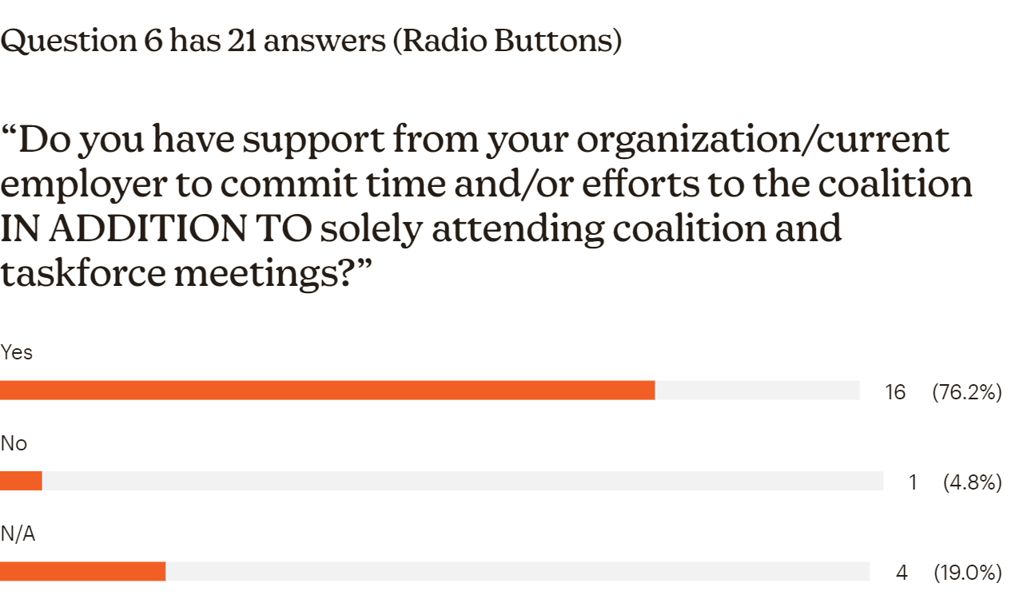
Member Engagement Survey

Slide 14
Question 7 has 18 answers (Open Text) “What are the biggest challenges you face to attending FULL COALITION meetings?”
"The commitment, and not seeing actual action being implemented as a former co chair on the task force I wish I could’ve seen actual work being done."
"Late notice of meeting logistics."
"The fact that they are held during the day and they can compete with other more critical meetings and/or task."
"As a student in high school, the in person meetings are typically held on Wednesdays during the school day, and therefore I cannot attend these meetings. I also am unaware of any zoom meetings that take place, when they occur, or where to log in from."
"I attend high school and have had to talk to my principal to get excused.“
"Need virtual option"
Schedule / Conflicting meetings - 7
Nothing - 5

Slide 15
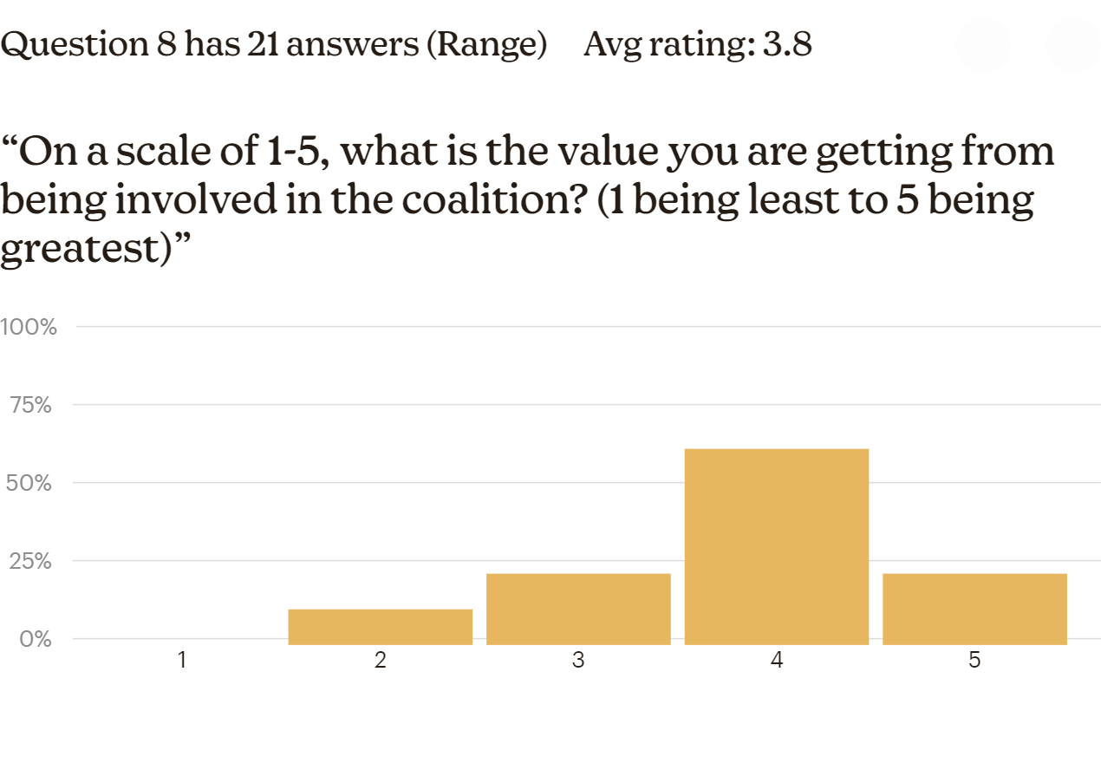
Member Engagement Survey

Slide 16
Question 9 has 15 answers (Open Text) “What could the coalition do/provide to increase YOUR engagement in the coalition?”
"Full time job commitments and schedule limits my engagement with the coalition"
"Insightful meetings"
"More funding opportunities"
"Engage more youth."
"I have felt frustrated by the lack of participation from our city leaders in assuring the Coalition goals are moved forward. We created an excellent plan but I feel there is minimal government and community investment in realizing them."
"I would love to be more engaged by changing the in person meetings to a weekend and making the zoom link more accessible."
"More direct information and request of need for my involvement. I want to fit in where I best can be utilized, but will not know where to begin without direction."
"Meetings in the evenings. Thank outside of the box when holding the meetings - speed meetings, organization highlight tables. recognition/shoutout to organizations/people on positive things they have done and/or doing."
"Monday or Wednesday afternoon meeting time(s), or Tuesday or Thursday morning meeting time(s)"
"Build a collaborative model that truly supports one another"
"Continue to design and demonstrate opportunities for collaboration between organizations in the Coalition."
"Provide opportunities for me to highlight my organization or achieve my organization's goals."

Slide 17
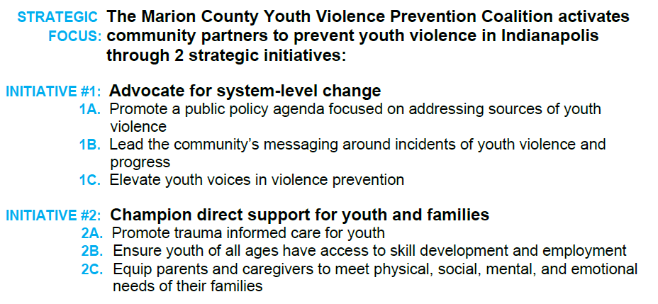
Strategic Planning 2024-2027 3-5 coalition members needed

Slide 18
Legislative Review
Sarah Kumfer
Public Policy and Advocacy Director
MCCOY- Marion County Commission on Youth
Sarah.kumfer@mccoyouth.org

Slide 19
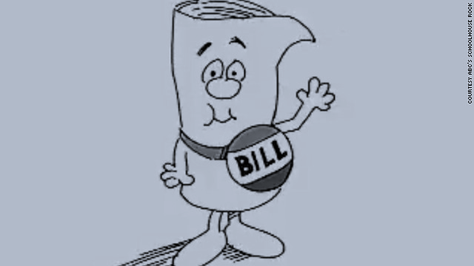
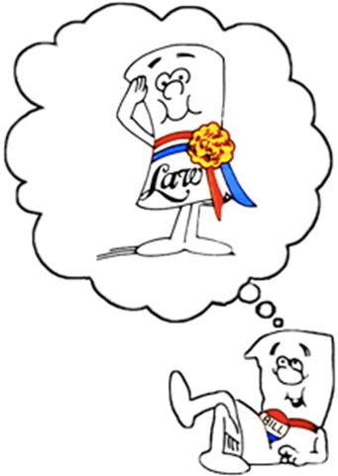
How Legislation Occurs
Deadline: 2/23 for House Bills; 2/27 for Senate Bills
Deadline to file bills is 1/12 for House and 1/13 for Senate
Committee reports due 2/21 for House Bills; 2/23 for Senate Bills
Deadline: 2/27 for House Bills; 2/28 for Senate Bills
Deadline to assign bills to committee is 1/20
Idea developed
Bill drafted
Bill introduced & referred to committee
Committee action
Second Reading
Third Reading
Second Chamber
Conference Committee
Governor
Law!
We are here
Starts 4/18/23, goes until Sine Die
House deadline for SBs: 4/13
Senate deadline for HBs: 4/17
Senate Committee reports for HBs due 4/13;
House CR reports for SBs due 4/11
House deadline for SBs: 4/17
Senate deadline for HBs: 4/18

Slide 20
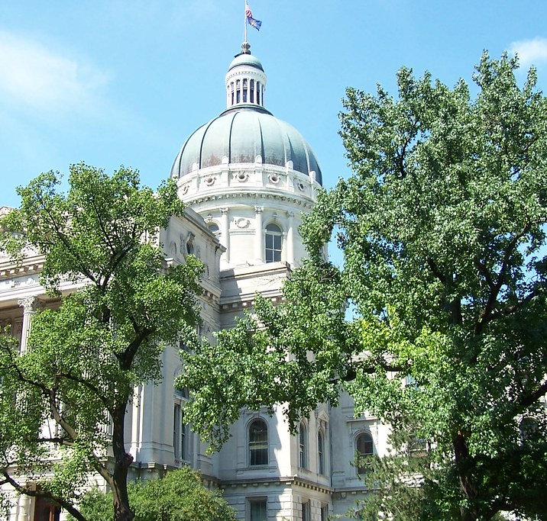
Bills of note as we wrap up the 2023 legislative session

Slide 21
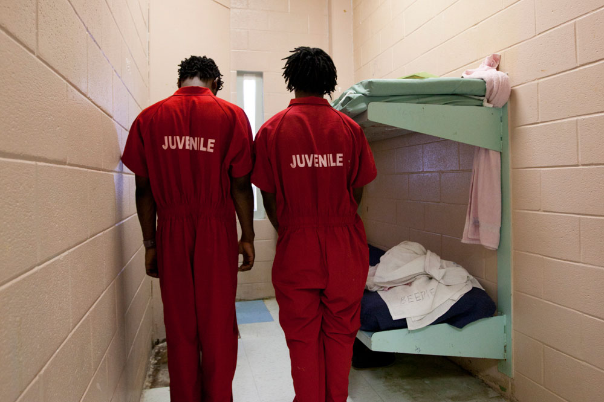
Juvenile Justice Reform:
HB1493, Elimination of Costs and Fees in Juvenile Court, on third reading 4/18 in the Senate
SB 415, Admissibility of a Statement by Juvenile in Custody, passed out of House 96-0 and the Senate concurred in the House amendments. Will be sent to Governor, likely this week.

Slide 22
Education issues
SB 12 Material Harmful to Minors: DEAD
SB380: Nearly was amended to include language from SB12, but ultimately amendment was dropped.
SB 167 “FAFSA” : Passed 3rd reading in House 84-9; Senate Concurred in House amendments; will likely be sent to Governor this week.
SB340 “Imagination Library:” DEAD ☹ - was last referred to Ways and Means committee but was never scheduled for a hearing.
SB 35 Financial Literacy : Conference Committee scheduled for 9am Wed 4/19
HB 1449 “Twenty-first century scholars’ program” - House concurred with Senate amendments
SB486 “Education Matters”: Senate concurred with House amendments(will remove a mandate requiring school administrators to discuss working conditions with teacher union reps.
HB1177 Handgun Training for Teachers- passed third reading in the Senate on 4/18

Slide 23
Bills that impact trans or non-binary youth
SB480, "Gender Transition Procedures for Minors," Governor Holcomb signed it into law on April 5. Now is Public Law 10. Will go into effect in July. Youth will need to end current procedures by the end of the year. ACLU is suing.
HB1608, “Education Matters” passed its 3rd reading in the Senate 37-12; has been returned to the House with amendments.

Slide 24
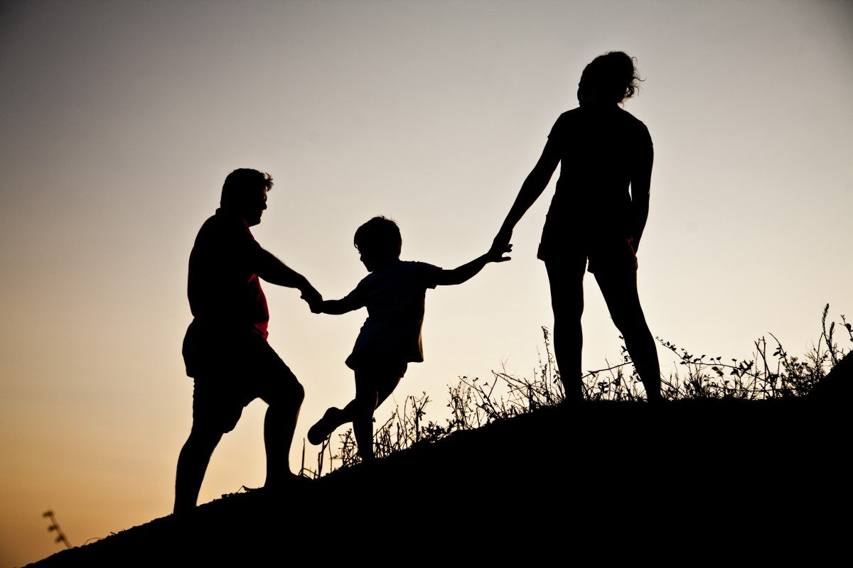
Other relevant bills:
SB151 FOSTER FAMILIES: Senate concurred in House Amendments
SB265 TANF ELIGIBILITY: Senate Concurred in House Amendments;
Both bills will likely be sent to Governor this week.
SB252 Long-Acting Reversible Contraceptives: CONFERENCE COMMITTEE
HB1568: Prescription for Hormonal Contraceptives: passed 3rd reading 28-20; returned to the House with no amendments.

Slide 25
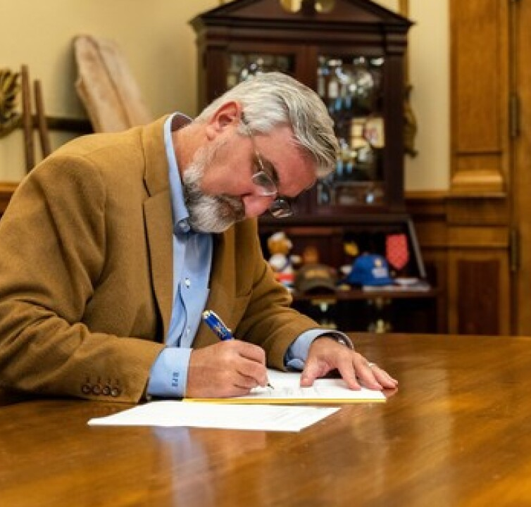
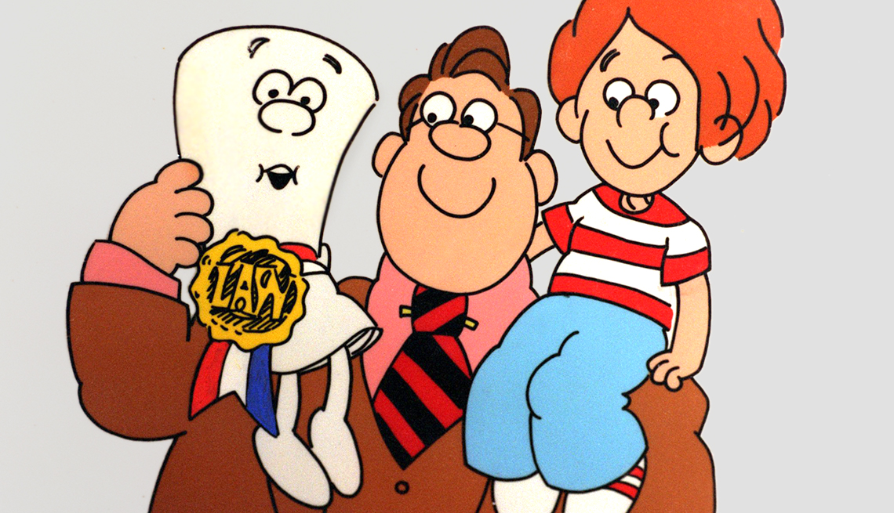
When a bill has passed through both chambers of the General Assembly, it is sent to Governor Holcomb.
Within 7 days, Gov. Holcomb has the option to:
Sign the bill into law (most common)
Veto the bill
Then the General Assembly can override his veto with a simple majority vote
Let the bill pass into law without his signature (not common)
Follow his 2023 Bill Watch here:
https://www.in.gov/gov/newsroom/2023-bill-watch/

Slide 26
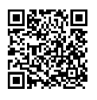
Thank You!
Sarah Kumfer
Public Policy and Advocacy Director
MCCOY
Sarah.Kumfer@mccoyouth.org
Advocacy Resources:
https://mccoyouth.org/advocacy/advocacy-resources/
Sarah’s Statehouse Sound-off
https://mccoyouth.org/advocacy/advocacy-statehouse-sound-off/

Slide 27
E-mail: mcyvpc@gmail.com – “Coalition Connection”
Website: saferindy.com
Social Networks: @mcyvpc
This Photo by Unknown Author is licensed under CC BY-SA
This Photo by Unknown Author is licensed under CC BY-SA

Slide 28
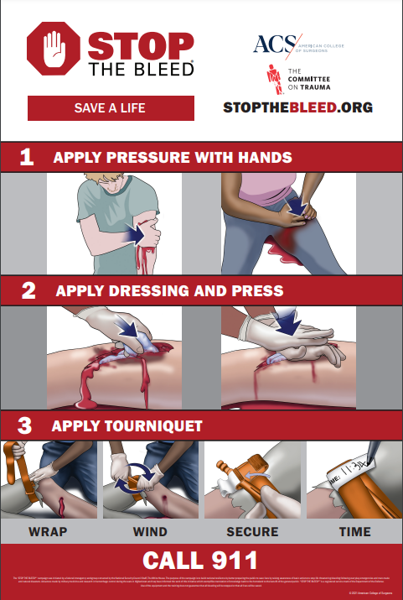

Slide 29
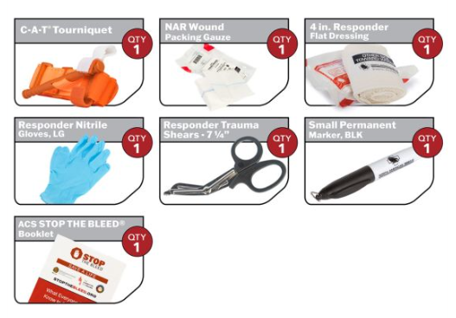
If you are interested in bringing a Stop the Bleed Training course to your organization, please fill out an organization contact card and drop it in the basket at the front.
You will be entered into a drawing for a FREE Stop the Bleed kit which contains the following and can be kept at your place of business:

