Slide 1
COALITION QUARTERLY MEETING
Snap the QR code to check-in

Slide 2
Mission Statement | Strategic Focus
The MCYVPC convenes community stakeholders, conducts research, provides leadership, and empowers people to create opportunities that build more peaceful homes, schools, neighborhoods, and workplaces.
The MCYVPC activates community partners to prevent youth violence in Indianapolis through 2 strategic initiatives:
Advocate for system-level change, and
Champion direct support for youth and families.

Slide 3
Steering team
Elected Co-chair: Tiffany Davis
Appointed Co-chair: Corey Davis
Member-at-Large: Anthony Beverly
Crisis Response Task Force Lead: Della Brown
Family Care Task Force Co-Leads: Brian Shobe, Carey Haley
Policy Task Force Lead: Jake Brosius
Trauma Task Force Co-Leads: Beatrice Beverly, Julie Hayden
Youth Employment Task Force Co-Leads: LaShauna Triplett, Rodney Francis
Youth Voices Task Force Lead: Mickey Carrothers
Coalition Coordinator: Becca McCracken

Slide 4
Agenda
Check-in via the QR code
Welcome
2023 Projects
Funding
Collaboration Projects
2024-2027 Strategic Plan
Voting*
* Anyone interested in being a write-in candidate on the ballot must let Becca know in the next 10 minutes. Write-in candidates will be asked to speak for 1 minute regarding why this position is a good fit for them.
Task Force Break-Outs

Slide 5
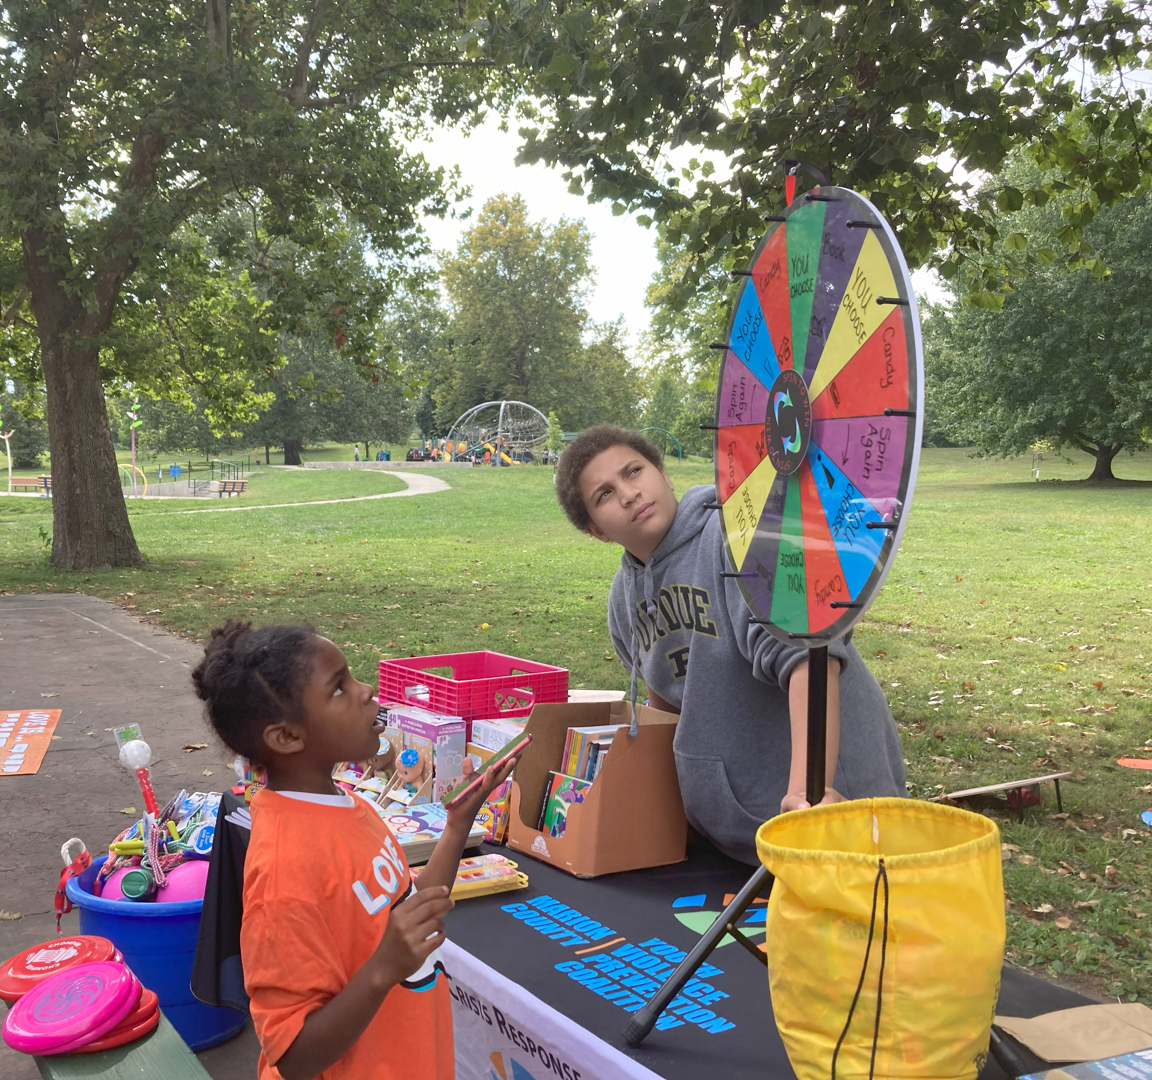
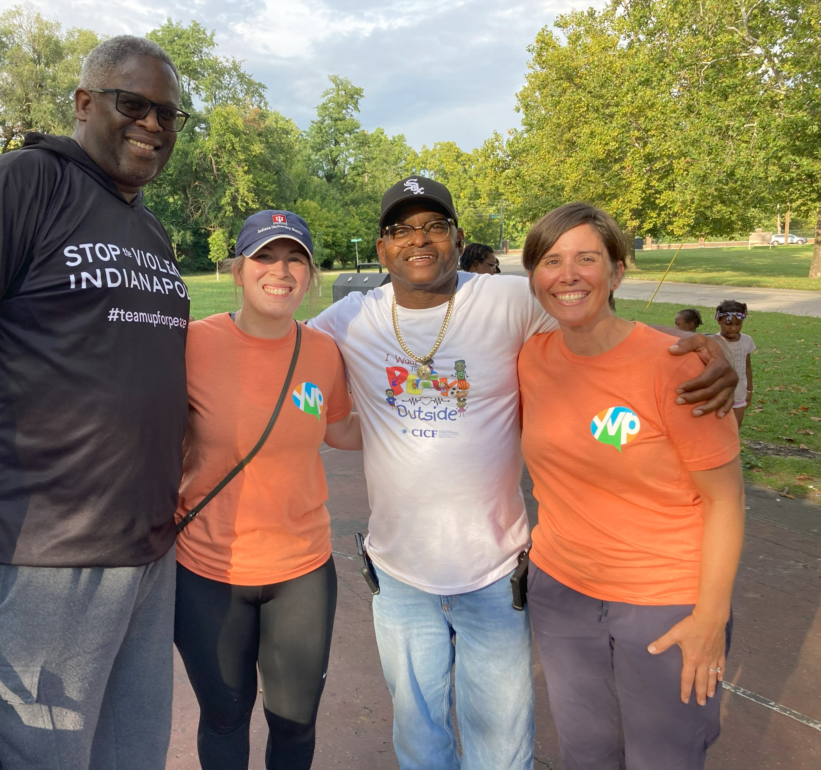
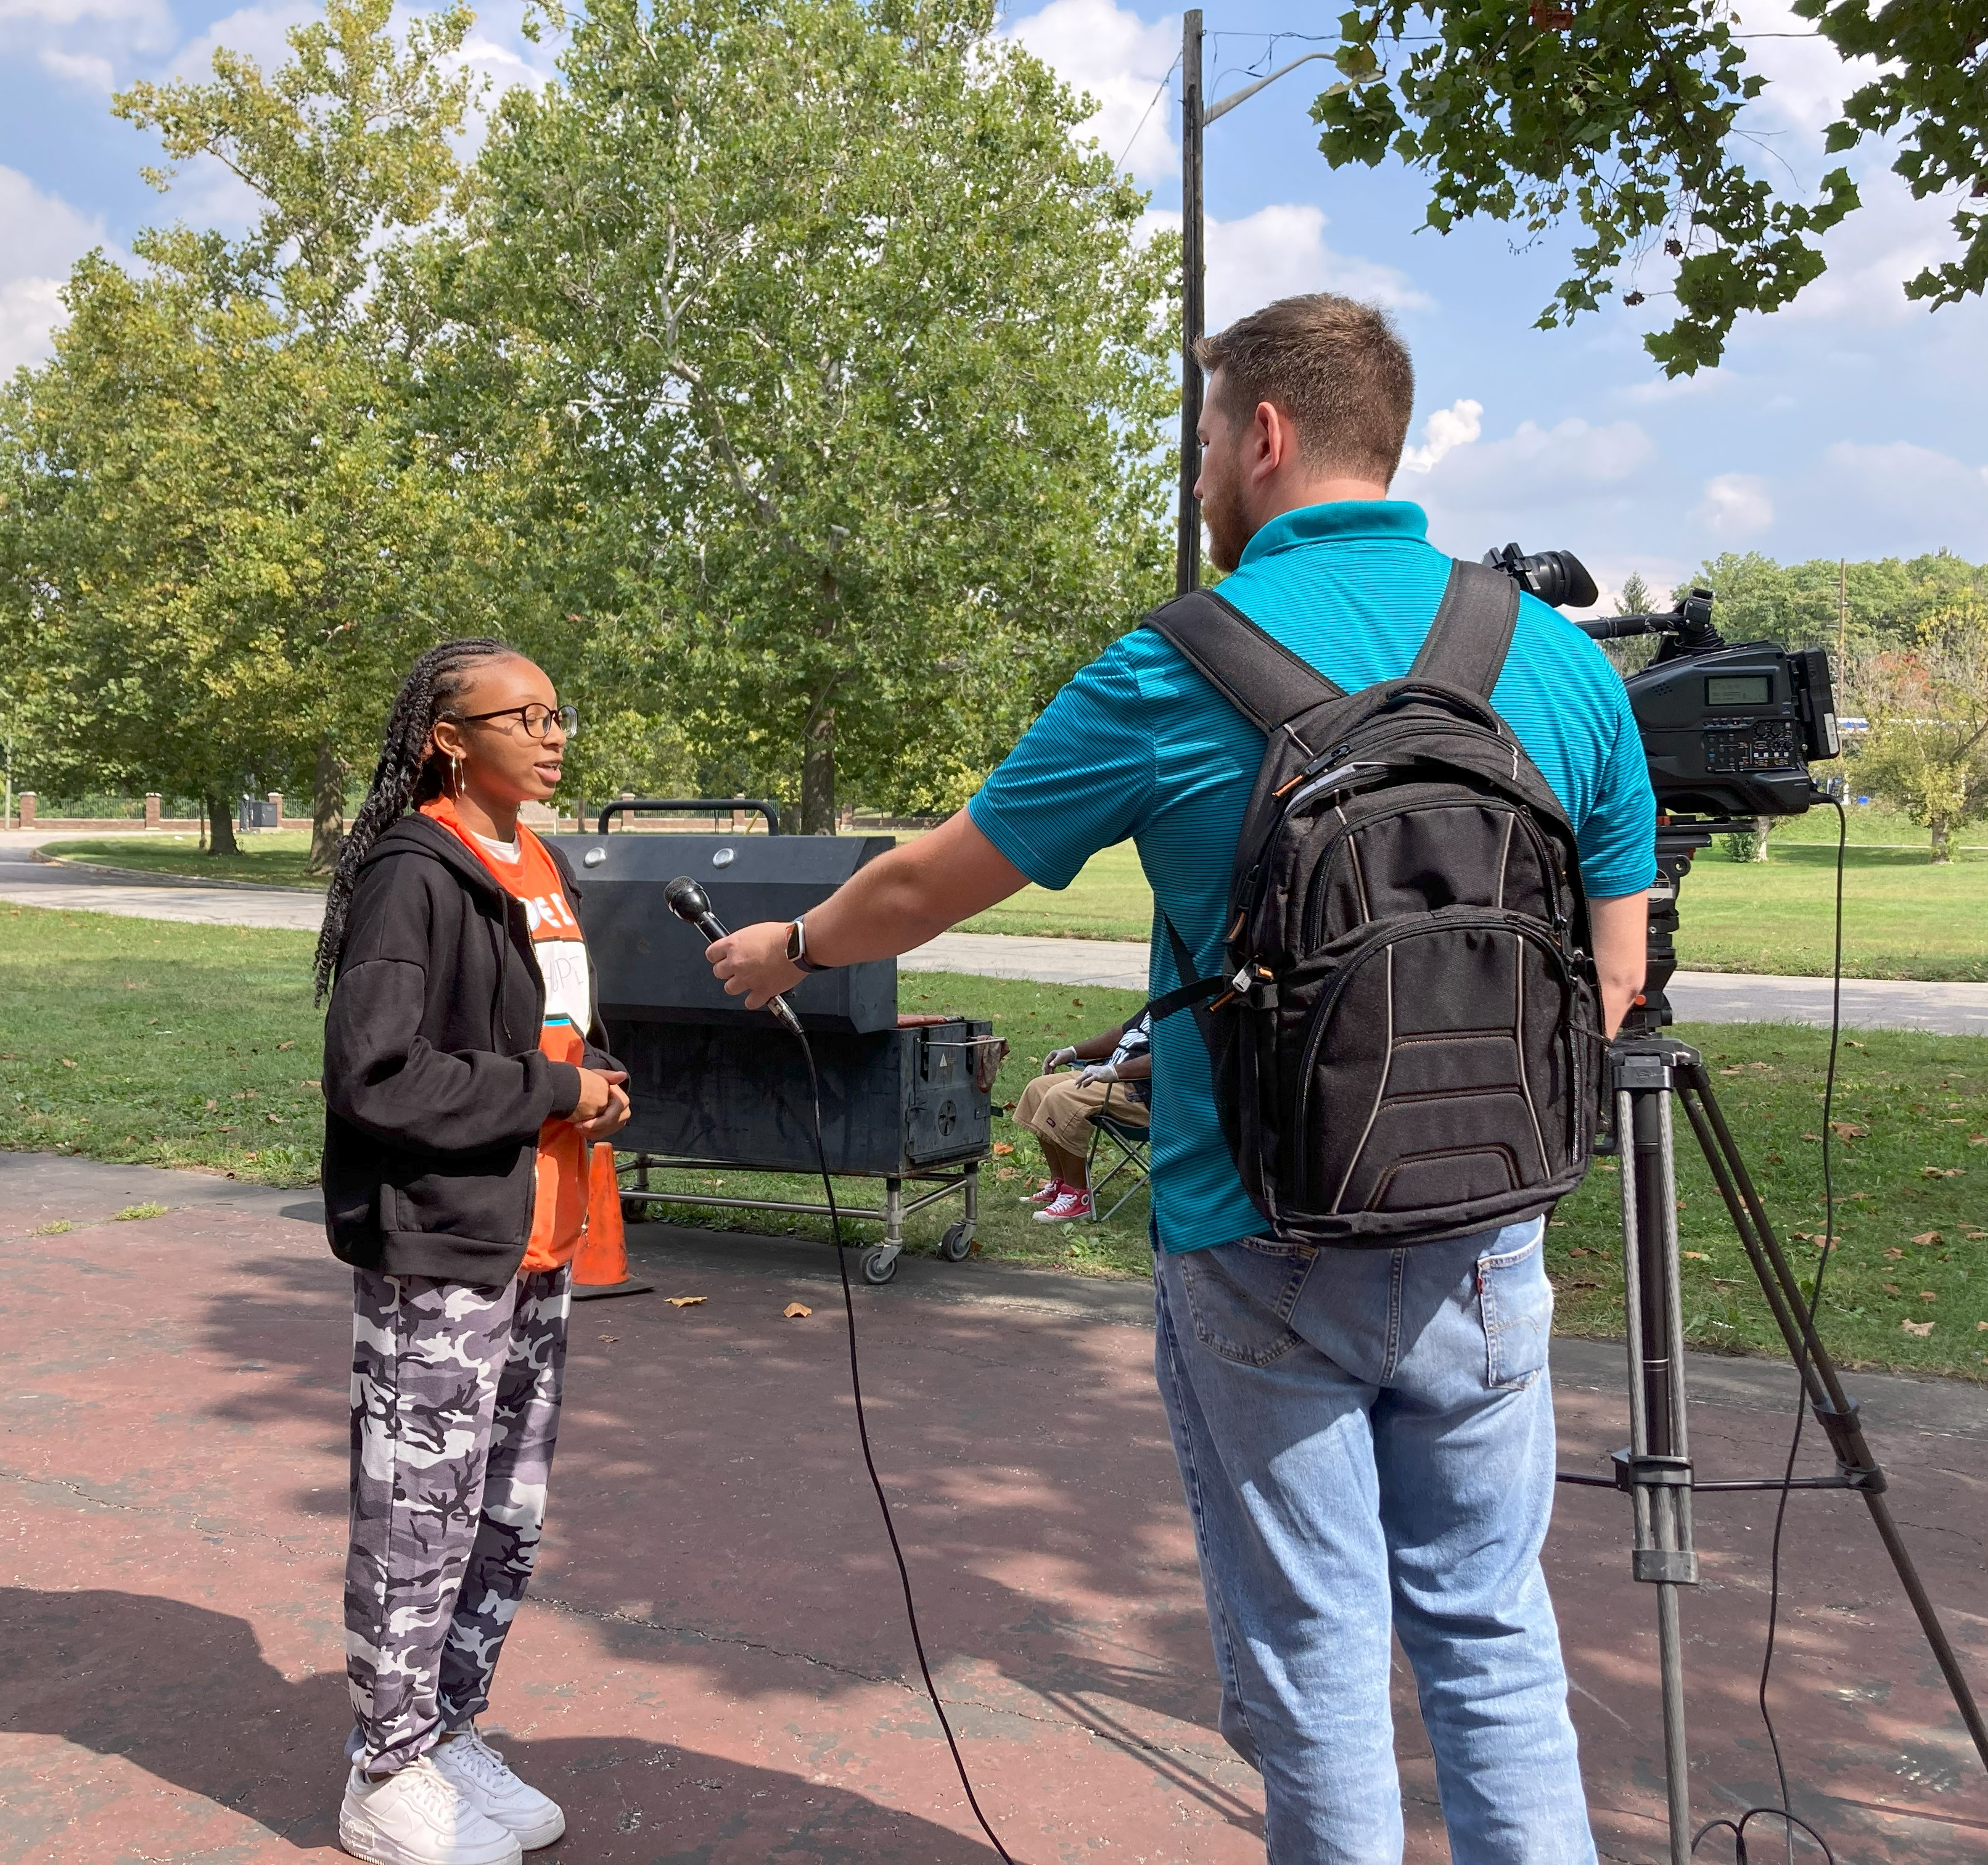
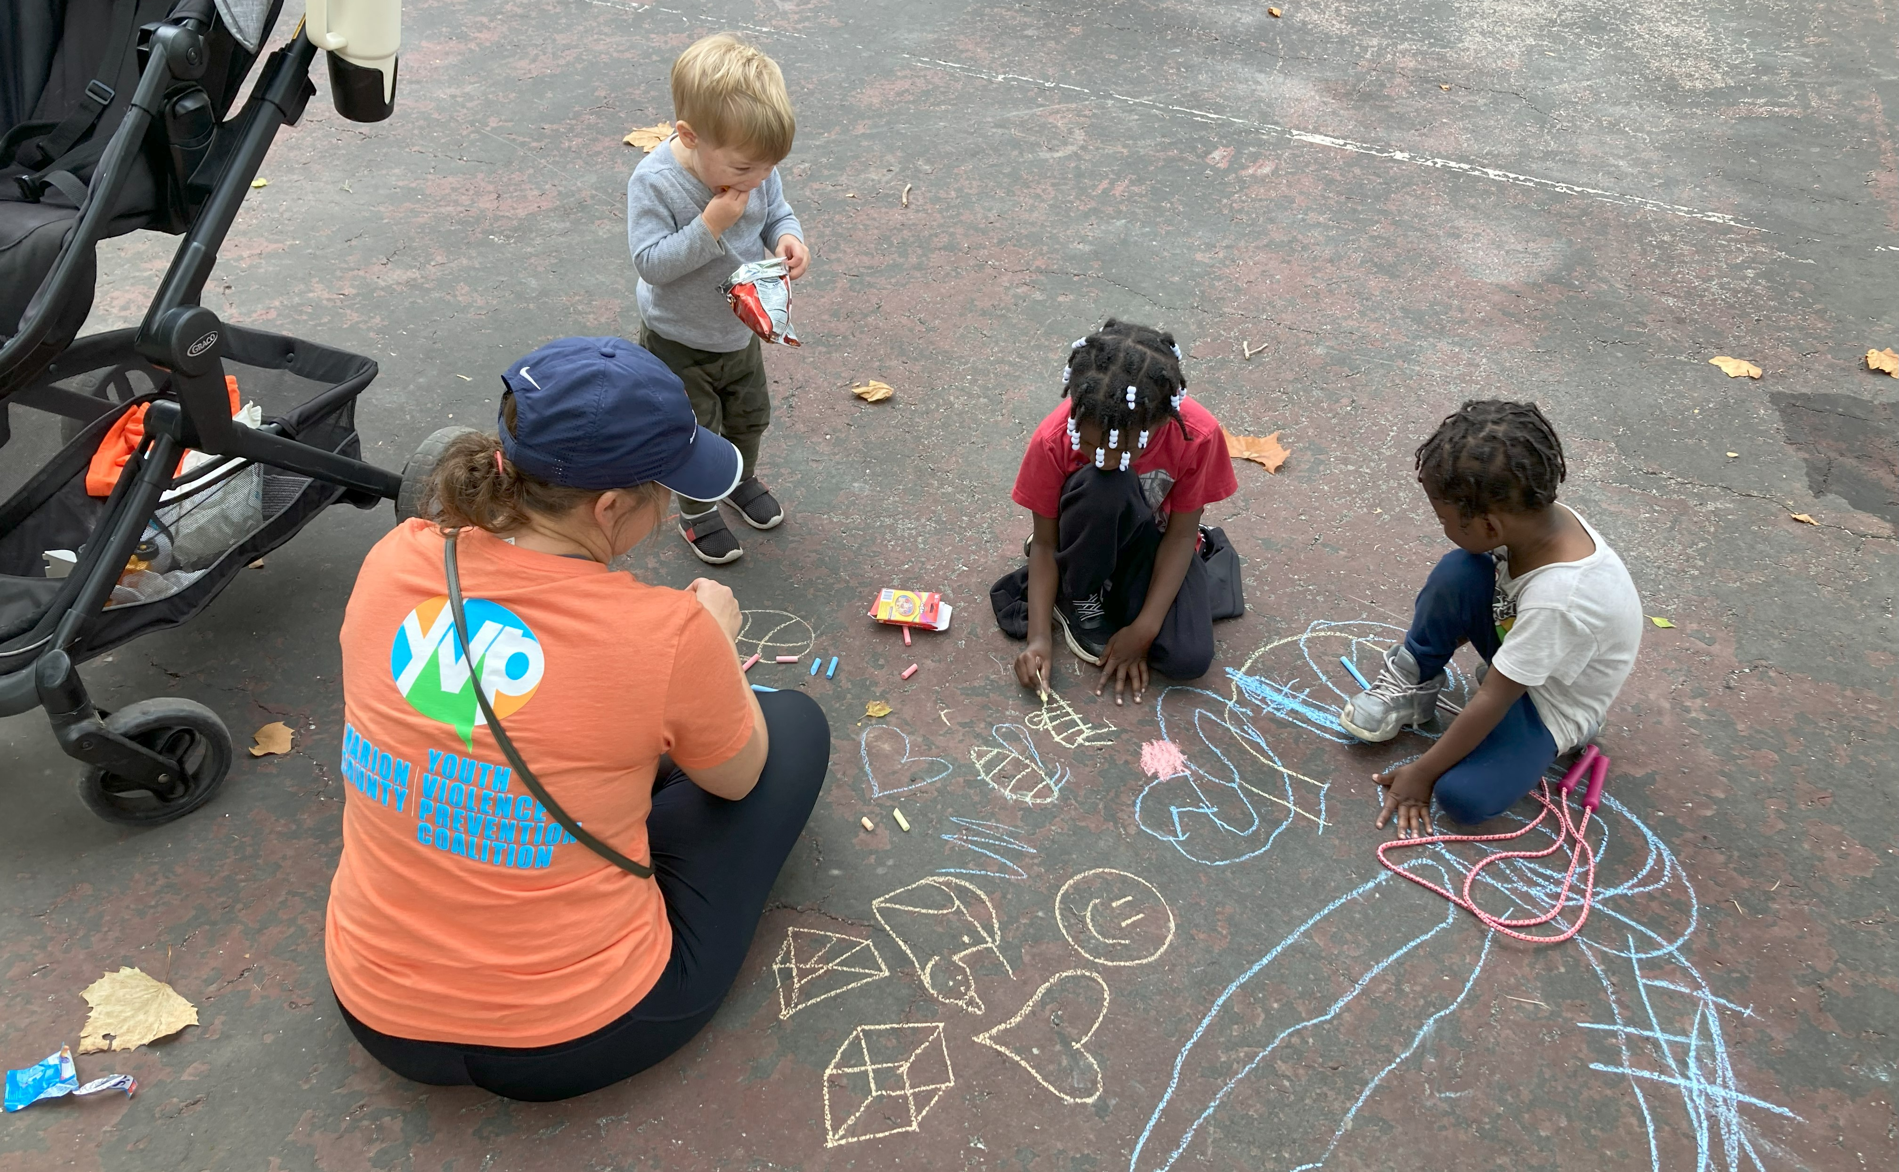
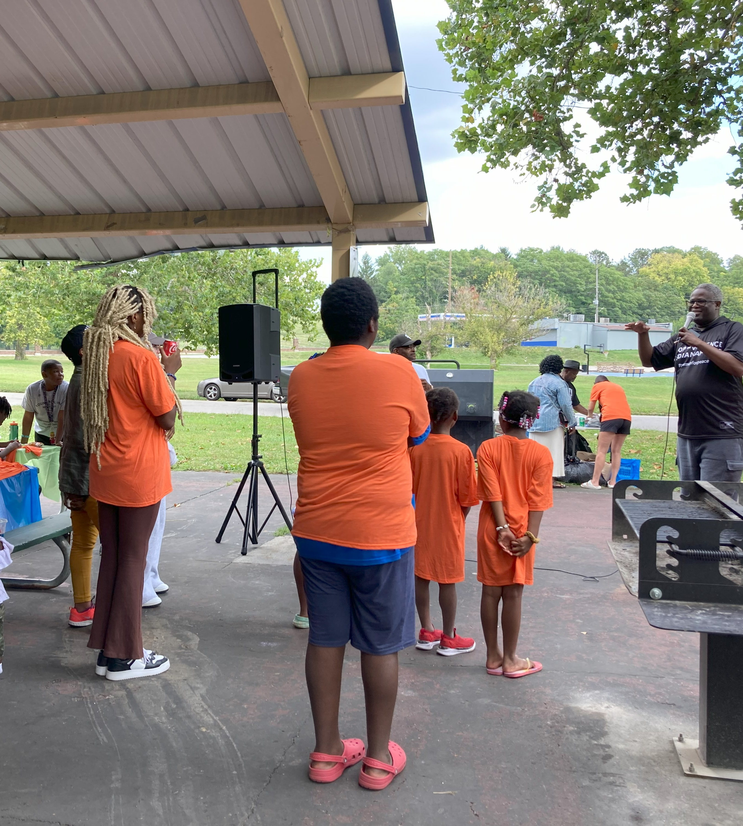
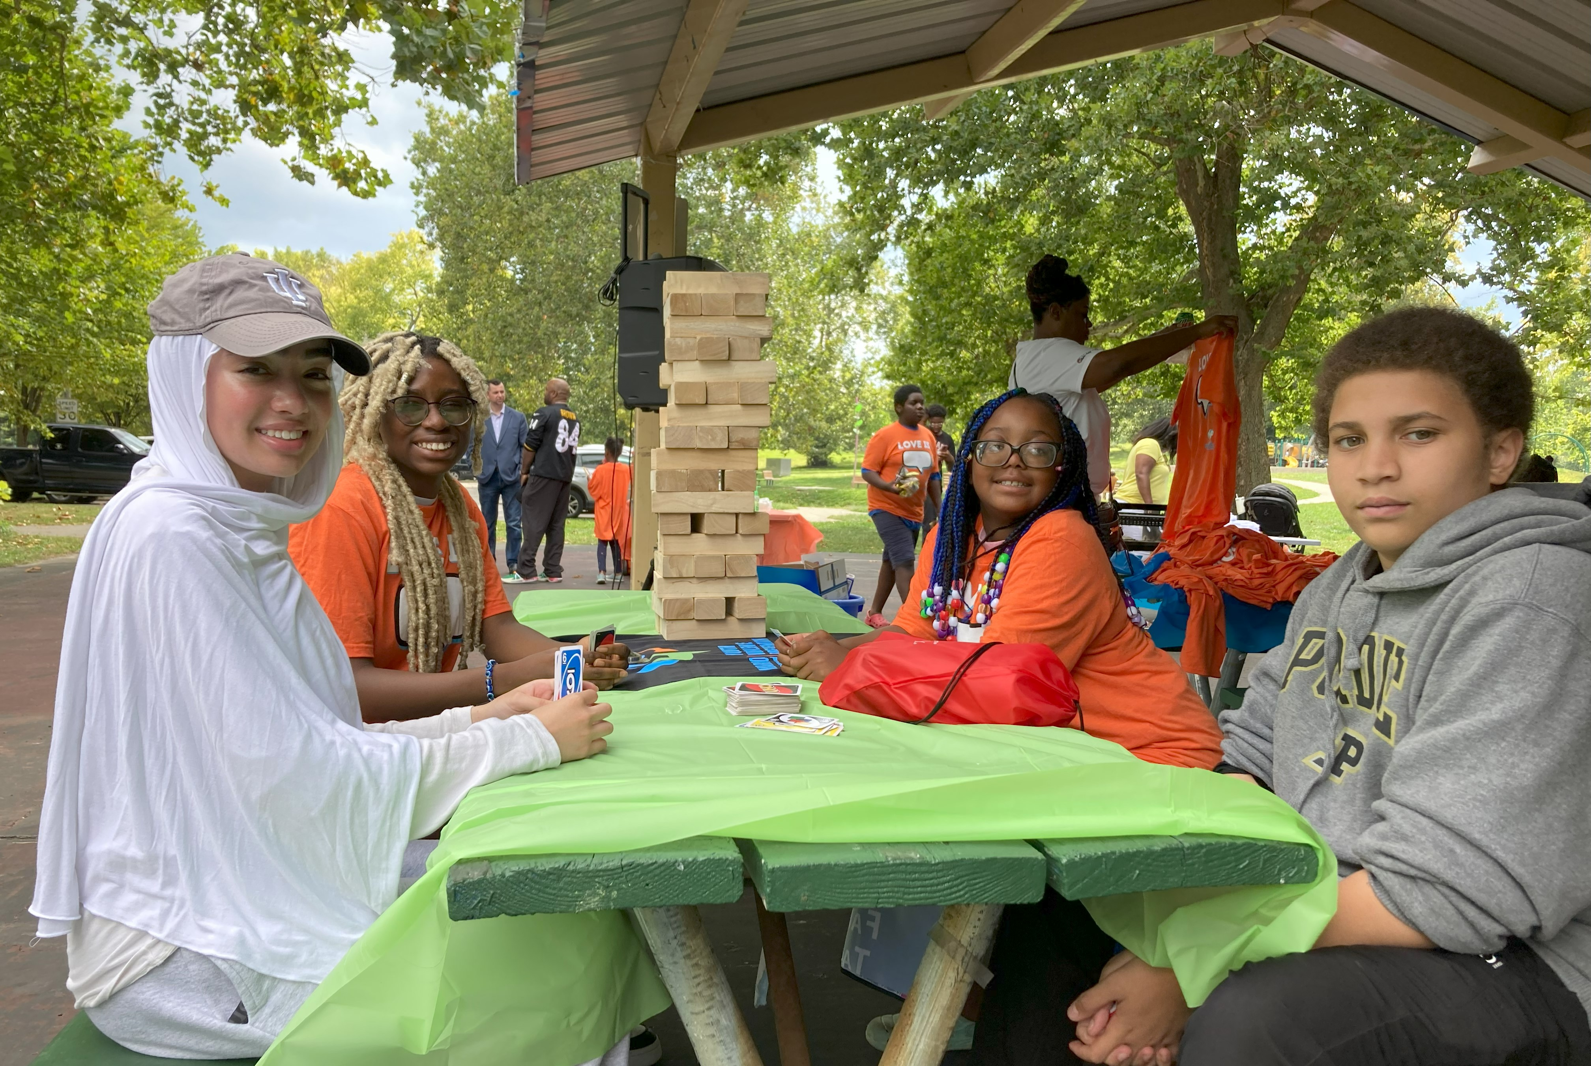
“Love Is” Campaign
Love Is ... Family Fun Day with He Cares Inc. and Stop the Violence Indianapolis, Inc.

Slide 6
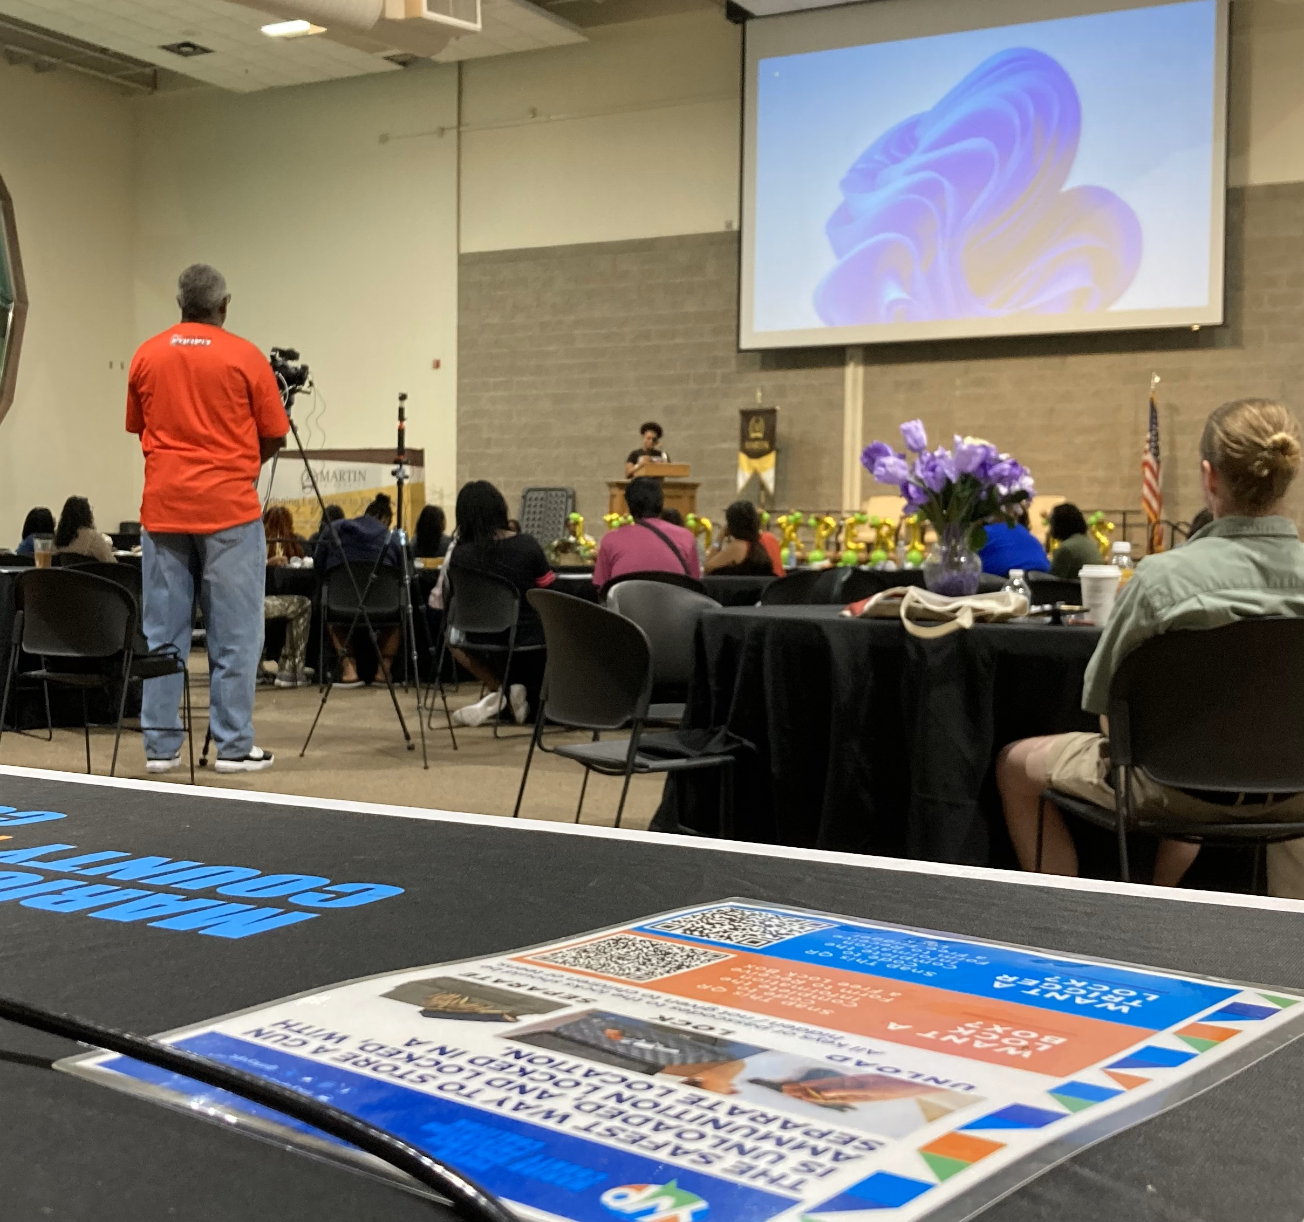
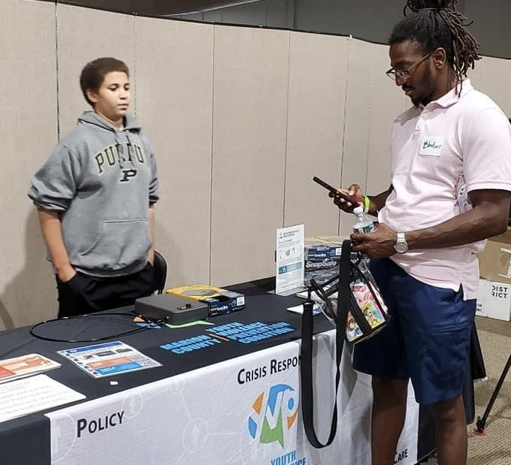
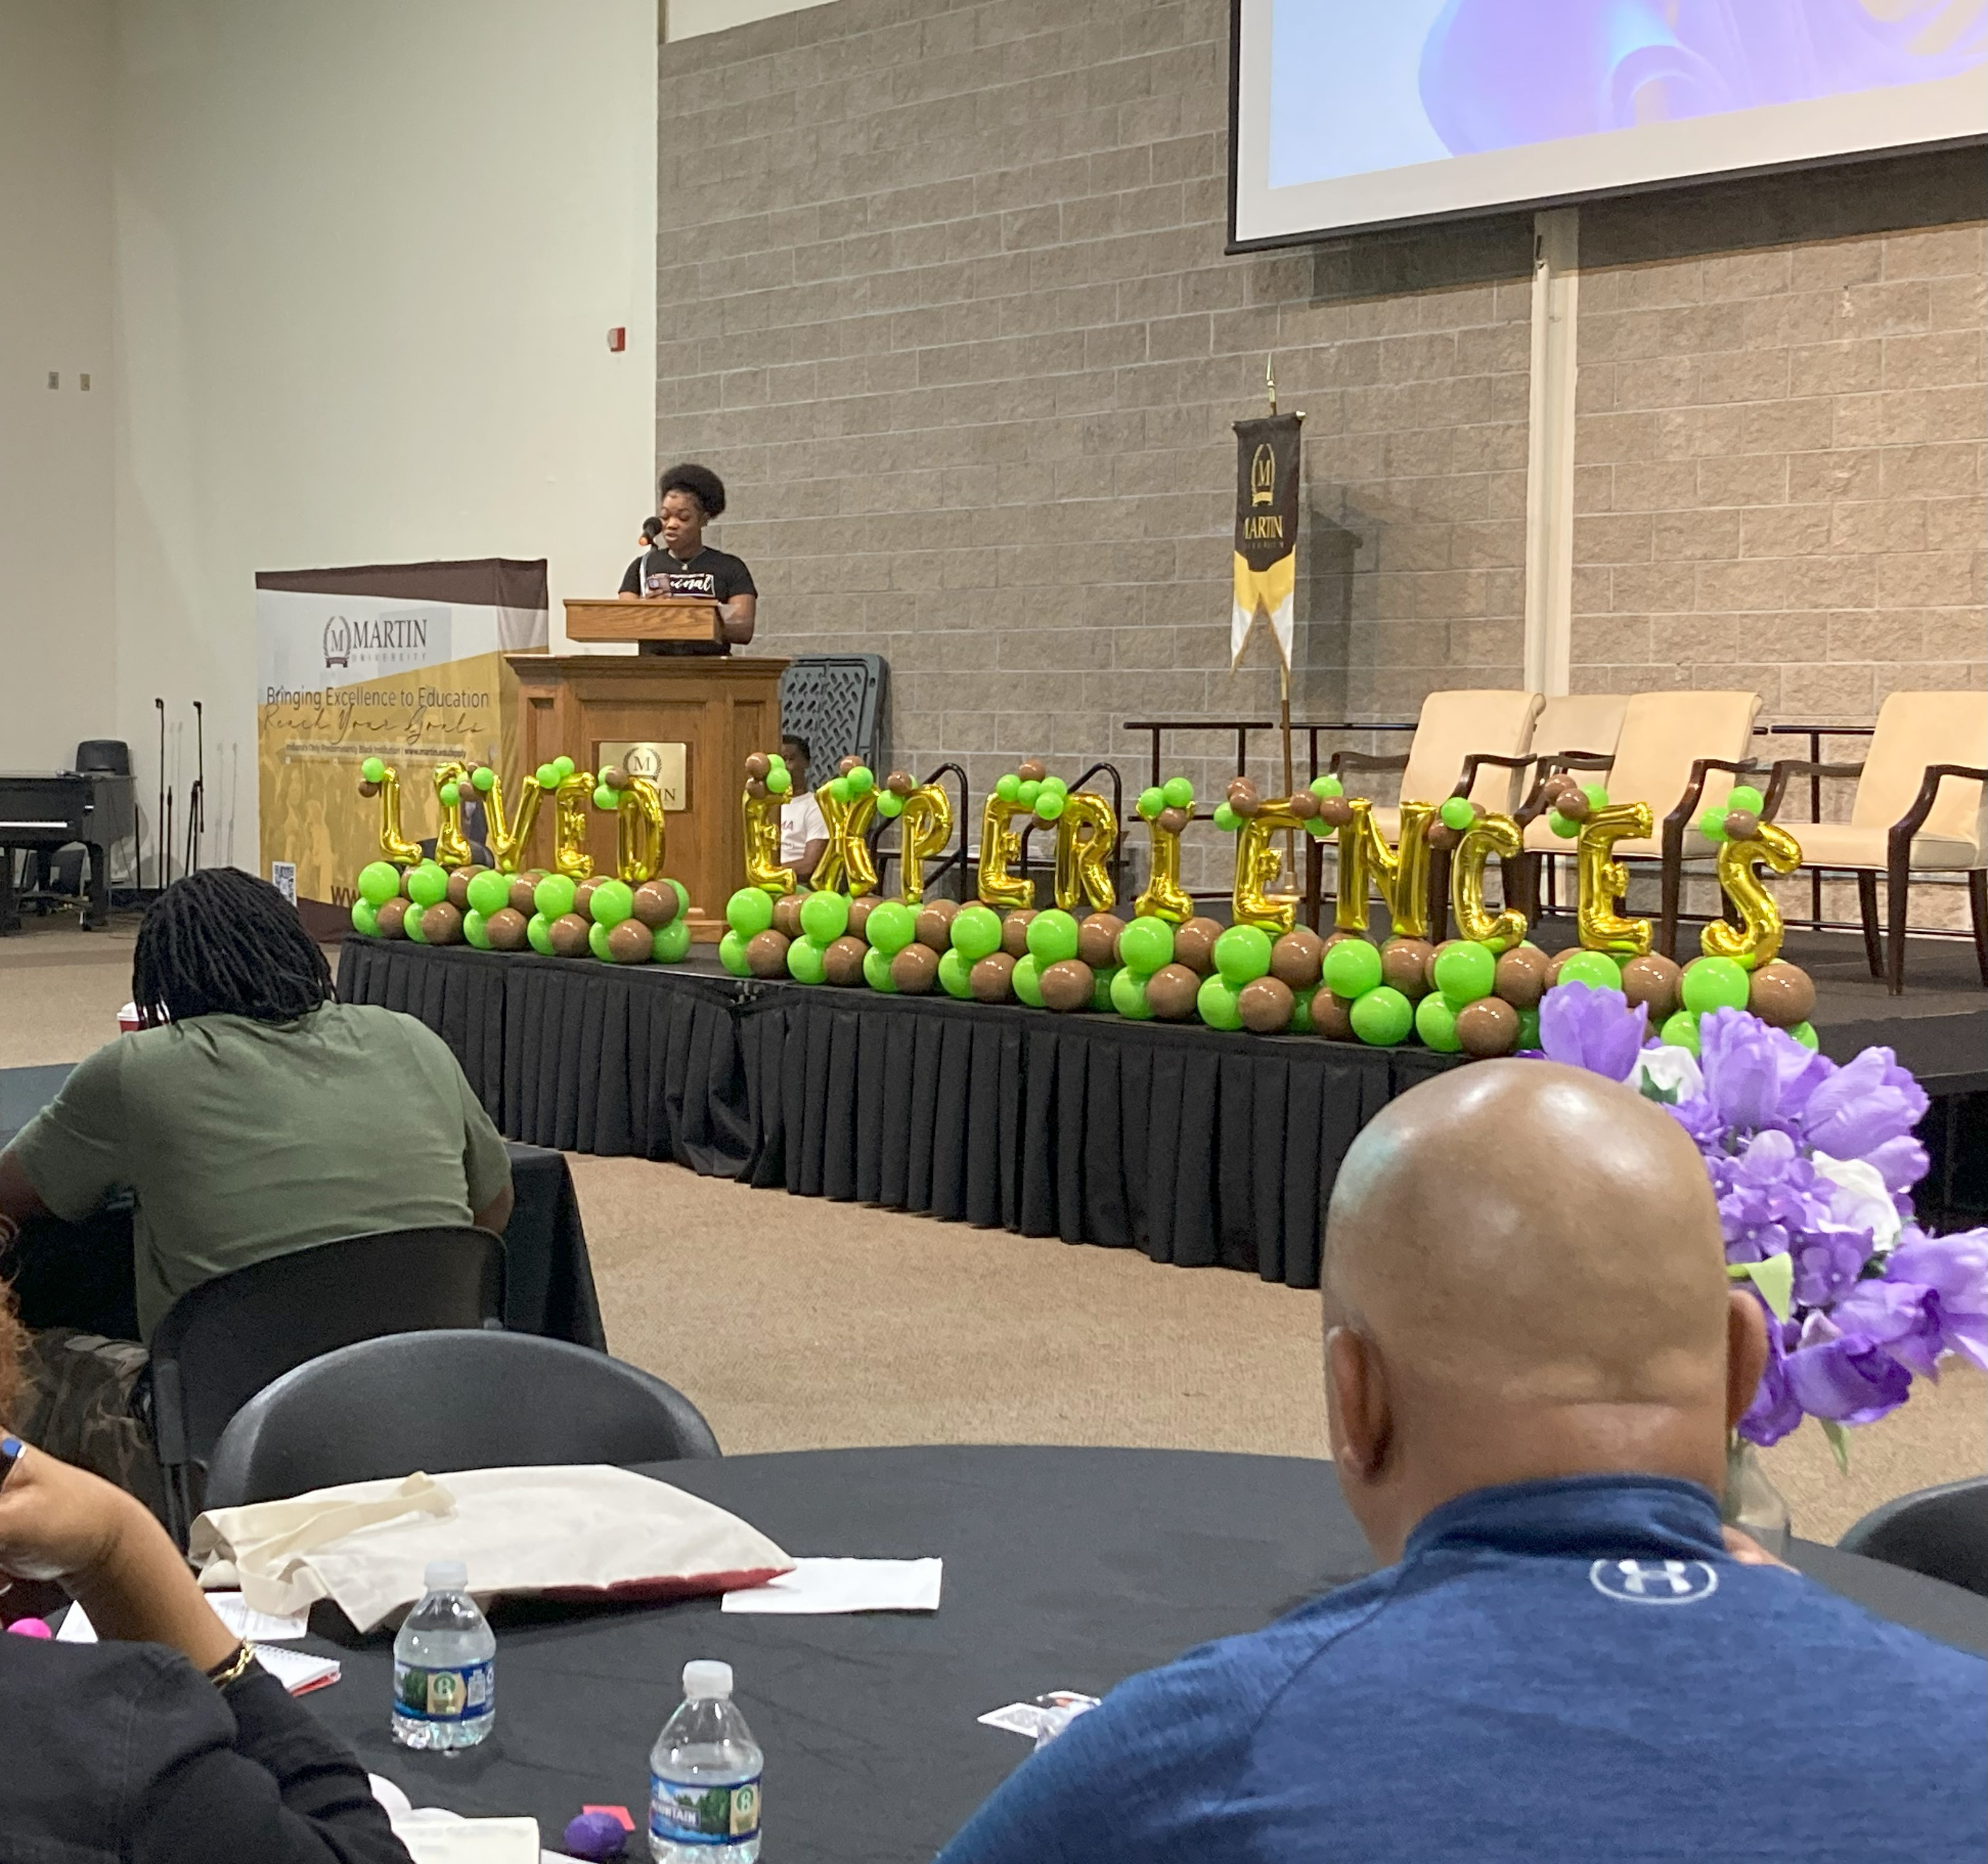
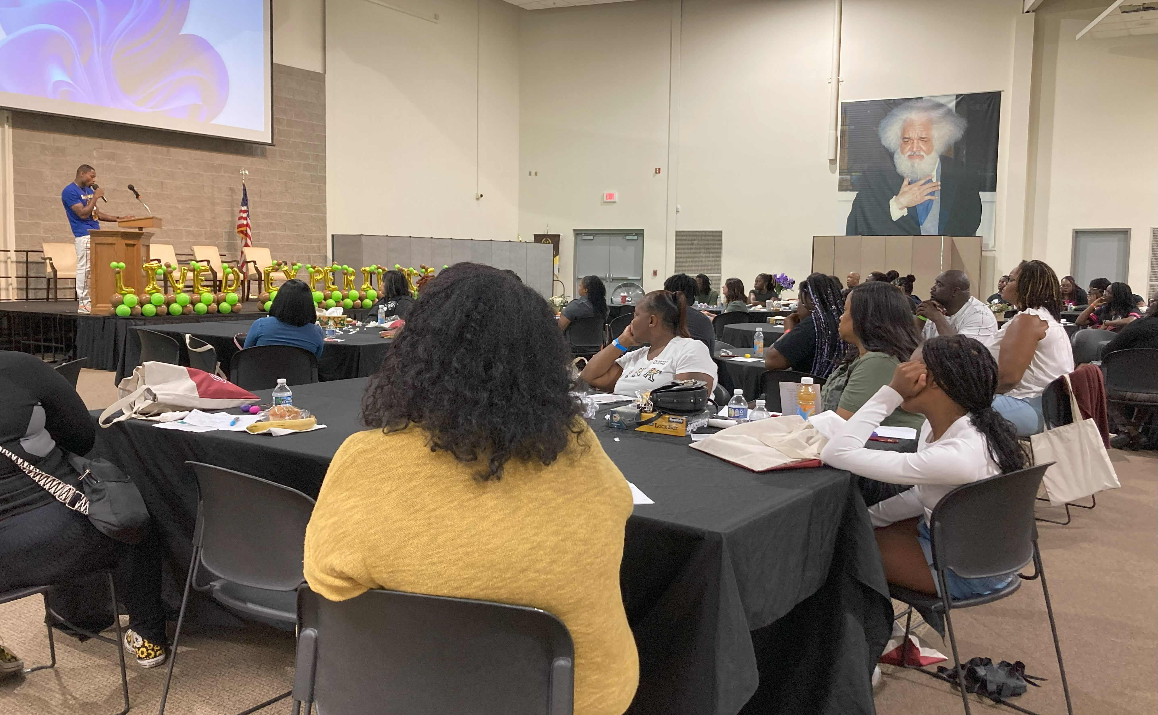
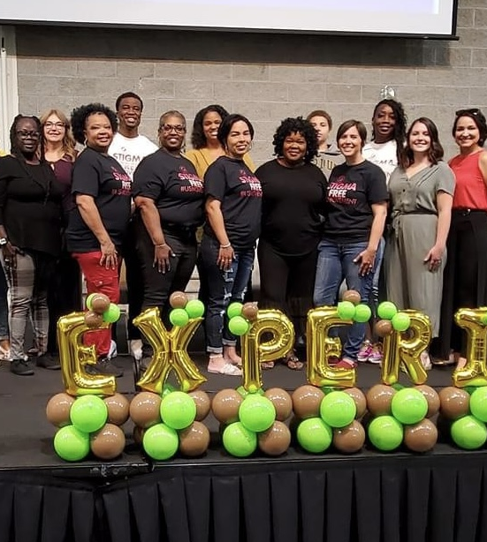
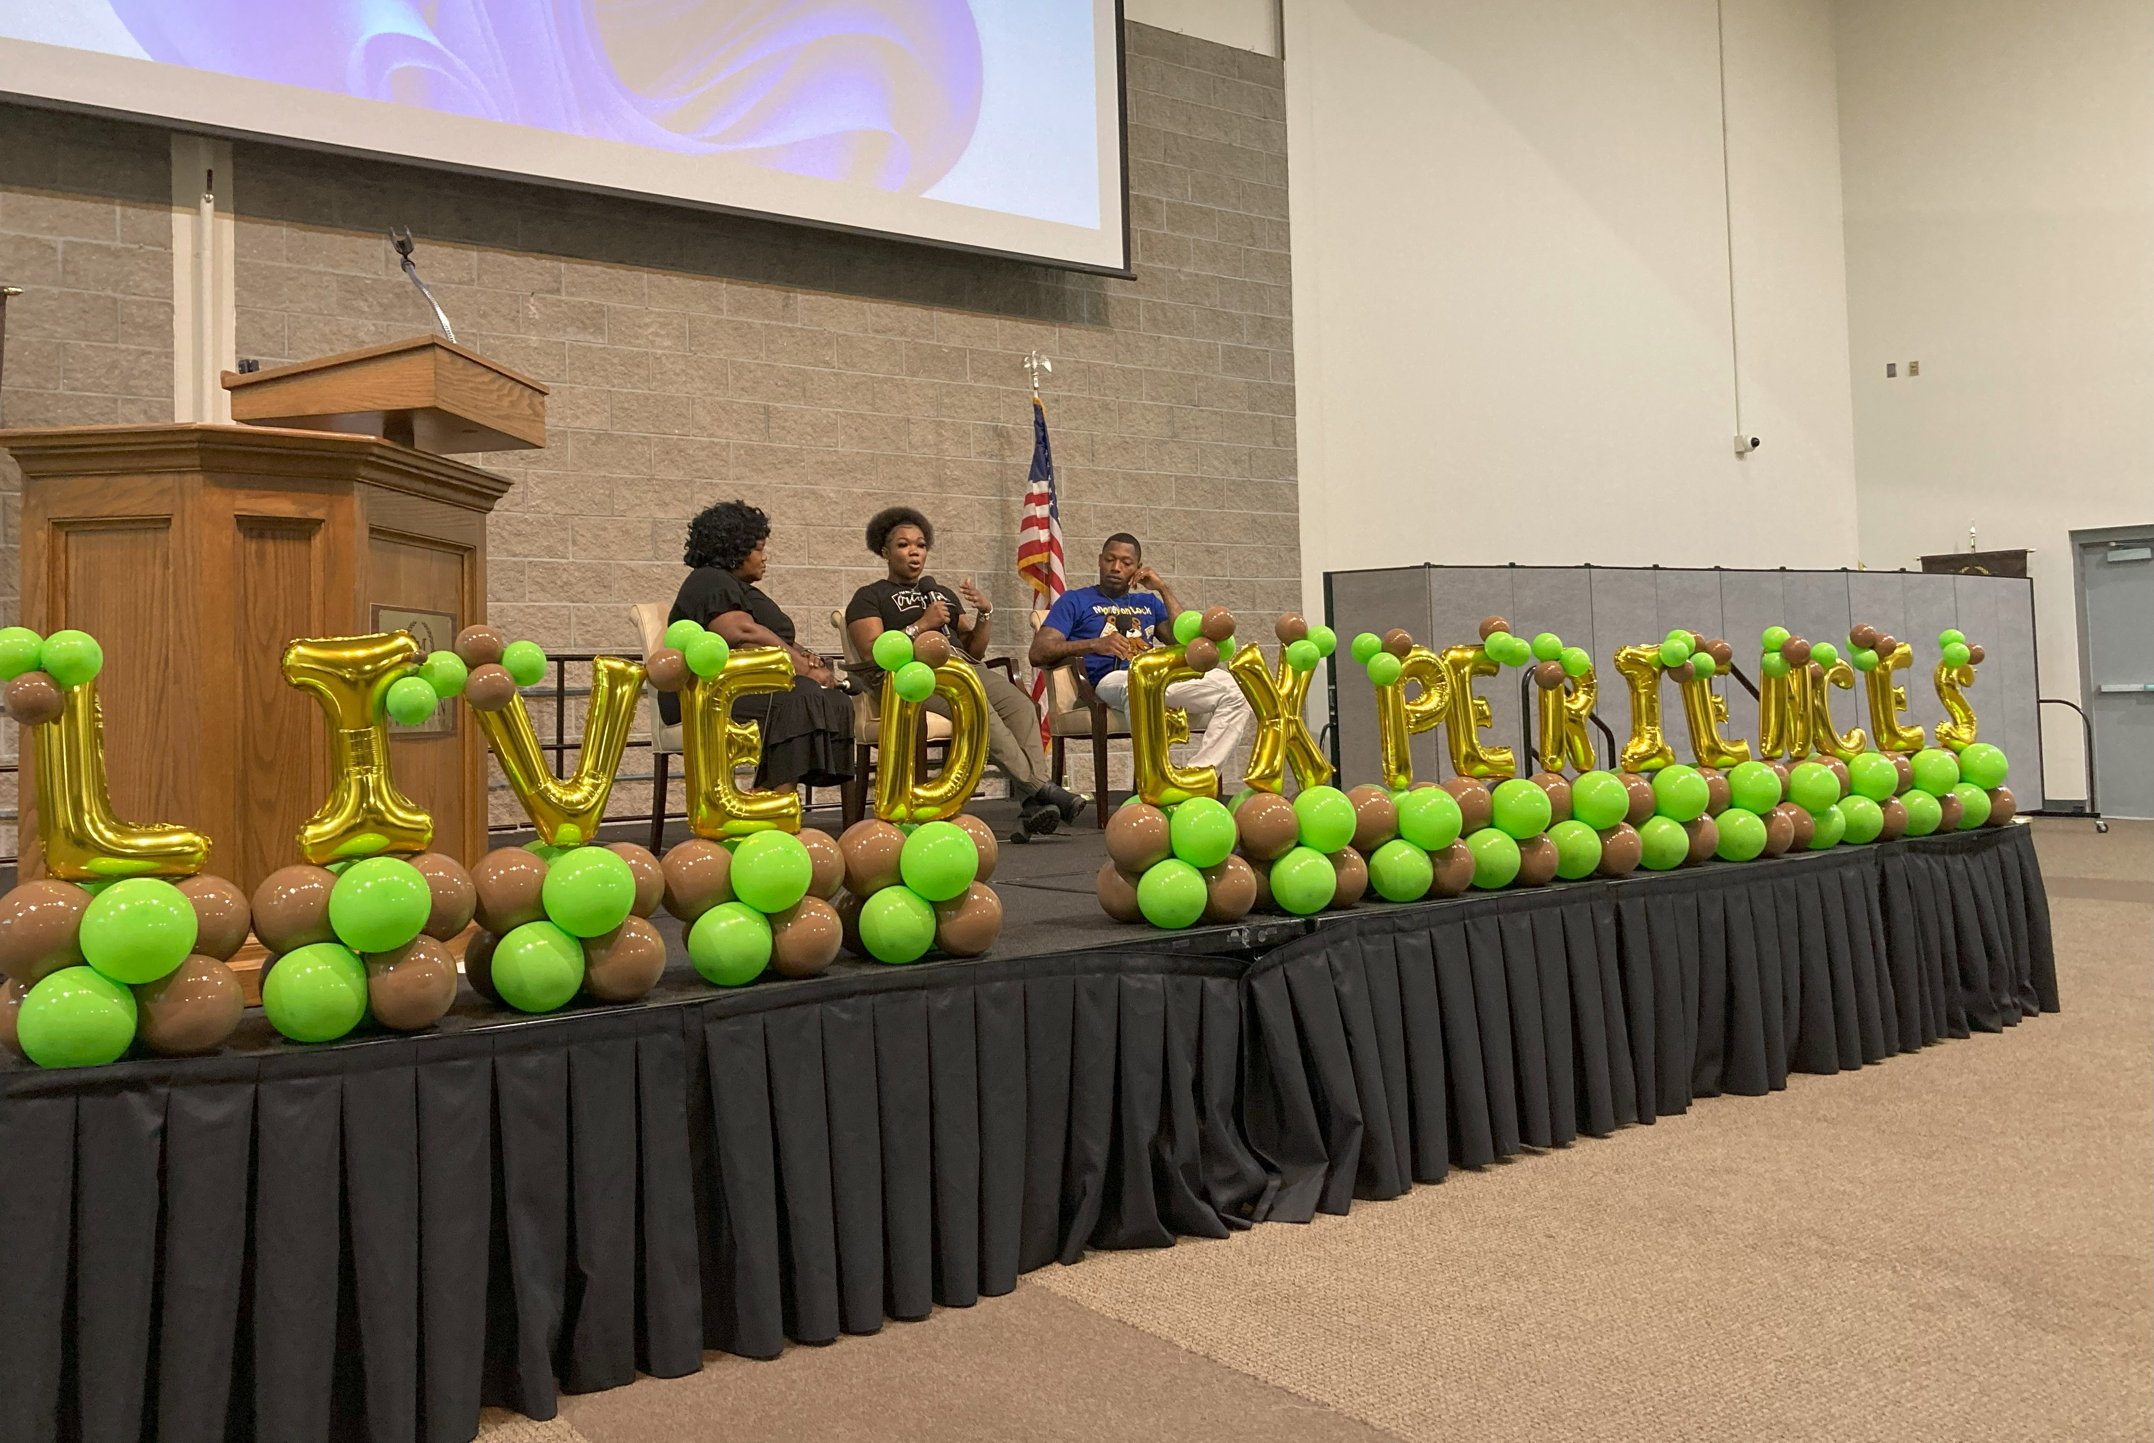
Lived Experience Trauma Informed Response Conference
The Lived Experience Trauma-Informed Response Conference was an empowering and insightful event that shed light on trauma and its impact on youth and parents/caregivers.

Slide 7
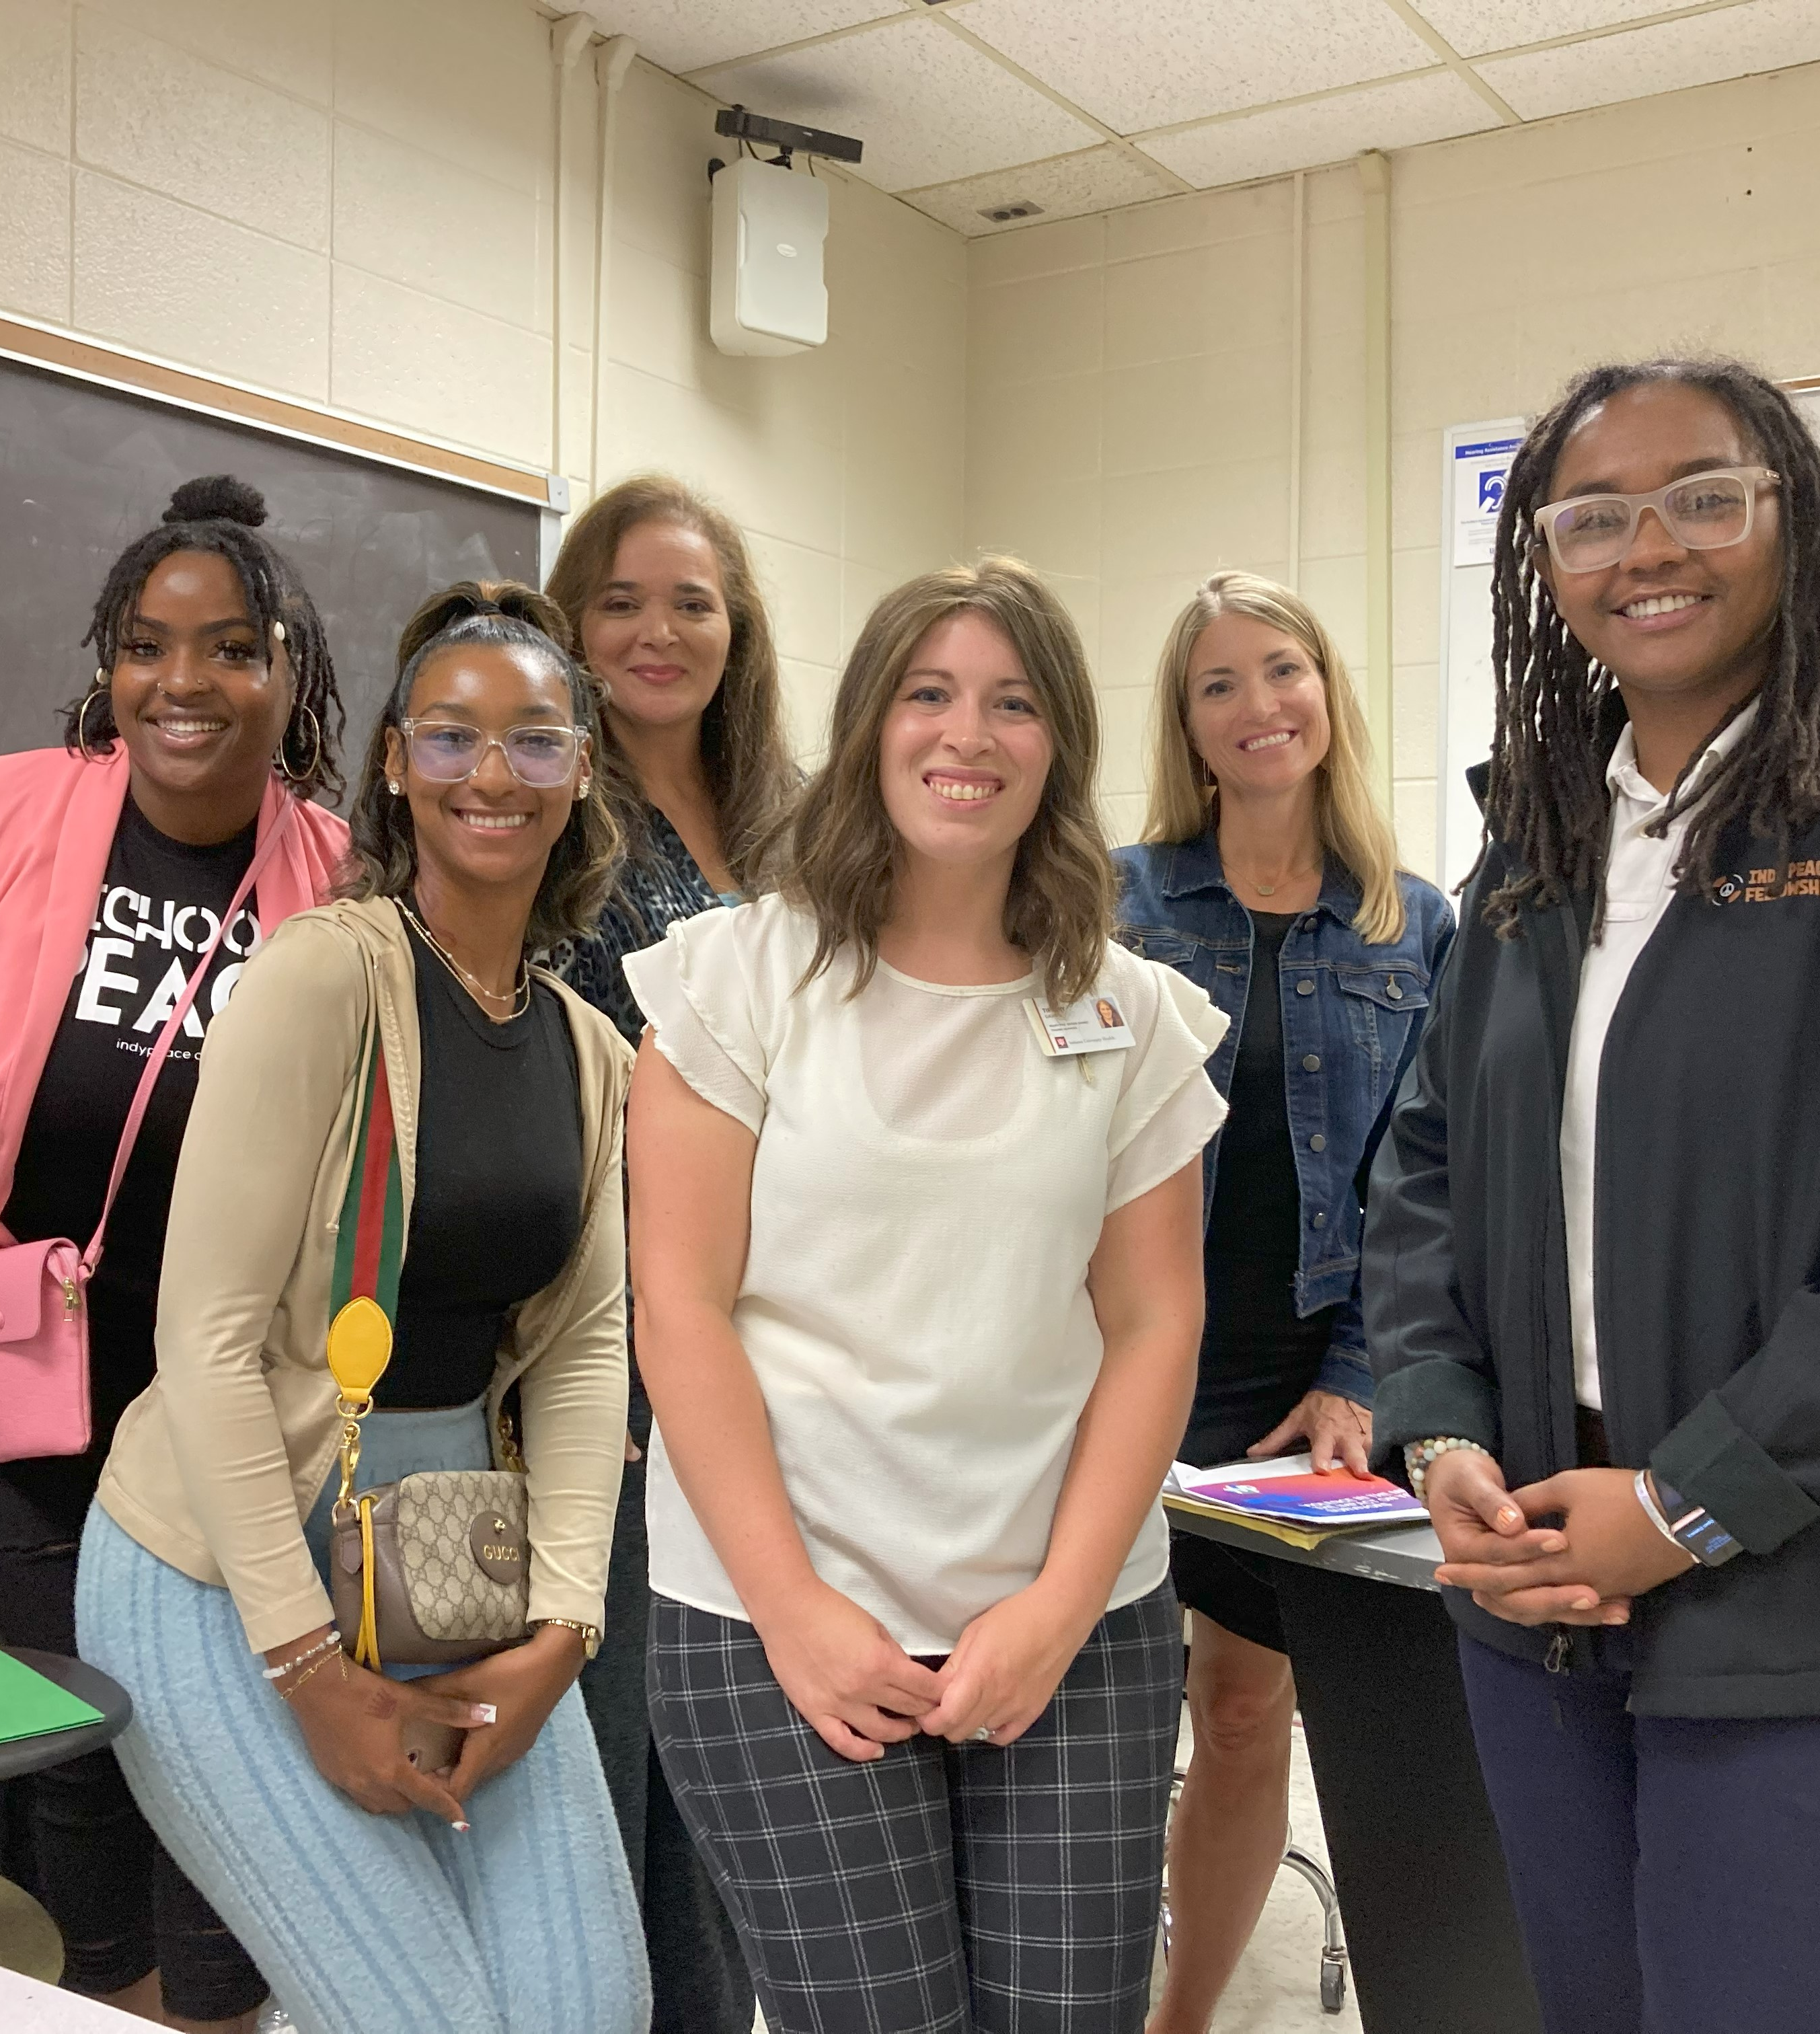
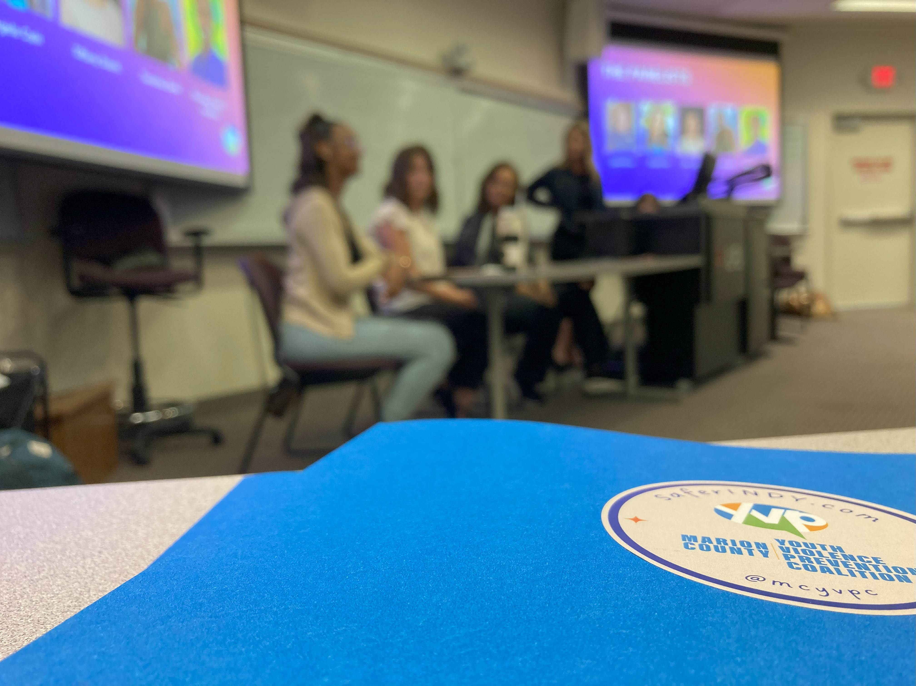
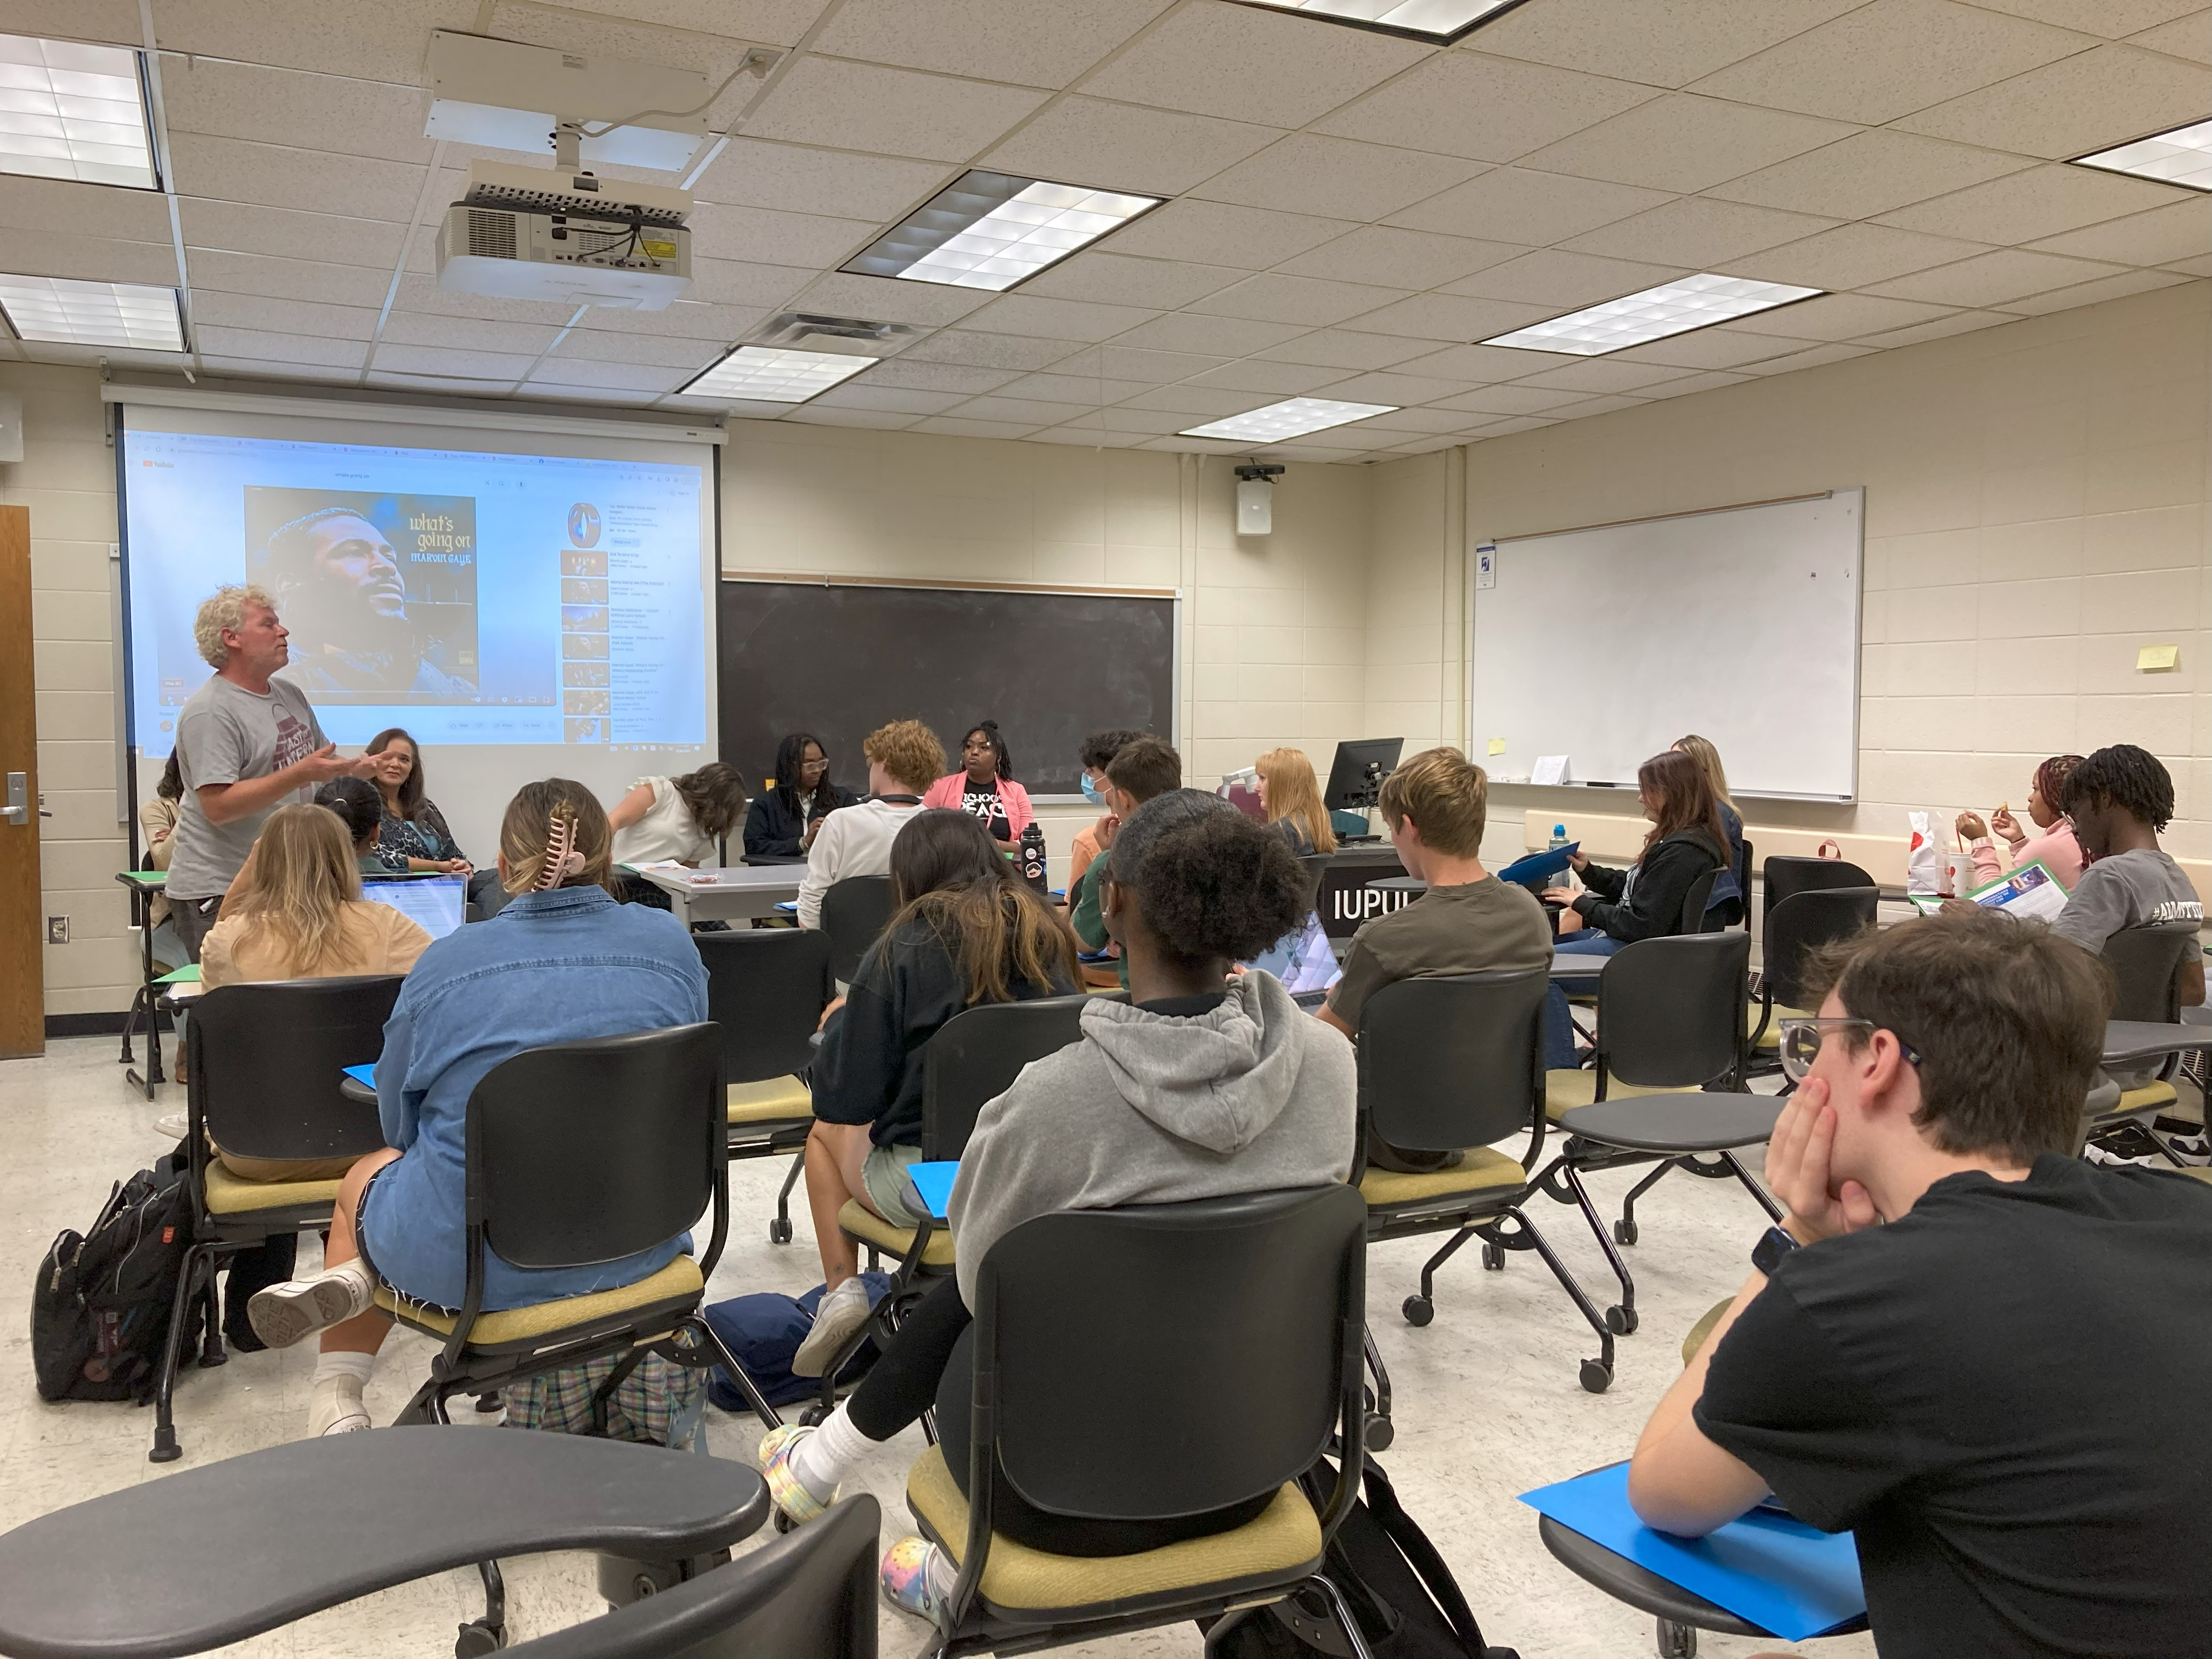
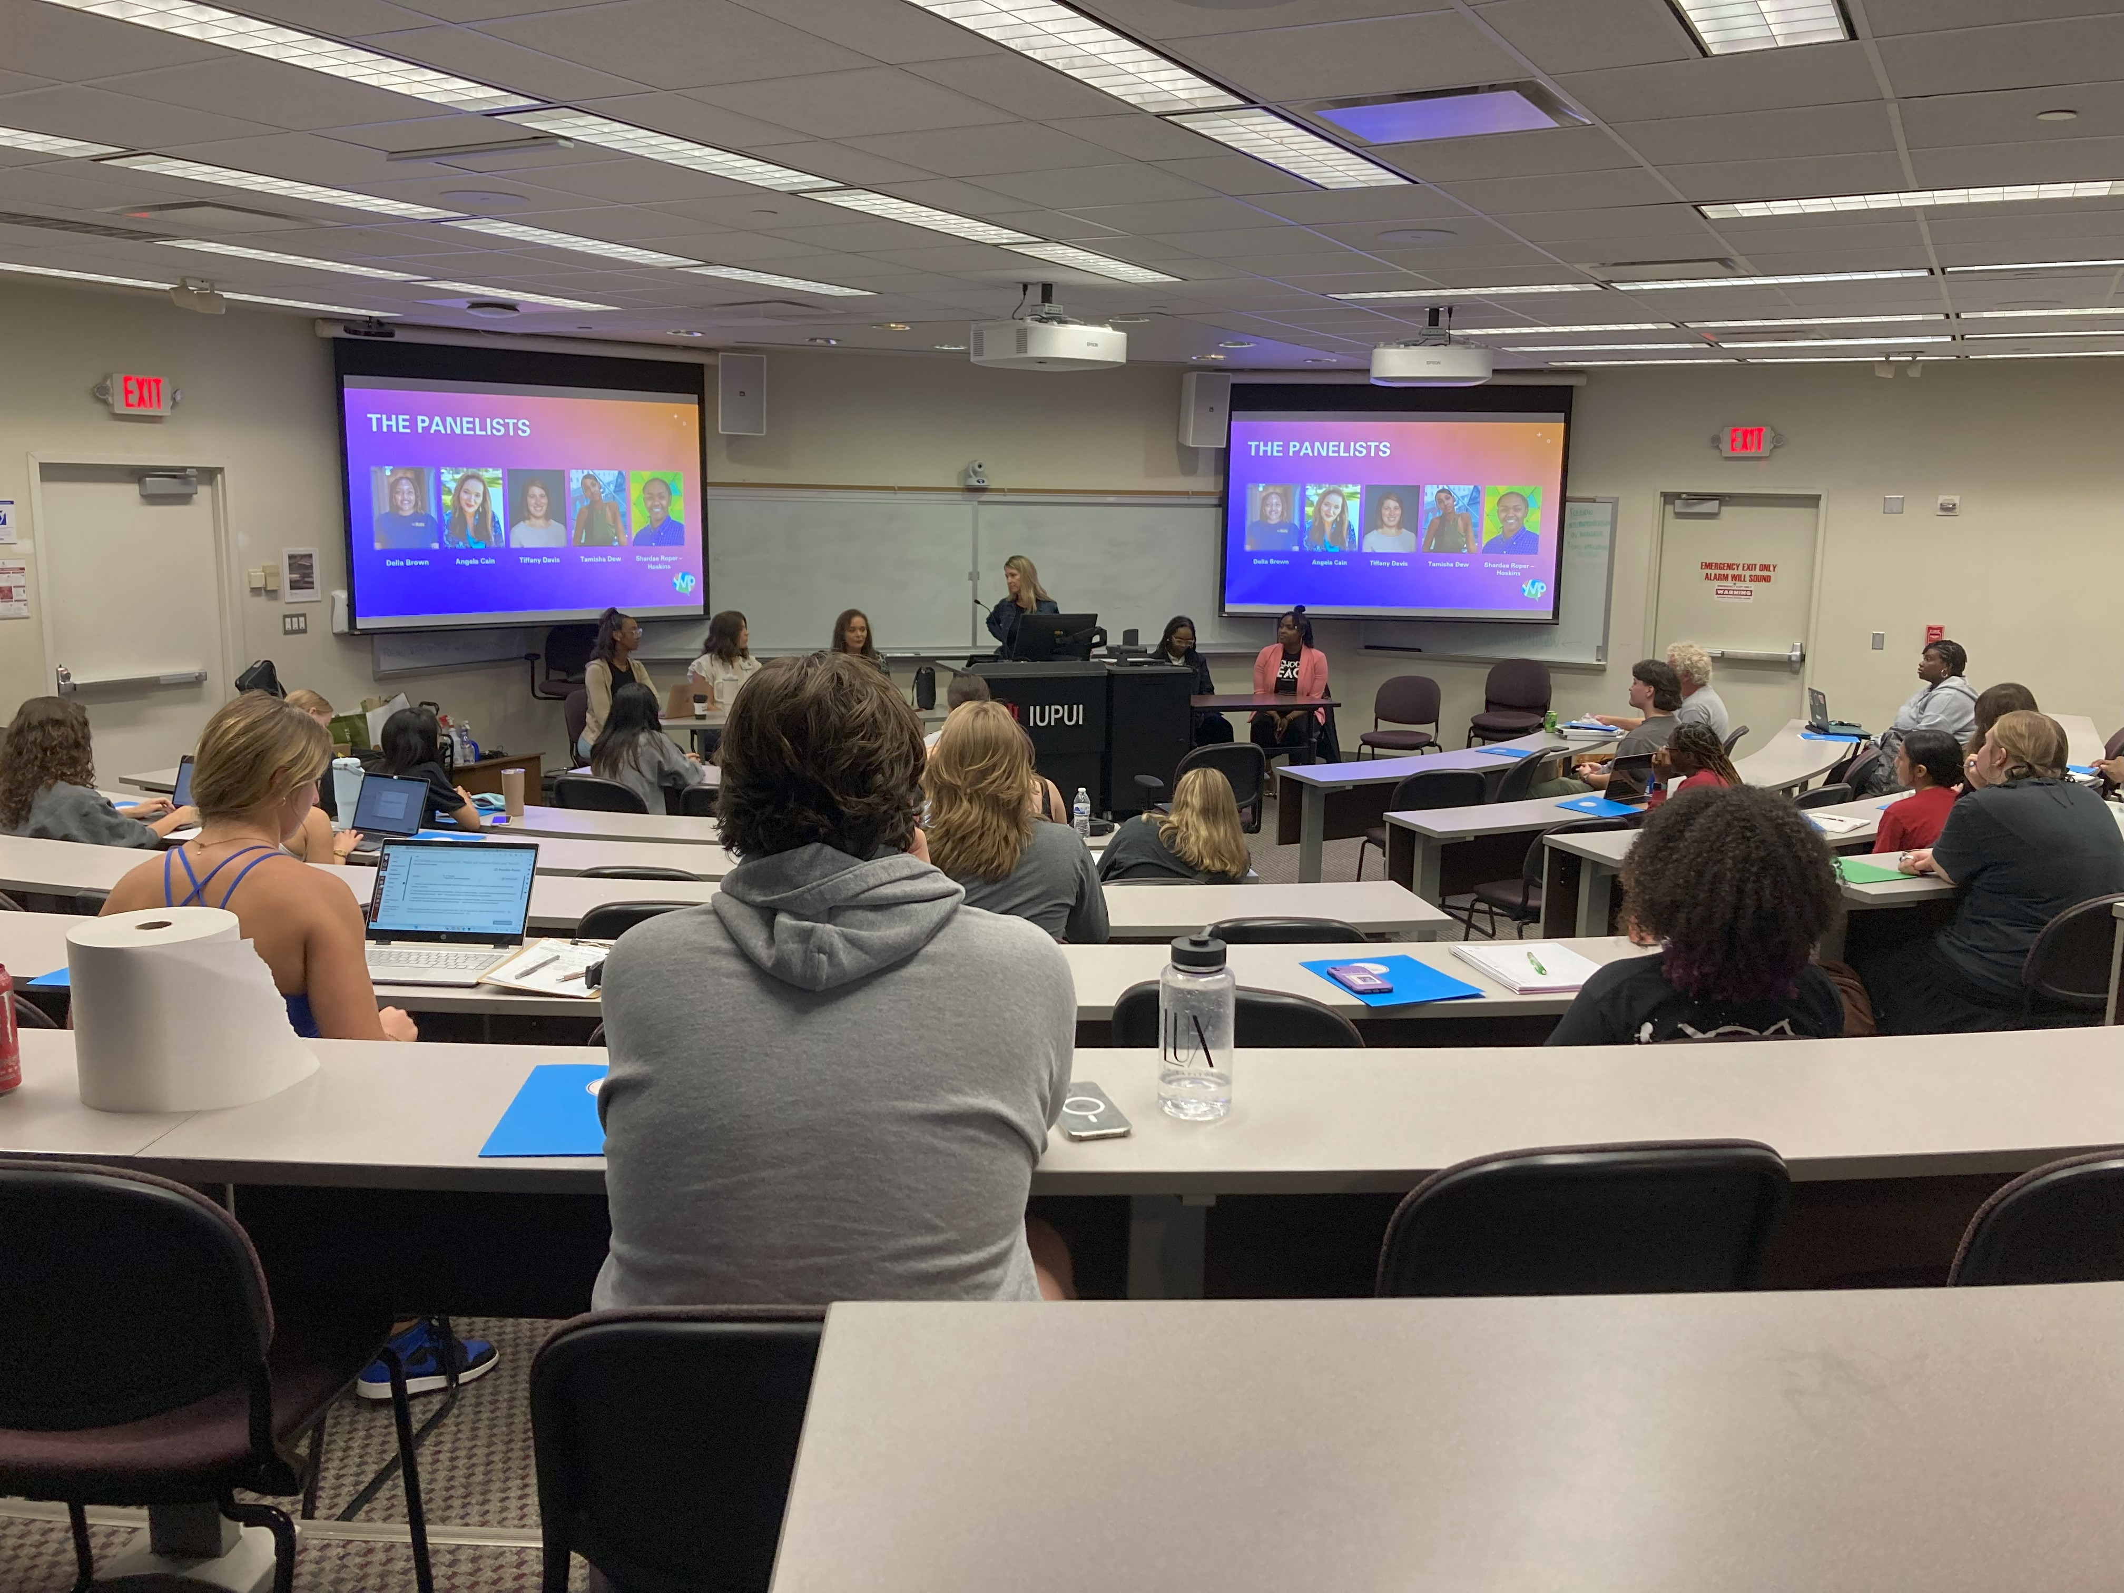
Educational Seminar
Media organizations can play a critical role in gun violence prevention.
Carey Haley led a media and community violence panel discussion with Tiffany Davis, Della Brown, Angela Cain, Tamisha Dew, and Shardae Hoskins at IUPUI.

Slide 8
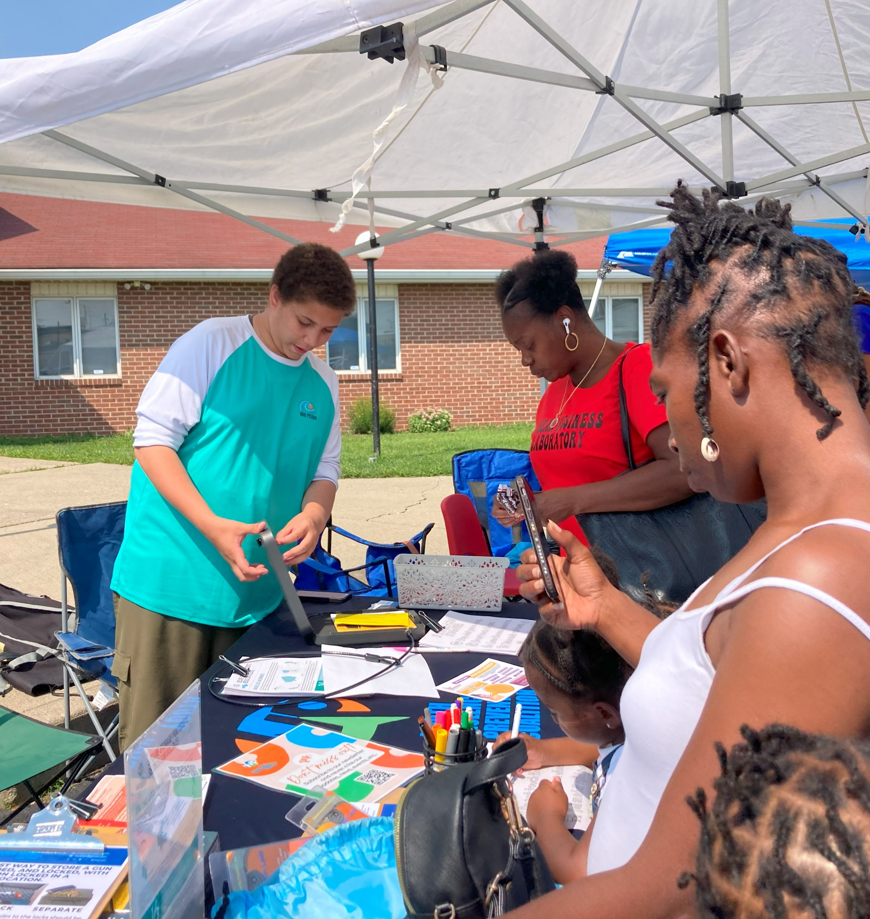
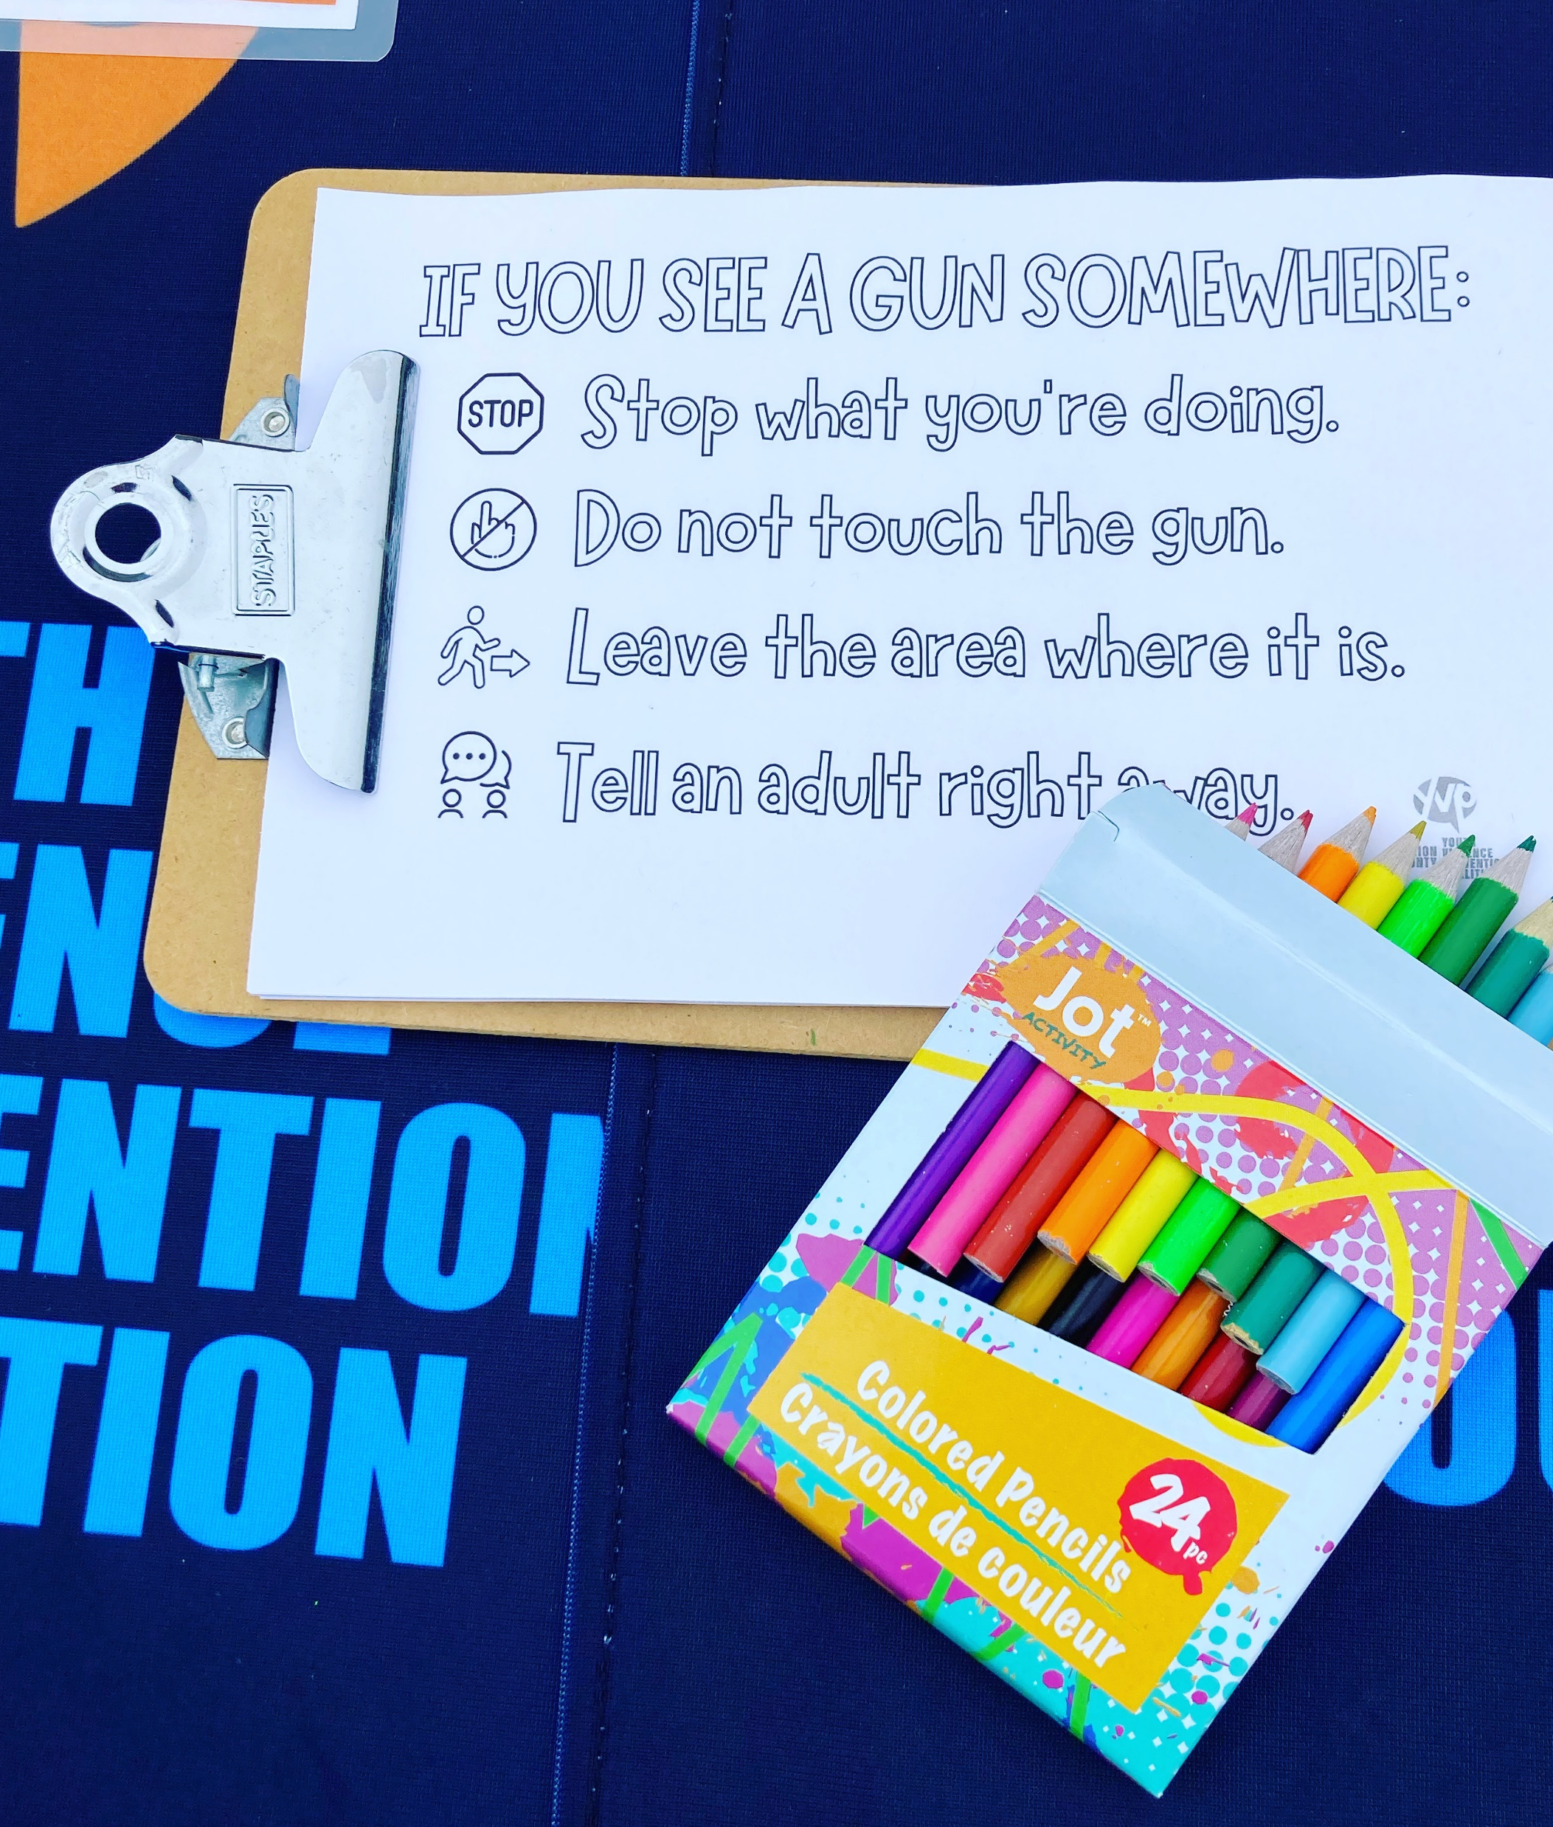
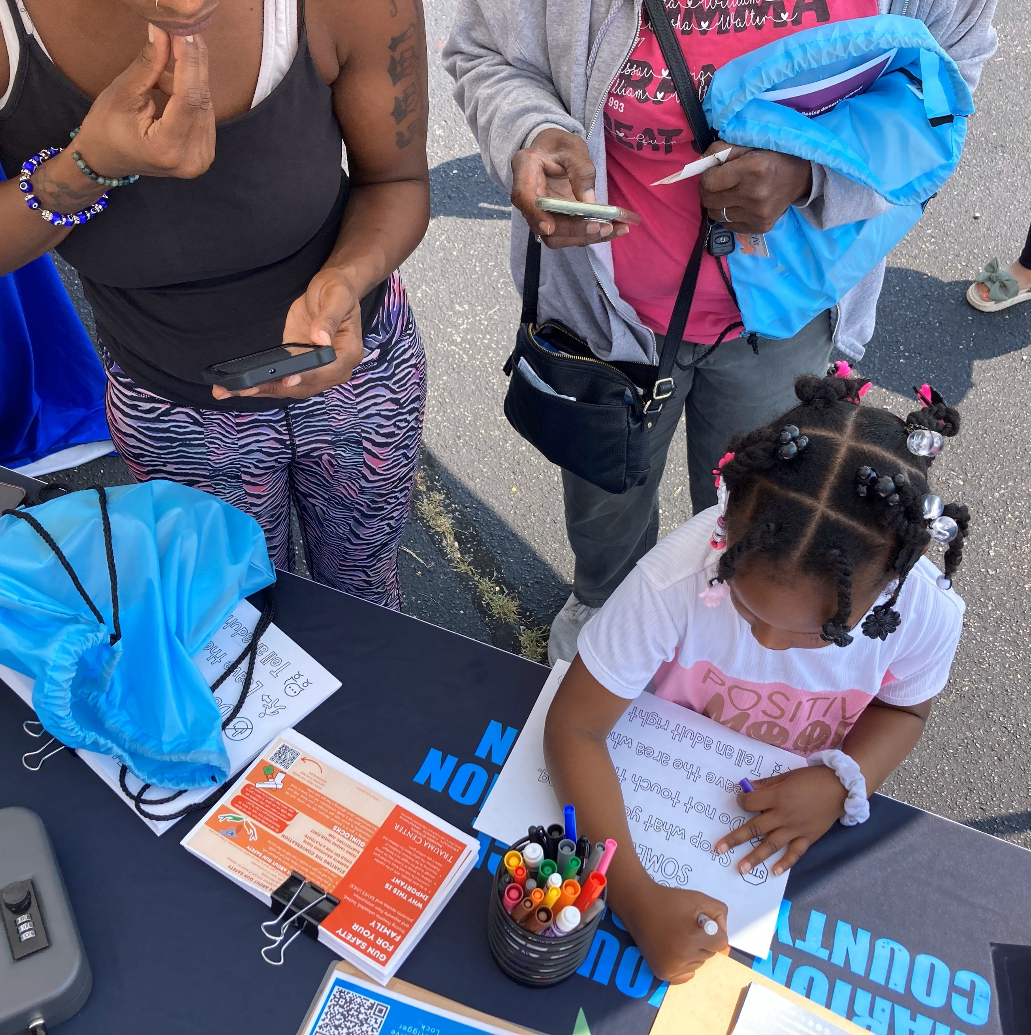
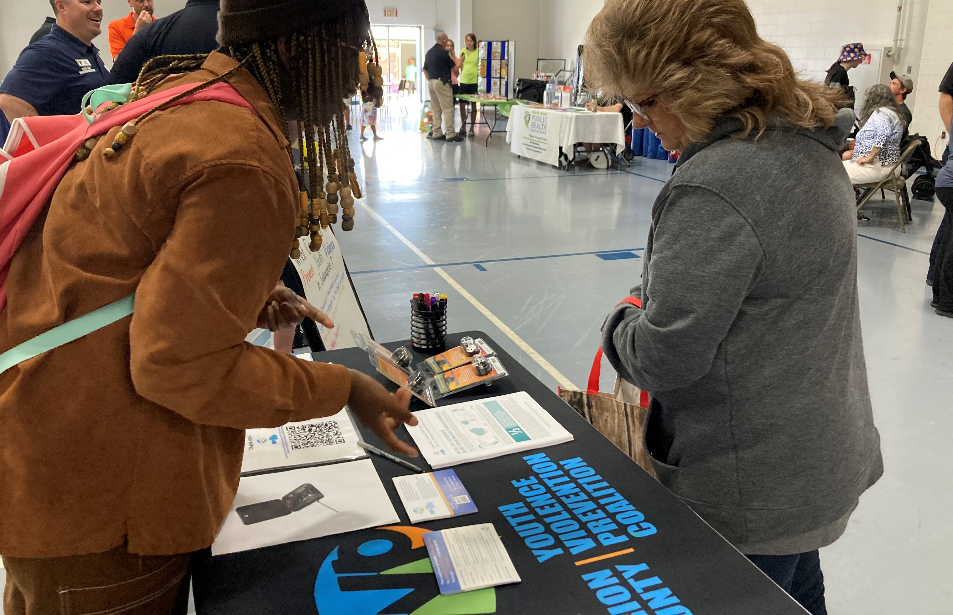
SaferINDY
Many families keep a gun in the home to protect their family from an intruder. Unfortunately, a gun in the home is more likely to hurt or kill a member of the household or a friend than an intruder. Secure storage of firearms can greatly reduce injury and death.

Slide 10
Funding

Slide 11
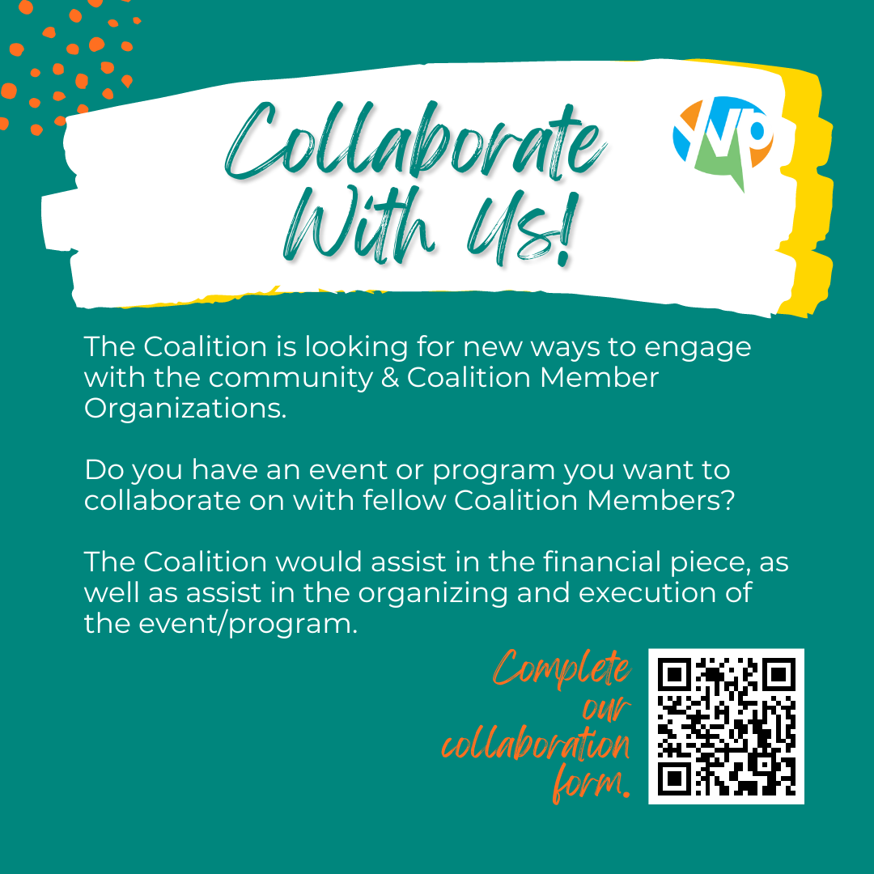
Please complete our collaboration form and let us know how we can work together.
Notes:
$40,950 interns, $18,000 collaborative community partner projects (Elevation Round 4)

Slide 12
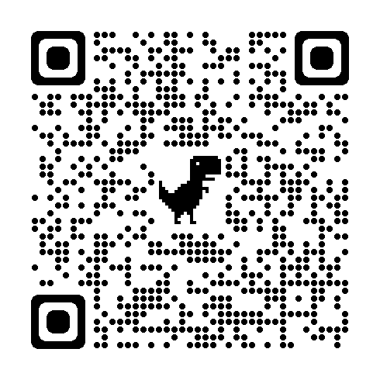
2024-2027 Strategic Plan
Proposed 2024-2027 Strategic Plan for MCYVPC follows
Provide concerns/feedback if desired: https://forms.gle/Qq7JGQwpc8PF1pfh9
During January’s Coalition meeting, we will vote on the plan, and it will be officially adopted as we enter the new year.

Slide 14
Strategic Focus
The Marion County Youth Violence Prevention Coalition activates community partners to prevent youth violence in Indianapolis through two strategic initiatives:
advocating for system-level change and
championing direct support for youth and families.

Slide 15
Operational Plan: To ensure the success of the strategic initiatives included in this plan, the Coalition recognizes the importance of adopting the following operational practices.
Communication of clear roles and responsibilities for all members
Update and adopt formal bylaws and strategic planning documentation clearly articulating the purpose and practices of the Coalition, the steering committee, and each task force (Policy, Crisis Response, Youth Voices, Trauma, Youth Employment, and Family Care)
Publish the bylaws and strategic plan in such a manner that each member and the community have easy access to them
Inclusive membership
Create an easily accessible Coalition member directory that is updated annually
Proactively engage and re-engage organizations that have been involved in the Coalition over time, inviting their active participation in task forces aligned with their work and communicating expectations for membership
Provide opportunities, and incentives where available and applicable, for youth and families (the community) to engage with the Coalition
Integrated systems and collaboration
Continue to structure Coalition meetings to focus on task forces and members sharing opportunities, challenges, and progress related to strategic initiatives
Provide central, easily accessible forums (in-person and/or online) where organizations working in this space can share and access resources, best practices, trainings, information about events, etc.
Leverage available Coalition funding to support youth violence prevention initiatives that meet the strategic goals of both the Coalition and its member organizations
Link Coalition members, task force efforts, and the community based on expressed needs

Slide 16
1A. Policy Promote a public policy position focused on addressing sources of youth violence
Objectives:
Provide opportunities to educate coalition members and the community on a) the legislative process, including how to connect with local government, and b) the coalition’s public policy agenda.
Connect directly with each coalition task force and with city and state systems leaders (such as City-County Council, state legislators, law enforcement, healthcare, education, and the Office of Public Health and Safety) to share the coalition’s public policy positions and identify opportunities for short- and long-term legislative advocacy.
Monitor City-County Council proposals and bills introduced in the Indiana General Assembly, considering each Task Force and the Coalition’s full strategic plan, to identify opportunities for advocacy (such as testifying before a committee).

Slide 17
1B. Crisis Response Lead the community’s messaging around youth violence and progress
Objectives:
Connect organizations that provide crisis intervention and response to facilitate networking, collective impact, and improved support for families.
Gather direct accounts of the lived experiences of youth and families impacted by violence. Promote comprehensive and trauma-informed storytelling with coalition members and community stakeholders, including media outlets.
Gather and share community-level data around both violent injuries/deaths, but also delinquent behavior, social determinants of health needs, and barriers that families experience before, during, and after a crisis.

Slide 18
1C. Youth Voices Elevate youth voices in violence prevention
Objectives:
Engage youth ambassadors, affiliated with member organizations, to empower these young people as leaders in their communities. Working within the coalition’s network of organizations and resources to provide them with access to tools, education, and employment opportunities.
Focus on existing youth spaces (schools, community-based programs, churches, skating rinks, parks, sporting events, etc.) to receive youth voice.
Identify and share best practices to engage and empower youth voice.

Slide 19
2A. Trauma Promote trauma-informed care for youth
Objectives:
Provide all coalition members, including youth, with clear training and resources (in-person and online) on trauma-informed care, diversity and inclusion, culturally competent care, and racial bias/implicit bias.
Organize or endorse member-led trauma-informed education for educators, school administrators, youth employment and skill development program staff, families, and other young workers.
Create a youth advisory board to review and edit content for coalition-based and youth-focused social media. Educate youth on existing teen apps, resources, and opportunities around trauma.
Identify and address opportunities to provide direct trauma care to youth before they ever have to interact with the juvenile justice system.

Slide 20
2B. Youth Employment Ensure youth have access to skill development and employment
Objectives:
Identify and address existing barriers preventing youth from gaining employment opportunities.
Identify organizations that are actively seeking and employing youth. Provide a list for coalition members and assist in creating connections between coalition members and youth.
Take advantage of existing youth spaces and gatherings (schools, churches, service providing organizations, skating rinks and parks, sports gatherings, etc.) to link youth with meaningful training and employment opportunities.
Create synergy between youth-hiring agencies in an effort to be the place organizations can go to when they have youth opportunities and need support.

Slide 21
2C. Family Care Ensure parents and caregivers have access to the resources they need to meet the physical, social, mental, and emotional needs of their families
Objectives:
Collect and share direct feedback (with both coalition member organizations and the community itself) from community members/families of ways in which we can effectively meet their continued needs.
Create or identify a system (i.e., community calendar, Facebook group) that will effectively connect member organizations together to share events and services, then identify ways to share that information with the community (i.e. mailed newsletters, electronic app).
Encourage and empower community members/families to get involved in prevention-focused programs and initiatives by addressing barriers and uncertainties.

Slide 22
Voting *Active Members that have been represented at two of the previous four (50%) convened General Coalition or Task Force meetings will have voting power.
Aspire Indiana Health
Big Brothers Big Sisters of Central Indiana (BBBS)
Boys & Girls Clubs of Indianapolis
Child Advocates
Child Care Answers
Congregations United to Reduce Violence (CURV)
Edna Martin Christian Center
EmployIndy
Eskenazi Health
Firefly Children & Family Alliance
Genesys Solutions
Indianapolis Metropolitan Police Department (IMPD)
Indy Parks and Recreation
IU Health Methodist Hospital
Job Corps
Lawrence Police Department
Mackida Loveal & Trip Outreach Center (MLT)
Marion County Commission on Youth (MCCOY)
Marion County Juvenile Probation Department
Marion County Prosecutor's Office (MCPO)
Marion County Public Health Department (MCPHD)
Metropolitan School District of Lawrence Township
Mental Health America of Indianapolis
Mission Makai Advocacy
Office of Public Health and Safety (OPHS)
Pathway Resource Center
Peace Learning Center (PLC)
Reach For Youth
Riley Hospital for Children
Shiloh Missionary Baptist Church
Stop the Violence Indianapolis
Trusted Mentors Inc
Use What You've Got Prison Ministry
VOICES Corp
Warriors 4 Peace
YMCA of Greater Indianapolis

Slide 23
Nominees Tiffany Davis Anthony Wright Sr
The Elected Co-chair convenes general membership and steering committee meetings and is responsible for organizing or working with the Coalition Coordinator to organize the agenda items and facilitation of those meetings. They supervise the affairs of the Coalition and act as an official speaker and liaison between the Coalition and community stakeholders.
Commitment
Day-to-day support and communication with the Coalition Coordinator
Monthly steering team meetings
Quarterly coalition meetings
Other necessary meetings and duties to ensure sustainability of Coalition and commitment to strategic planning action items

Slide 24
Nominees
Beatrice Beverly (requested to be removed)
Kieana Franklin
Damita Jefferson
Brian Shobe
The main role of a Member-at-Large is to provide support to the steering committee. Official duties and responsibilities are not fixed but instead vary according to the needs of the Coalition. A Member-at-Large, for example, may be tasked to head up a search to fill steering team vacancies.
Commitment
Monthly steering team meetings
Quarterly coalition meetings
Other necessary meetings and duties to ensure sustainability of Coalition and commitment to strategic planning action items.

Slide 25
Nominees Kieana Franklin Carey Haley Damita Jefferson Antonio Lipscomb Ashley Morgan Donita Royal Brian Shobe Katina Washington
Task force leaders lead task force breakouts at quarterly Coalition meetings, monitor task force progress on strategic plan goals and activities, and collaborate on efforts to implement coalition practices outlined in the strategic plan.
Commitment
Complete/facilitate necessary meetings, actions to meet task force goals
Monthly steering team meetings
Quarterly Coalition meetings
Participation in community-based, Coalition sponsored or involved events

Slide 26
Antonio Lipscomb *Biography not provided by the email due date
Antonio Lipscomb, Founder of the Community Church Indy and National Political Network, and a radio broadcaster through Urban One programming. I also have an organization for re-entry clients that is called Indiana Re-entry, we provide wrap-around services to member of the community that has a criminal background that helps them transition back into society, we also have an umbrella company under our re-entry program which is the Community Ambassadors Church Coalition. This organization that helps the re-entry program through a faith-based approach. My vision is to have a faith-based community represent the morality of our city. As President I am looking to partner with church leaders, Elected Officials, and community servants, to represent our interest, and support our communities from gentrification, recidivism, and violence. I have recognized that there are issues arising in our community. Lastly, I have a full apprenticeship program for trades such as plumbing, painting, electrical, carpentry, masonry, and HVAC. I also provide vocational construction training as well. There are four areas that we have focused on, which are, health &amp; wellness / mental health, homicides, re-entry, and education. We plan to come together as one. As the President over all of these programs is to create a life changing atmosphere for our community. I am a Pastor who support the community and understands the interpretation of life and that life relies on direction from God. I created these programs to show the community and encourage them to focus on the Bible, and their goals, and God will support them.

Slide 27
Nominees Damita Jefferson Ashley Morgan Drew Neddo Donita Royal Katina Washington Anthony Wright Sr
Task force leaders lead task force breakouts at quarterly Coalition meetings, monitor task force progress on strategic plan goals and activities, and collaborate on efforts to implement coalition practices outlined in the strategic plan.
Commitment
Complete/facilitate necessary meetings, actions to meet task force goals
Monthly steering team meetings
Quarterly Coalition meetings
Participation in community-based, Coalition sponsored or involved events

Slide 28
Nominees Ashley Morgan Lashauna Triplett Katina Washington
Task force leaders lead task force breakouts at quarterly Coalition meetings, monitor task force progress on strategic plan goals and activities, and collaborate on efforts to implement coalition practices outlined in the strategic plan.
Commitment
Complete/facilitate necessary meetings, actions to meet task force goals
Monthly steering team meetings
Quarterly Coalition meetings
Participation in community-based, Coalition sponsored or involved events

Slide 29
Nominees Beatrice Beverly Carey Haley Donita Royal
Task force leaders lead task force breakouts at quarterly Coalition meetings, monitor task force progress on strategic plan goals and activities, and collaborate on efforts to implement coalition practices outlined in the strategic plan.
Commitment
Complete/facilitate necessary meetings, actions to meet task force goals
Monthly steering team meetings
Quarterly Coalition meetings
Participation in community-based, Coalition sponsored or involved events

Slide 30
Nominees Tiffany Davis Drew Neddo Tiera Howleit (write-in)
Task force leaders lead task force breakouts at quarterly Coalition meetings, monitor task force progress on strategic plan goals and activities, and collaborate on efforts to implement coalition practices outlined in the strategic plan.
Commitment
Complete/facilitate necessary meetings, actions to meet task force goals
Monthly steering team meetings
Quarterly Coalition meetings
Participation in community-based, Coalition sponsored or involved events

Slide 31
Tiera Howleit *write-in
As a recent graduate of Indiana University, Tiera Howleit has been a lifelong advocate for social justice and is on a path to assist in the elimination of the systemic barriers which negatively impact Black and other marginalized groups of people.
Born and raised in Indianapolis, Indiana, Howleit has been able to work with at-risk youth and various community organizations to help ensure local community needs are being met. Howleit has been working in this field since she was in middle school.
While in attendance at Indiana University, Howleit double majored in Political Science and African American and African Diaspora Studies, as her field of work has lied at the intersection of these areas of study. Howleit is a Groups (G’18) Scholar and a former Chi Alpha Epsilon Honors Society member.
During her sophomore year at Indiana University, Howleit founded a campus organization, Black Collegians, Inc. to assist Black and Brown scholars with political advocacy and civic engagement. Howleit plans to continue her academic career by obtaining a juris doctorate degree in the upcoming years.
Among some of her distinguished accomplishments, Howleit created a Bill of Rights resolution alongside other central Indianapolis youth to address the key issues youth face within the city. This resolution was passed within the Indiana General Assembly, City of Lawrence Common Council, and the City of Indianapolis.
Aside from this, Howleit has also served on various boards and coalitions including the Marion County Youth Violence Prevention Coalition, Neal Marshall Black Presidents Cabinet, IU Dean of Students Cabinet of Student Leaders, IU Student Government (Chief of Staff), and the IU United Council for Equity.
In 2020, Howleit co-founded a campus wide initiative at Indiana University to create a student led Black Lives Matter mural. This mural, in essence, sparked great unity among students, faculty and staff at IU, and Bloomington community members.
During her senior year at IU, Howleit received the 2022 Neal-Marshall legacy award and was inducted into the first inaugural Neal Marshall Hall of Fame.
As a way of continuing to elevate the voices of others within the realm of social justice and advocacy, Howleit will use her lifelong storytelling skills to ensure history does not forget those whose stories are traditionally left untold.
Howleit was named a 2022 recipient of the Soros Justice Youth Advocacy Fellowship with Open Society Foundations. Since starting this fellowship, Howleit has collected stories of directly impacted individuals and plans to continue to collect them in order to advocate for policy reform within the state of Indiana.

Slide 32
Nominees Della Brown Lashauna Triplett
Task force leaders lead task force breakouts at quarterly Coalition meetings, monitor task force progress on strategic plan goals and activities, and collaborate on efforts to implement coalition practices outlined in the strategic plan.
Commitment
Complete/facilitate necessary meetings, actions to meet task force goals
Monthly steering team meetings
Quarterly Coalition meetings
Participation in community-based, Coalition sponsored or involved events

Slide 33
Task Force Break-Outs Pick a task force to join for discussion.
Crisis Response: Lead the community's messaging around incidents of youth violence and progress
Family Care: Equip parents and caregivers to meet physical, social, mental, and emotional needs of their families
Policy: Promote a public policy agenda focused on addressing sources of youth violence
Trauma: Promote trauma informed care for youth
Youth Employment: Ensure youth of all ages have access to skill development and employment
Youth Voices: Elevate youth voices in violence prevention

Slide 34
E-mail: mcyvpc@gmail.com – “Coalition Connection”
Website: saferindy.com
Social Networks: @mcyvpc

