Slide 1
COALITION QUARTERLY MEETING
Snap the QR code to check-in

Slide 2
Mission Statement | Strategic Focus
The MCYVPC convenes community stakeholders, conducts research, provides leadership, and empowers people to create opportunities that build more peaceful homes, schools, neighborhoods, and workplaces.
The MCYVPC activates community partners to prevent youth violence in Indianapolis through 2 strategic initiatives:
Advocate for system-level change, and
Champion direct support for youth and families.

Slide 3
Steering team
Elected Co-chair: Tiffany Davis
Appointed Co-chair: Corey Davis
Member-at-Large: Brian Shobe
Crisis Response Task Force Lead: Della Brown
Family Care Task Force Lead: Damita Jefferson
Policy Task Force Lead: Tiera Howleit
Trauma Task Force Co-Leads: Beatrice Beverly, Julie Hayden
Youth Employment Task Force Lead: LaShauna Triplett
Youth Voices Task Force Co-Leads: Drew Neddo, Jake Brosius

Slide 4
Agenda
Check-in via the QR code
Welcome
Ralph Durrett, Chief Violence Prevention Officer
Intern Presentations
Chin Community of Indiana
We Bloom (Discovery Café)
VOICES Corp
Black & Latino Policy Institute
Let Them Talk
Inner Beauty Program, Inc.
Mackida Loveal & Trip Outreach Center, Can We Ryde
Genesys Solutions
Announcements
Task Force Break-Outs
Task Force Report-Outs

Slide 15
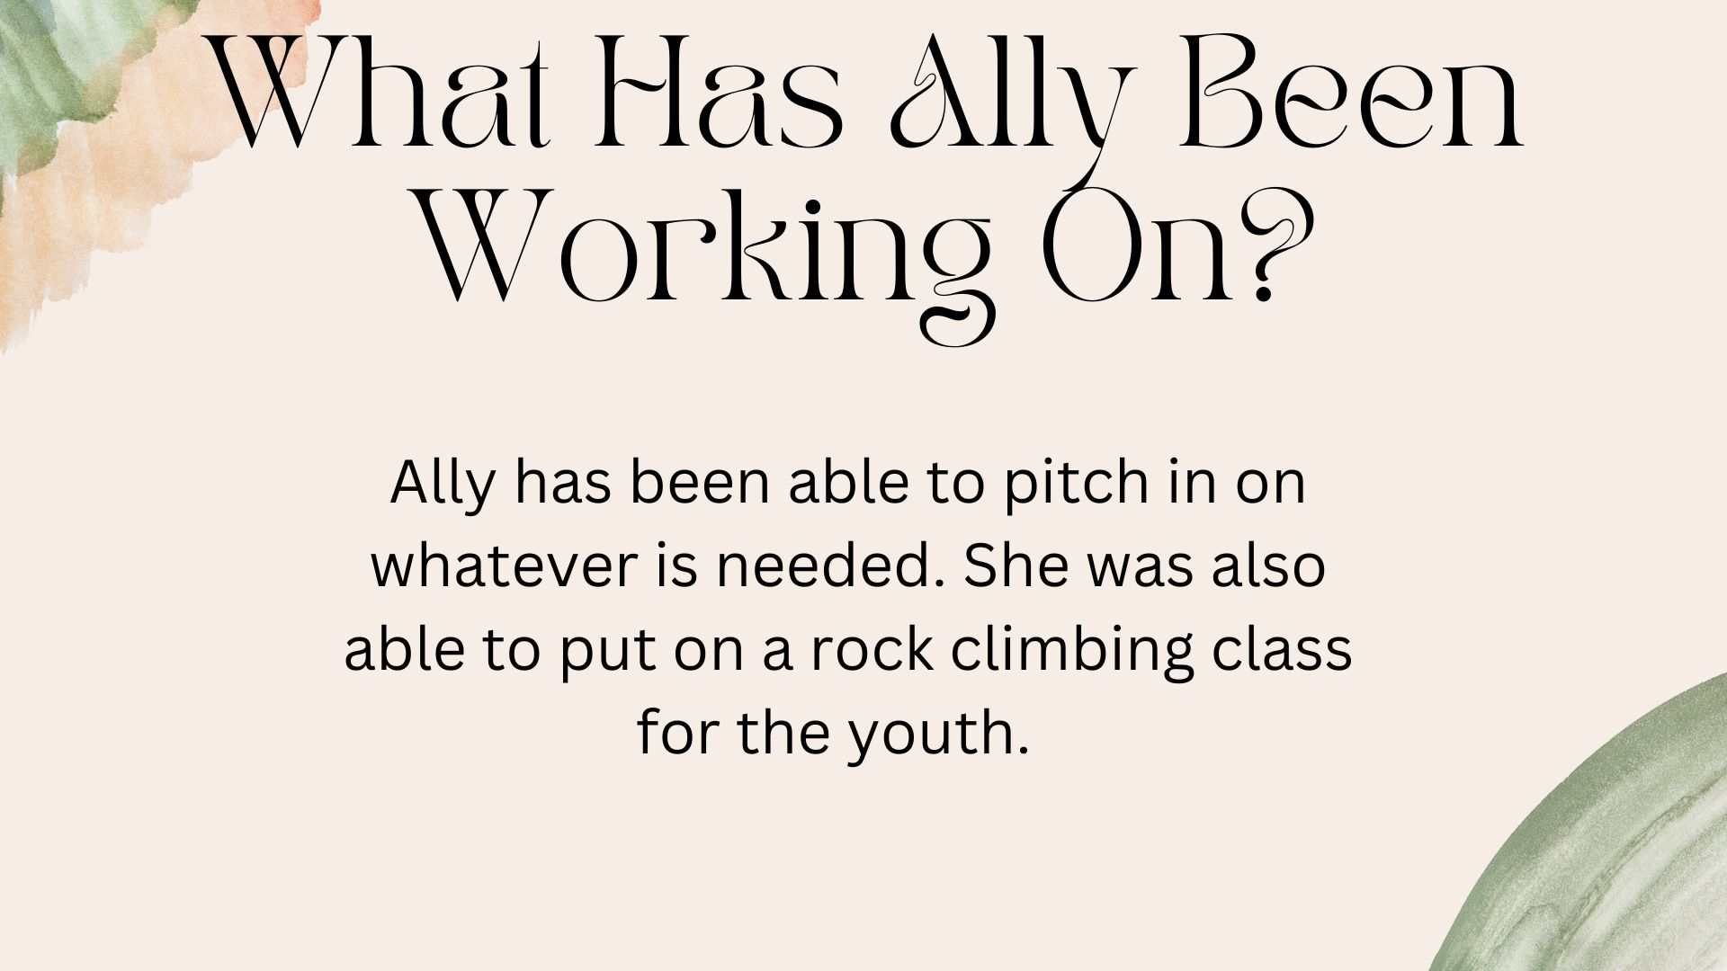

Slide 16
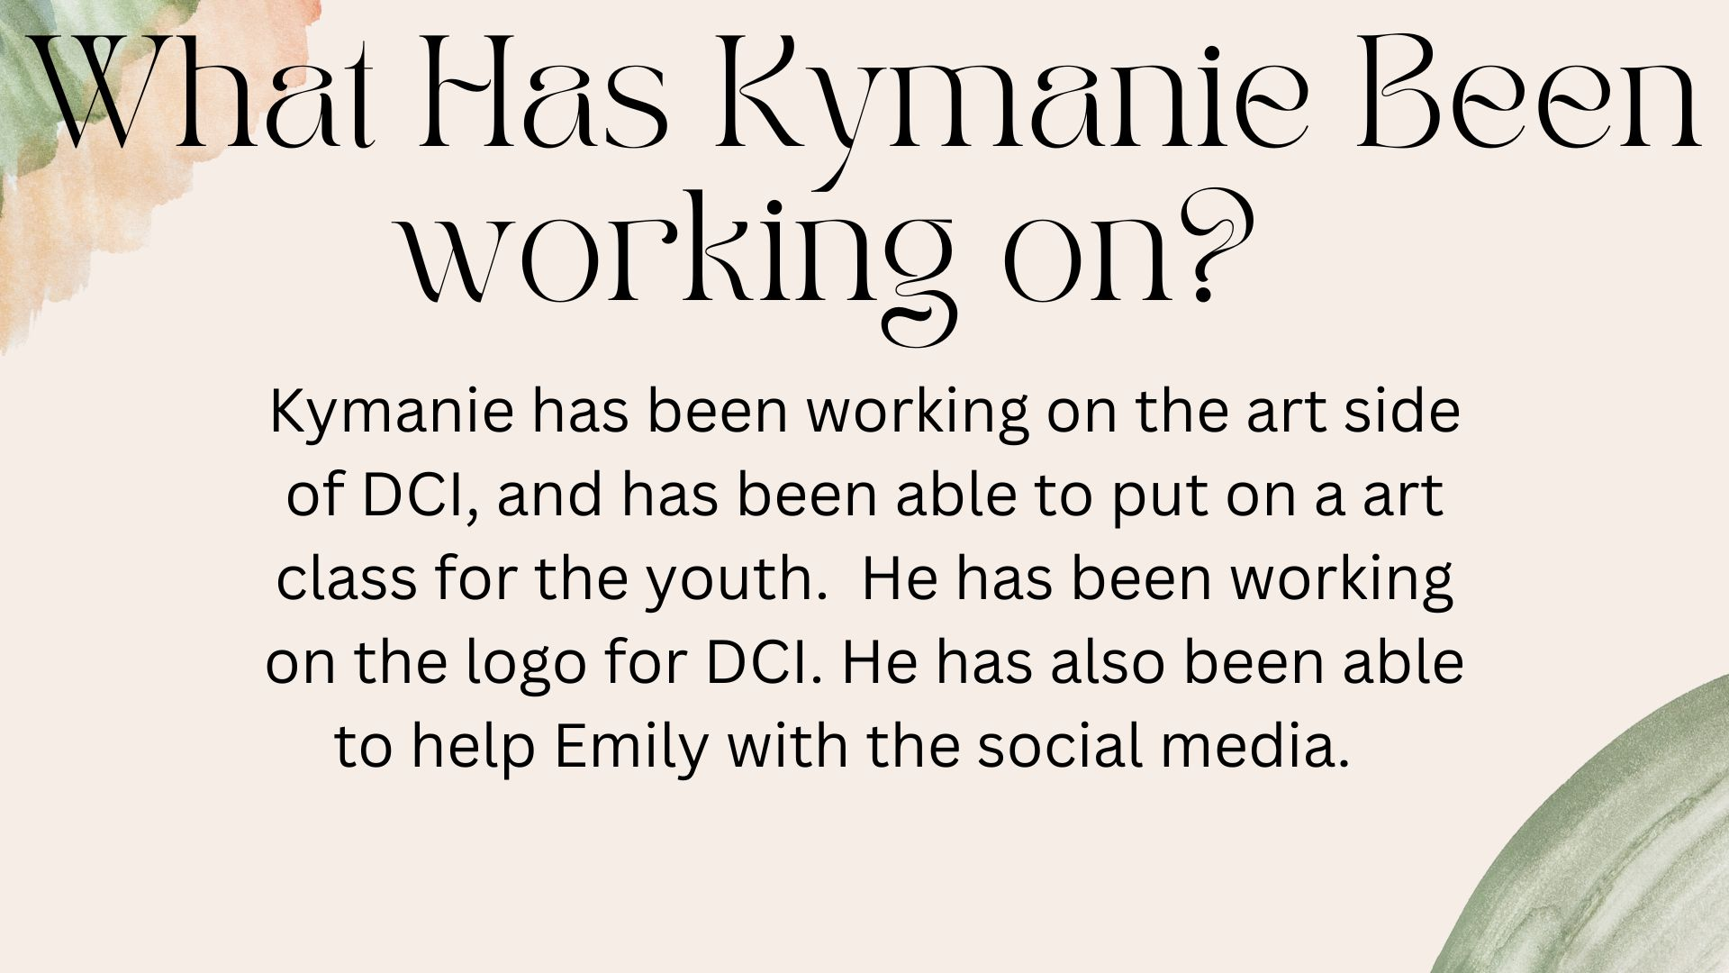

Slide 18
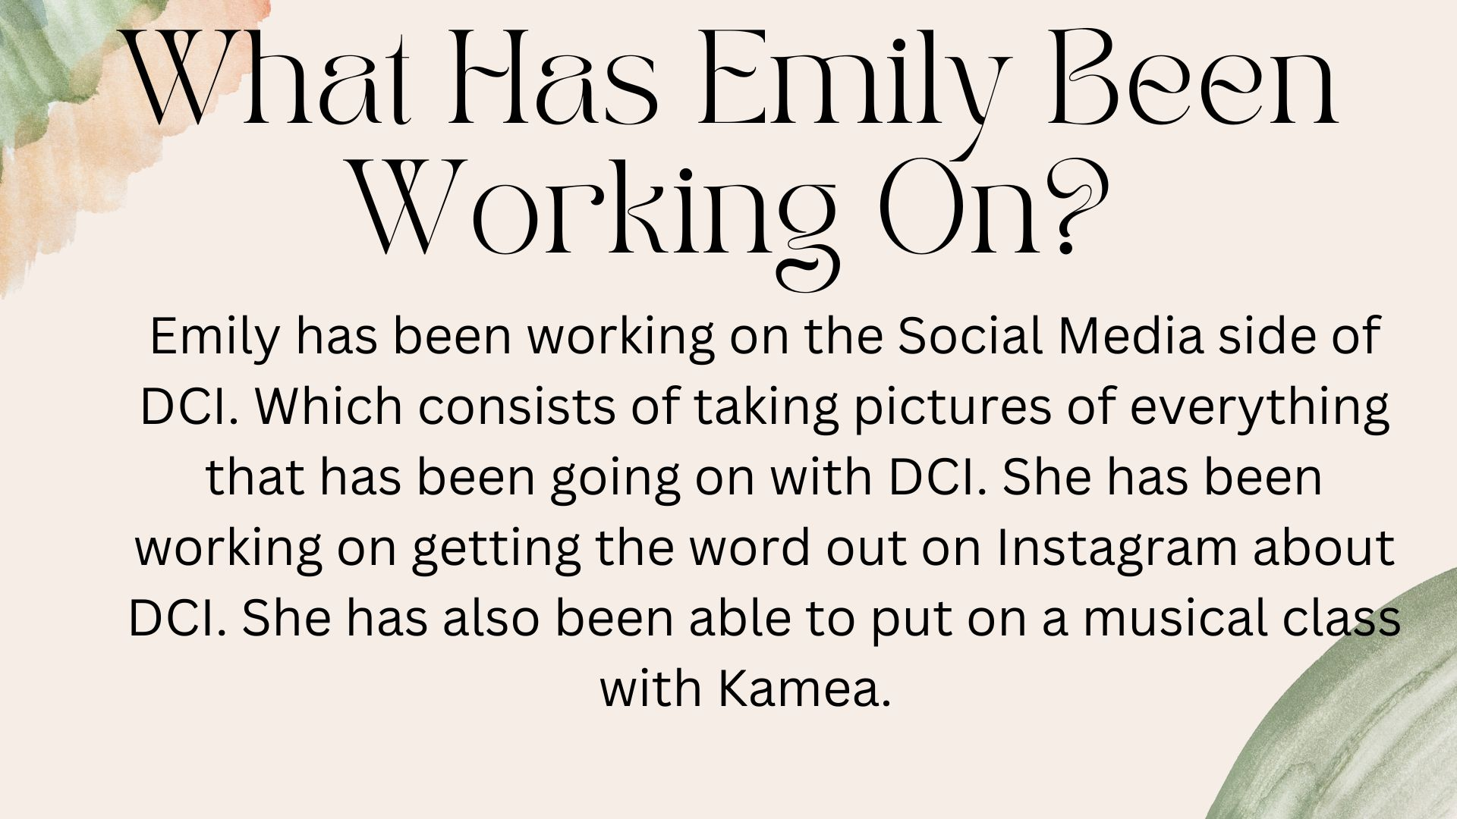

Slide 19
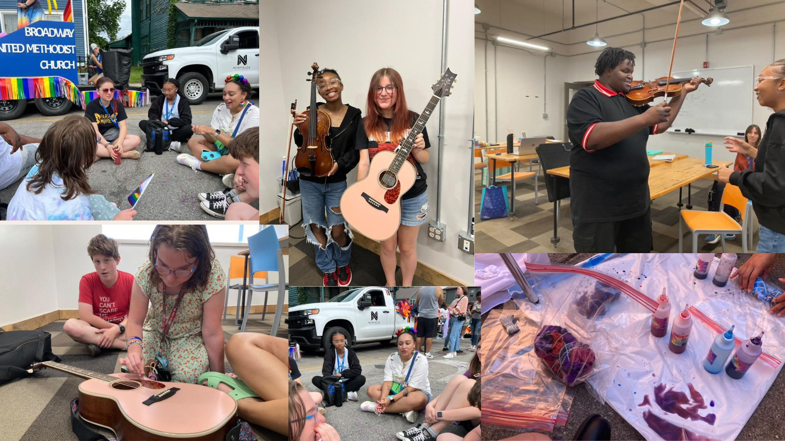

Slide 26
Black & Latino Policy Institute Intern: Daja Brangman

Slide 31
Let Them Talk Interns: Sarah Guillaume & Edward Webster

Slide 32
Inner Beauty Program, Inc. Interns: Abisak Awi & Danielle Daniels

Slide 33
Mackida Loveal & Trip Outreach Center, Can We Ryde Inc Interns: Allison Cordova-Cortez, Alejandra Hernandez, Kelin Peraza-Argueta, & Malcolm Tepehua Martinez

Slide 34
Genesys Solutions Interns: Julia Hurley & Denaya Travis

Slide 35
Genesys Solutions Intern: Shalise Truxler

Slide 36
Announcements
Coalition Coordinator, Becca McCracken, is resigning from full-time employment with the Coalition, effective August 15th.
With this change, we will be seeking a new Coalition Coordinator. If you or someone you know is interested in this position, please check out LinkedIn soon for the job posting and application details.

Slide 37
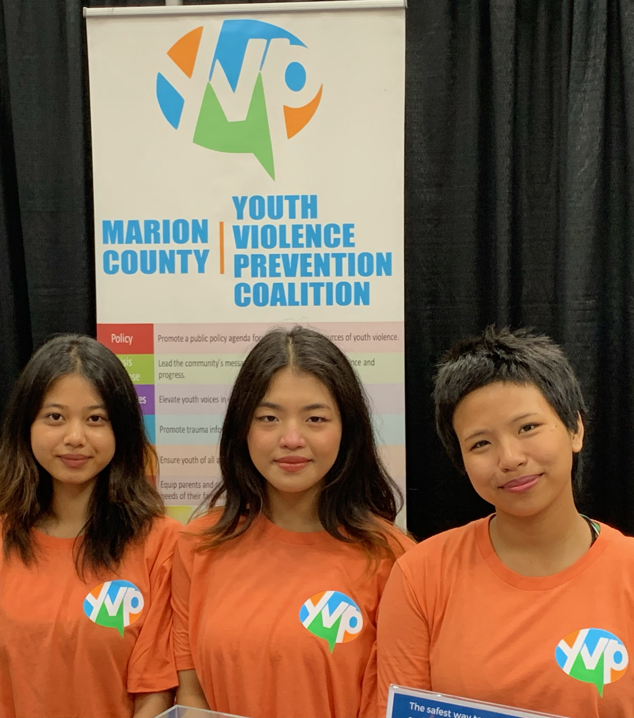
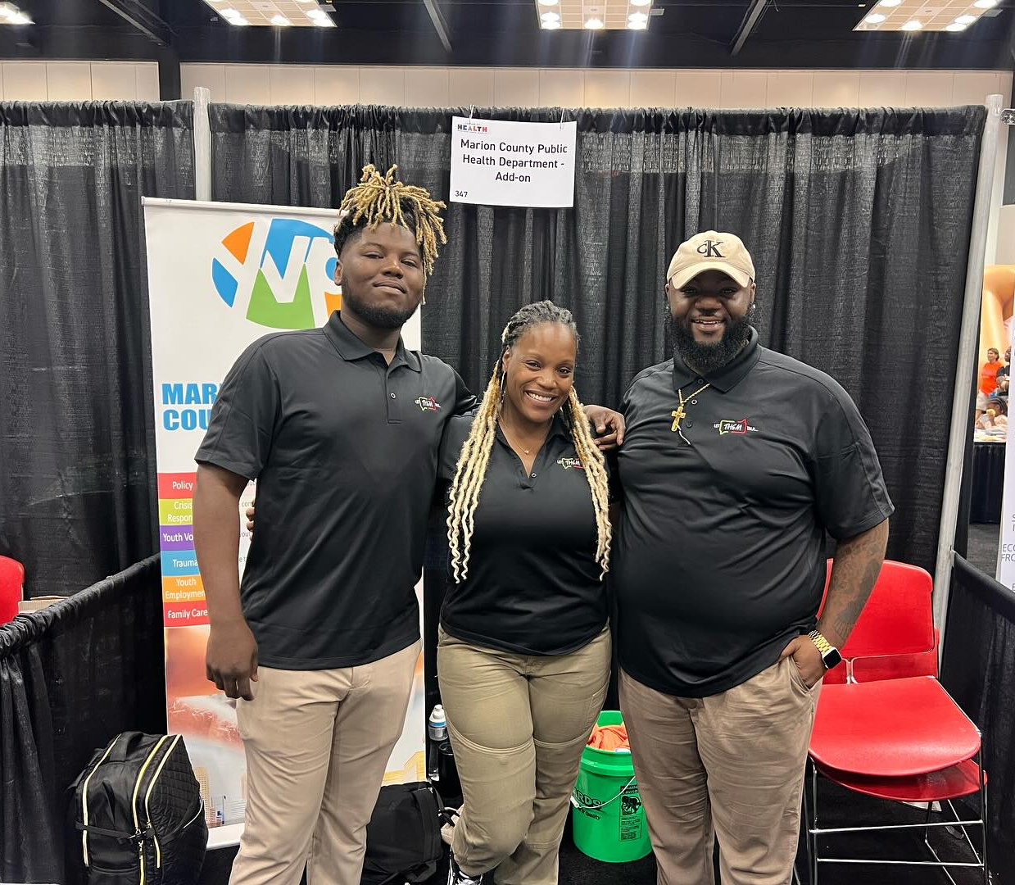
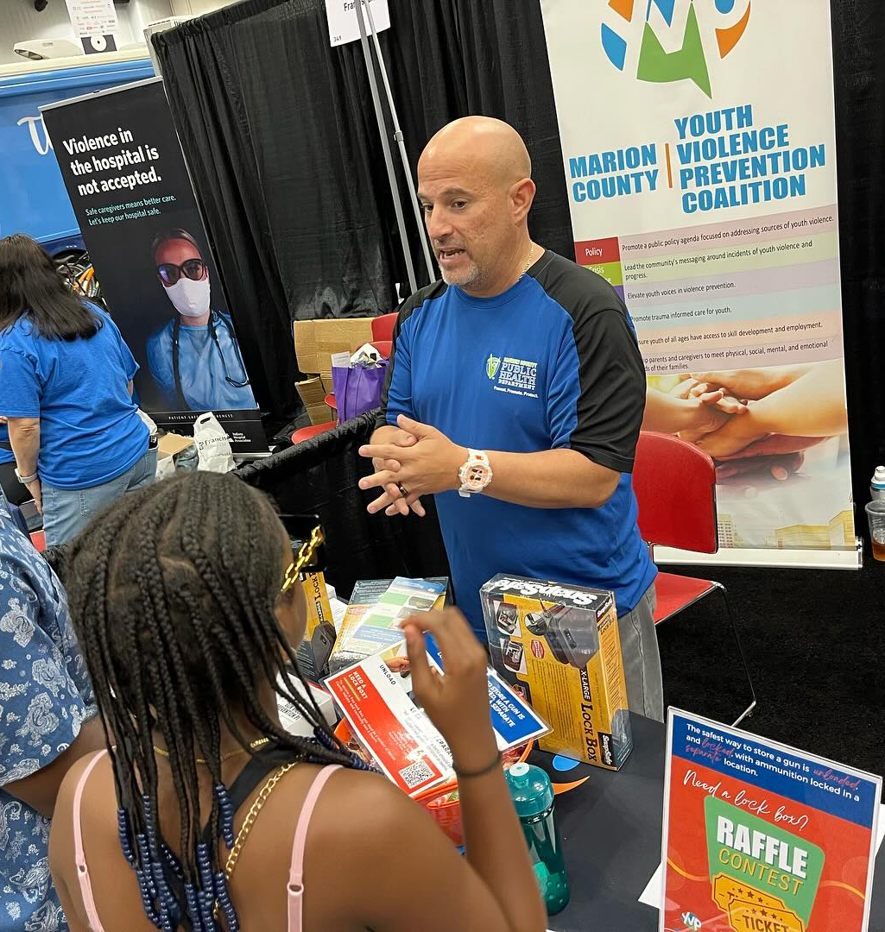
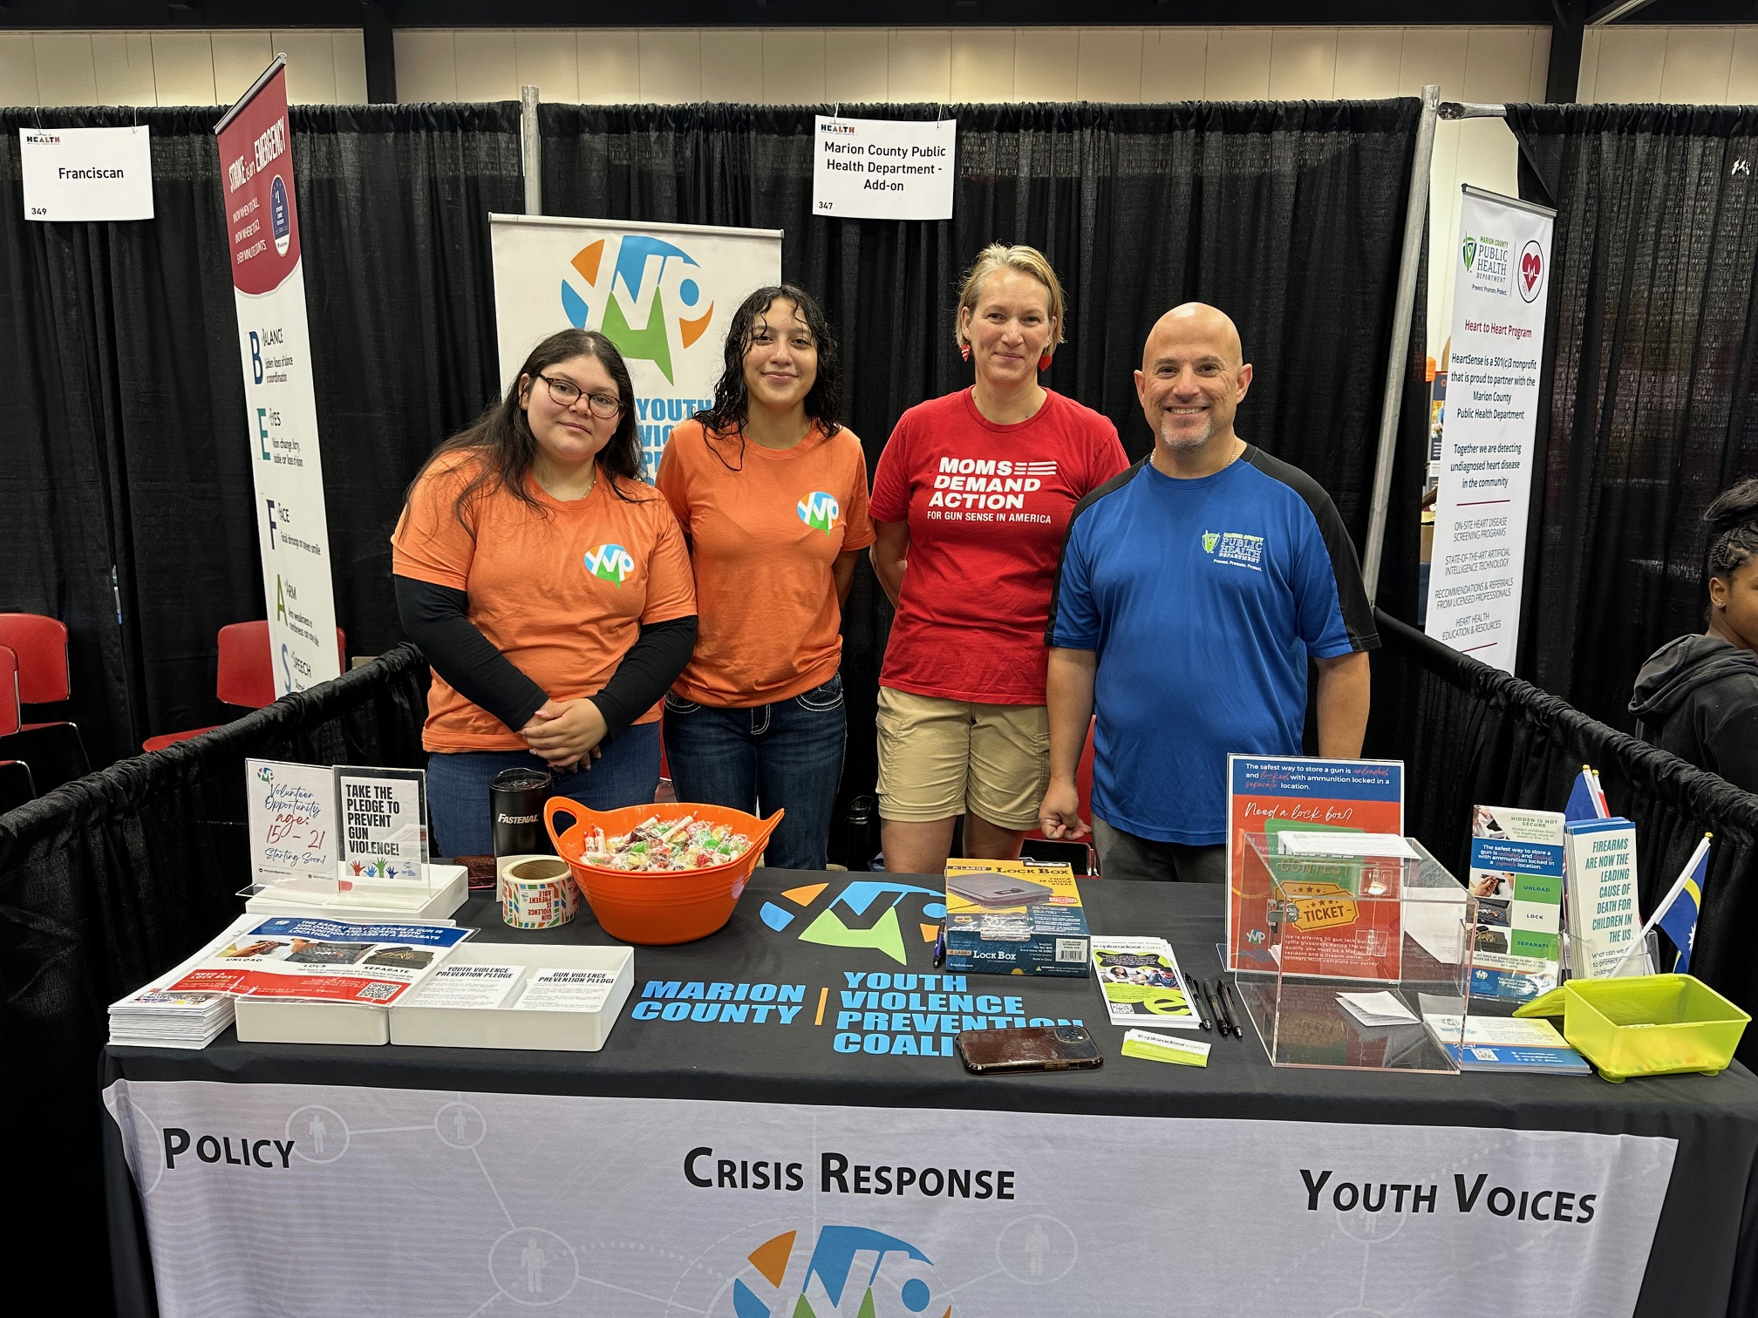
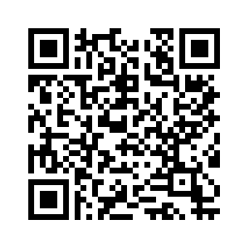
Tabling Opportunities
Huge shoutout to everyone who tabled at the Indiana Black Expo!
The Coalition is tabling at more events coming up:
MDwise 30th Anniversary Community Health Fair, Saturday 07/27/2024 10:00 am-1:00 pm
Road to Resources Block Party,
Tuesday 07/30/2024 5:00 pm-7:00 pm, Morris and Belmont
Tuesday 08/13/2024 5:00 pm-7:00 pm, 946 N Oxford St
Youth Anti-Gun Violence Day, Saturday 08/24/2024 12:00 pm-3:00 pm, Pathway Resource Center
Can you help?

Slide 38
Member Orientation
Are you new to the Marion County Youth Violence Prevention Coalition?
Have you been a member for a while but would like a refresher on the Coalition?
Do you have questions about how the Coalition operates, what we have going on, and/or how to get involved?
If your answer to any of these questions is "Yes!" then please join us for the Member Orientation.

Slide 39
501(c)(3) update
Please take 1 minute to share your thoughts!

Slide 40
Task Force Break-Outs Pick a task force to join for discussion.
Crisis Response: Lead the community's messaging around incidents of youth violence and progress
Family Care: Equip parents and caregivers to meet physical, social, mental, and emotional needs of their families
Policy: Promote a public policy agenda focused on addressing sources of youth violence
Trauma: Promote trauma informed care for youth
Youth Employment: Ensure youth of all ages have access to skill development and employment
Youth Voices: Elevate youth voices in violence prevention

Slide 41
Task Force Report-Outs
Crisis Response
Family Care
Policy
Trauma
Youth Employment
Youth Voices

Slide 42
E-mail: mcyvpc@gmail.com – “Coalition Connection”
Website: saferindy.com
Social Networks: @mcyvpc

