Slide 1
COALITION QUARTERLY MEETING
Snap the QR code to check-in

Slide 2
Mission Statement | Strategic Focus
The MCYVPC convenes community stakeholders, conducts research, provides leadership, and empowers people to create opportunities that build more peaceful homes, schools, neighborhoods, and workplaces.
The MCYVPC activates community partners to prevent youth violence in Indianapolis through 2 strategic initiatives:
Advocate for system-level change, and
Champion direct support for youth and families.

Slide 3
Steering team
Elected Co-chair: Tiffany Davis
Appointed Co-chair: Corey Davis
Member-at-Large: Brian Shobe
Crisis Response Task Force Lead: Della Brown
Family Care Task Force Lead: Damita Jefferson
Policy Task Force Lead: Tiera Howleit
Trauma Task Force Co-Leads: Beatrice Beverly, Julie Hayden
Youth Employment Task Force Lead: LaShauna Triplett
Youth Voices Task Force Co-Leads: Drew Neddo, Jake Brosius

Slide 4
Agenda
Check-in via the QR code
Welcome
Vote on 2024 Bylaws
Task Force Break-Outs
Task Force Report-Outs

Slide 5
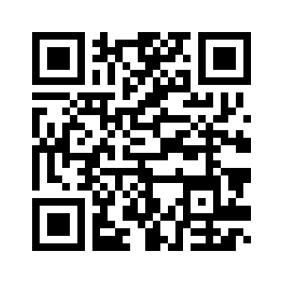
Vote on 2024 Bylaws
General Membership in the Coalition shall consist of any community member or organization who adheres to the Coalition’s mission and is further defined by the following sections.
Active Member. An Active Member shall be a General Member that has been represented at two of the previous four (50%) convened General Coalition meetings, has signed the Coalition Membership Agreement Form, and shall have voting power in General Coalition meetings.
Supporting Member. A Supporting Member shall be any other organization or community member that wants to be associated with the Coalition but is not an active member.

Slide 6
Active Members
Aspire Indiana Health
Big Brothers Big Sisters of Central Indiana (BBBS)
Child Advocates
Child Care Answers
Eskenazi Health
Firefly Children & Family Alliance
Genesys Solutions
IU Health Methodist Hospital
Job Corps
Mackida Loveal & Trip Outreach Center (MLT)
Marion County Commission on Youth (MCCOY)
Marion County Juvenile Probation Department
Marion County Prosecutor's Office (MCPO)
Marion County Public Health Department (MCPHD)
Mental Health America of Indianapolis
Metropolitan School District of Lawrence Township
Pathway Resource Center, Inc.
Riley Hospital for Children
Shiloh Missionary Baptist Church
Stop the Violence Indianapolis
VOICES Corp.
Warriors for Peace
YMCA Of Greater Indianapolis

Slide 7
Task Force Break-Outs Pick a task force to join for discussion.
Crisis Response: Lead the community's messaging around incidents of youth violence and progress
Family Care: Equip parents and caregivers to meet physical, social, mental, and emotional needs of their families
Policy: Promote a public policy agenda focused on addressing sources of youth violence
Trauma: Promote trauma informed care for youth
Youth Employment: Ensure youth of all ages have access to skill development and employment
Youth Voices: Elevate youth voices in violence prevention

Slide 8
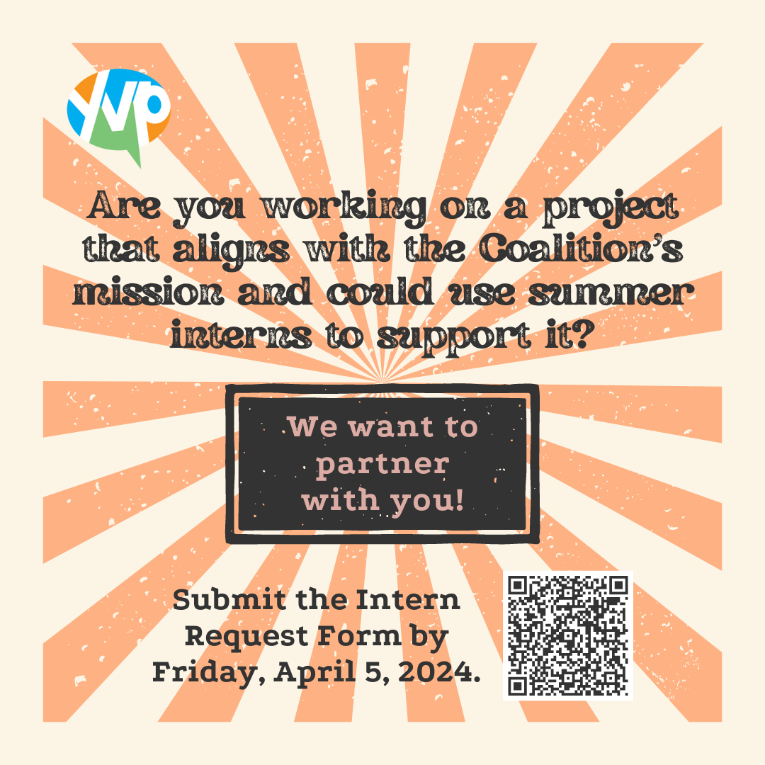
Interns
We are hiring 18 interns (ages 16 – 25) to be paired with community partners to engage in a project relating to the mission of the Coalition.
Submit your request ASAP!
If you turn it in at the last minute, the steering committee may not have time to approve your request before interviews on Sat, 4/13/2023 11:00 AM - 1:00 PM.

Slide 9
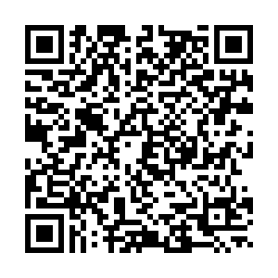
Peace Walk We are hosting a Peace Walk in honor of National Youth Violence Prevention Week with the Mayor's Youth Leadership Council, Hoosiers Concerned About Gun Violence, and others.
We would like other organizations to be present at the event to walk & table.

Slide 10
Member Orientation
Are you new to the Marion County Youth Violence Prevention Coalition?
Have you been a member for a while but would like a refresher on the Coalition?
Do you have questions about how the Coalition operates, what we have going on, and/or how to get involved?
If your answer to any of these questions is "Yes!" then please join us for the Member Orientation. This will be a Zoom meeting, so you will need to register.

Slide 11
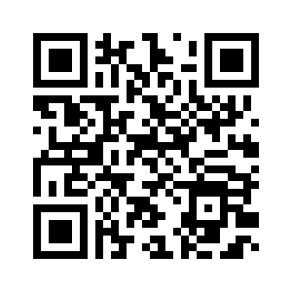
Gas Cards for Guns
We would like other organizations to be present at the event to offer more resources.

Slide 12
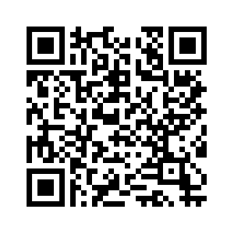
Indiana Black Expo
We were asked if we could have a booth on gun safety at Indiana Black Expo - June 28-30th.
Can you help?

Slide 13
Task Force Report-Outs
Crisis Response
Family Care
Policy
Trauma
Youth Employment
Youth Voices

Slide 14
E-mail: mcyvpc@gmail.com – “Coalition Connection”
Website: saferindy.com
Social Networks: @mcyvpc

