Slide 1



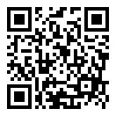
COALITION QUARTERLY MEETING
Snap the QR code to check-in

Slide 2

Mission Statement | Strategic Focus
The MCYVPC convenes community stakeholders, conducts research, provides leadership, and empowers people to create opportunities that build more peaceful homes, schools, neighborhoods, and workplaces.
The MCYVPC activates community partners to prevent youth violence in Indianapolis through 2 strategic initiatives:
Advocate for system-level change, and
Champion direct support for youth and families.

Slide 3
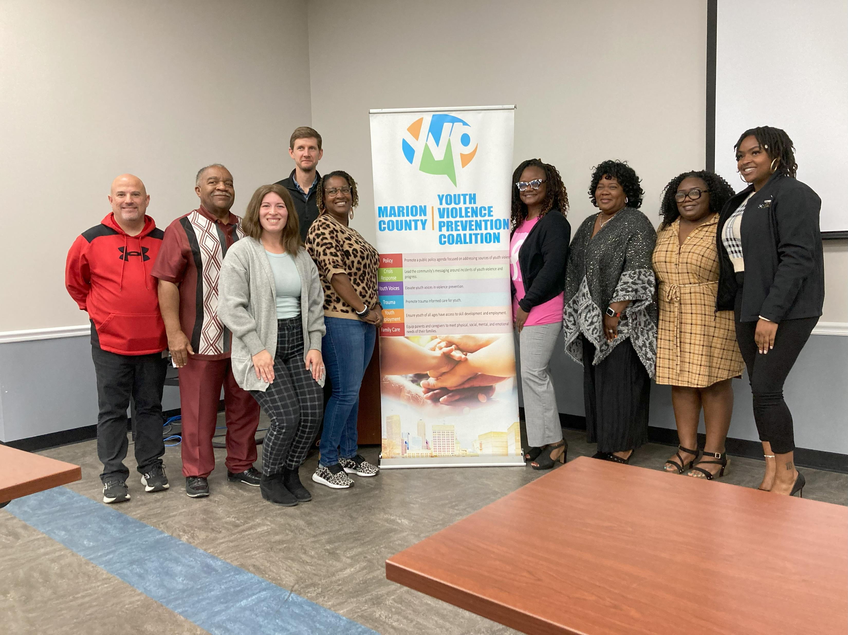
Steering team
Elected Co-chair: Tiffany Davis
Appointed Co-chair: Corey Davis
Member-at-Large: Brian Shobe
Crisis Response Task Force Lead: Della Brown
Family Care Task Force Lead: Damita Jefferson
Policy Task Force Lead: Tiera Howleit
Trauma Task Force Co-Leads: Beatrice Beverly, Julie Hayden
Youth Employment Task Force Lead: LaShauna Triplett
Youth Voices Task Force Co-Leads: Drew Neddo, Jake Brosius

Slide 4
Agenda
Check-in via the QR code
Welcome
Updates
Speed Networking
Task Force Report-Outs
Task Force Break-Outs

Slide 5
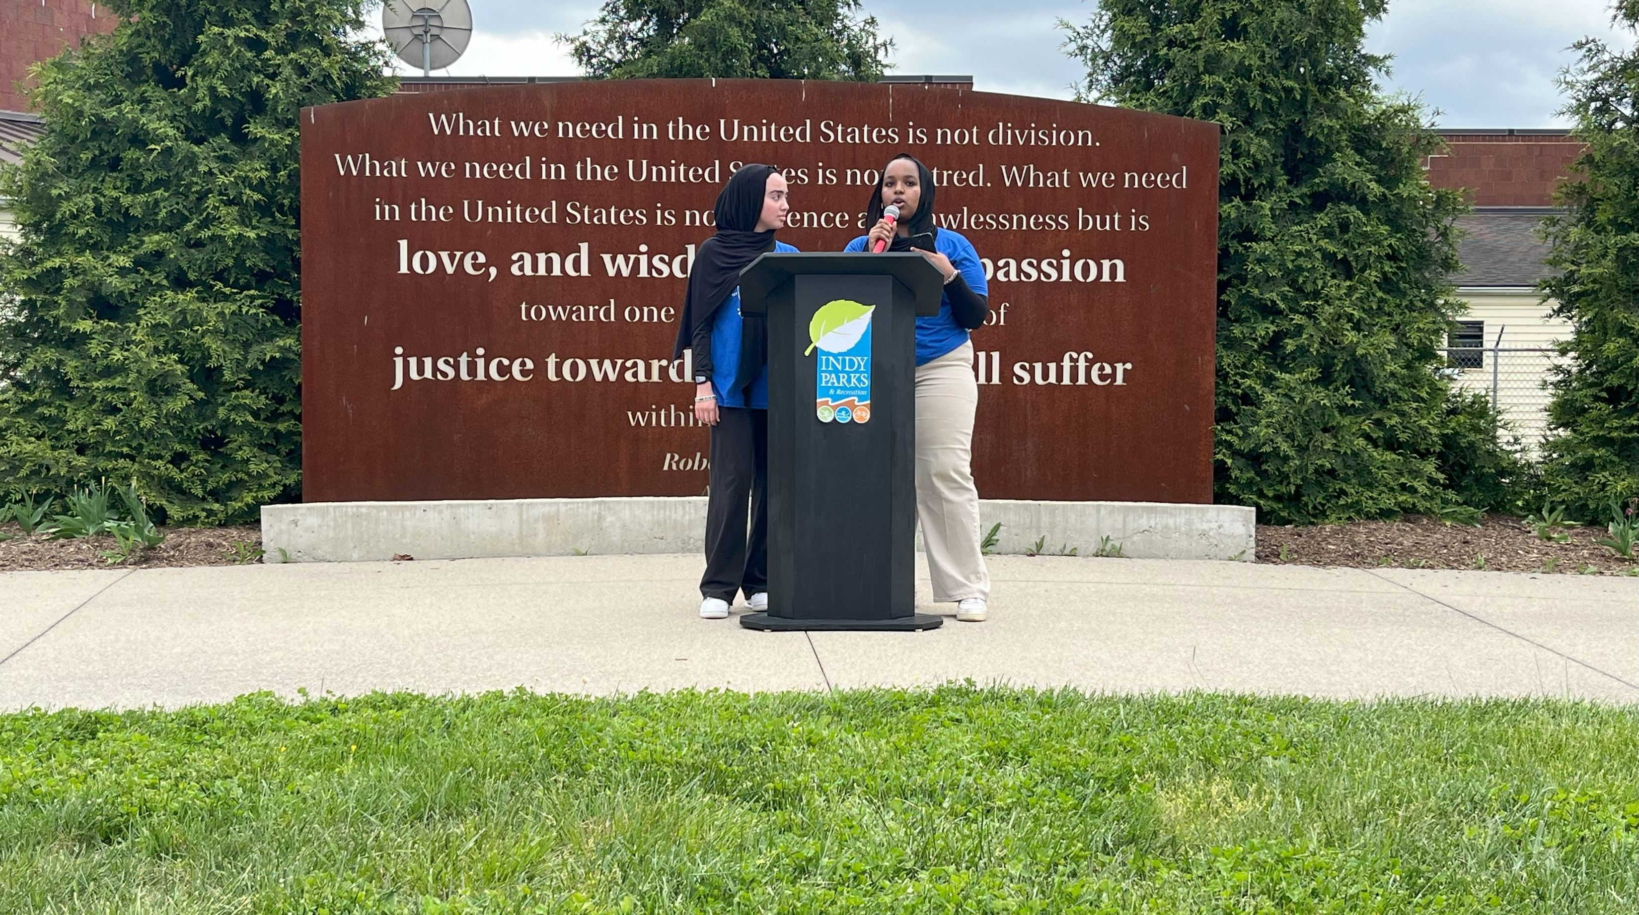
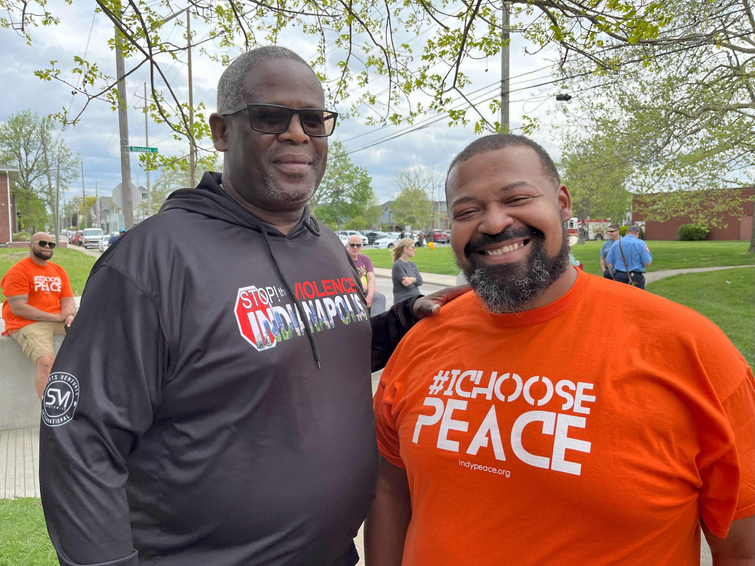
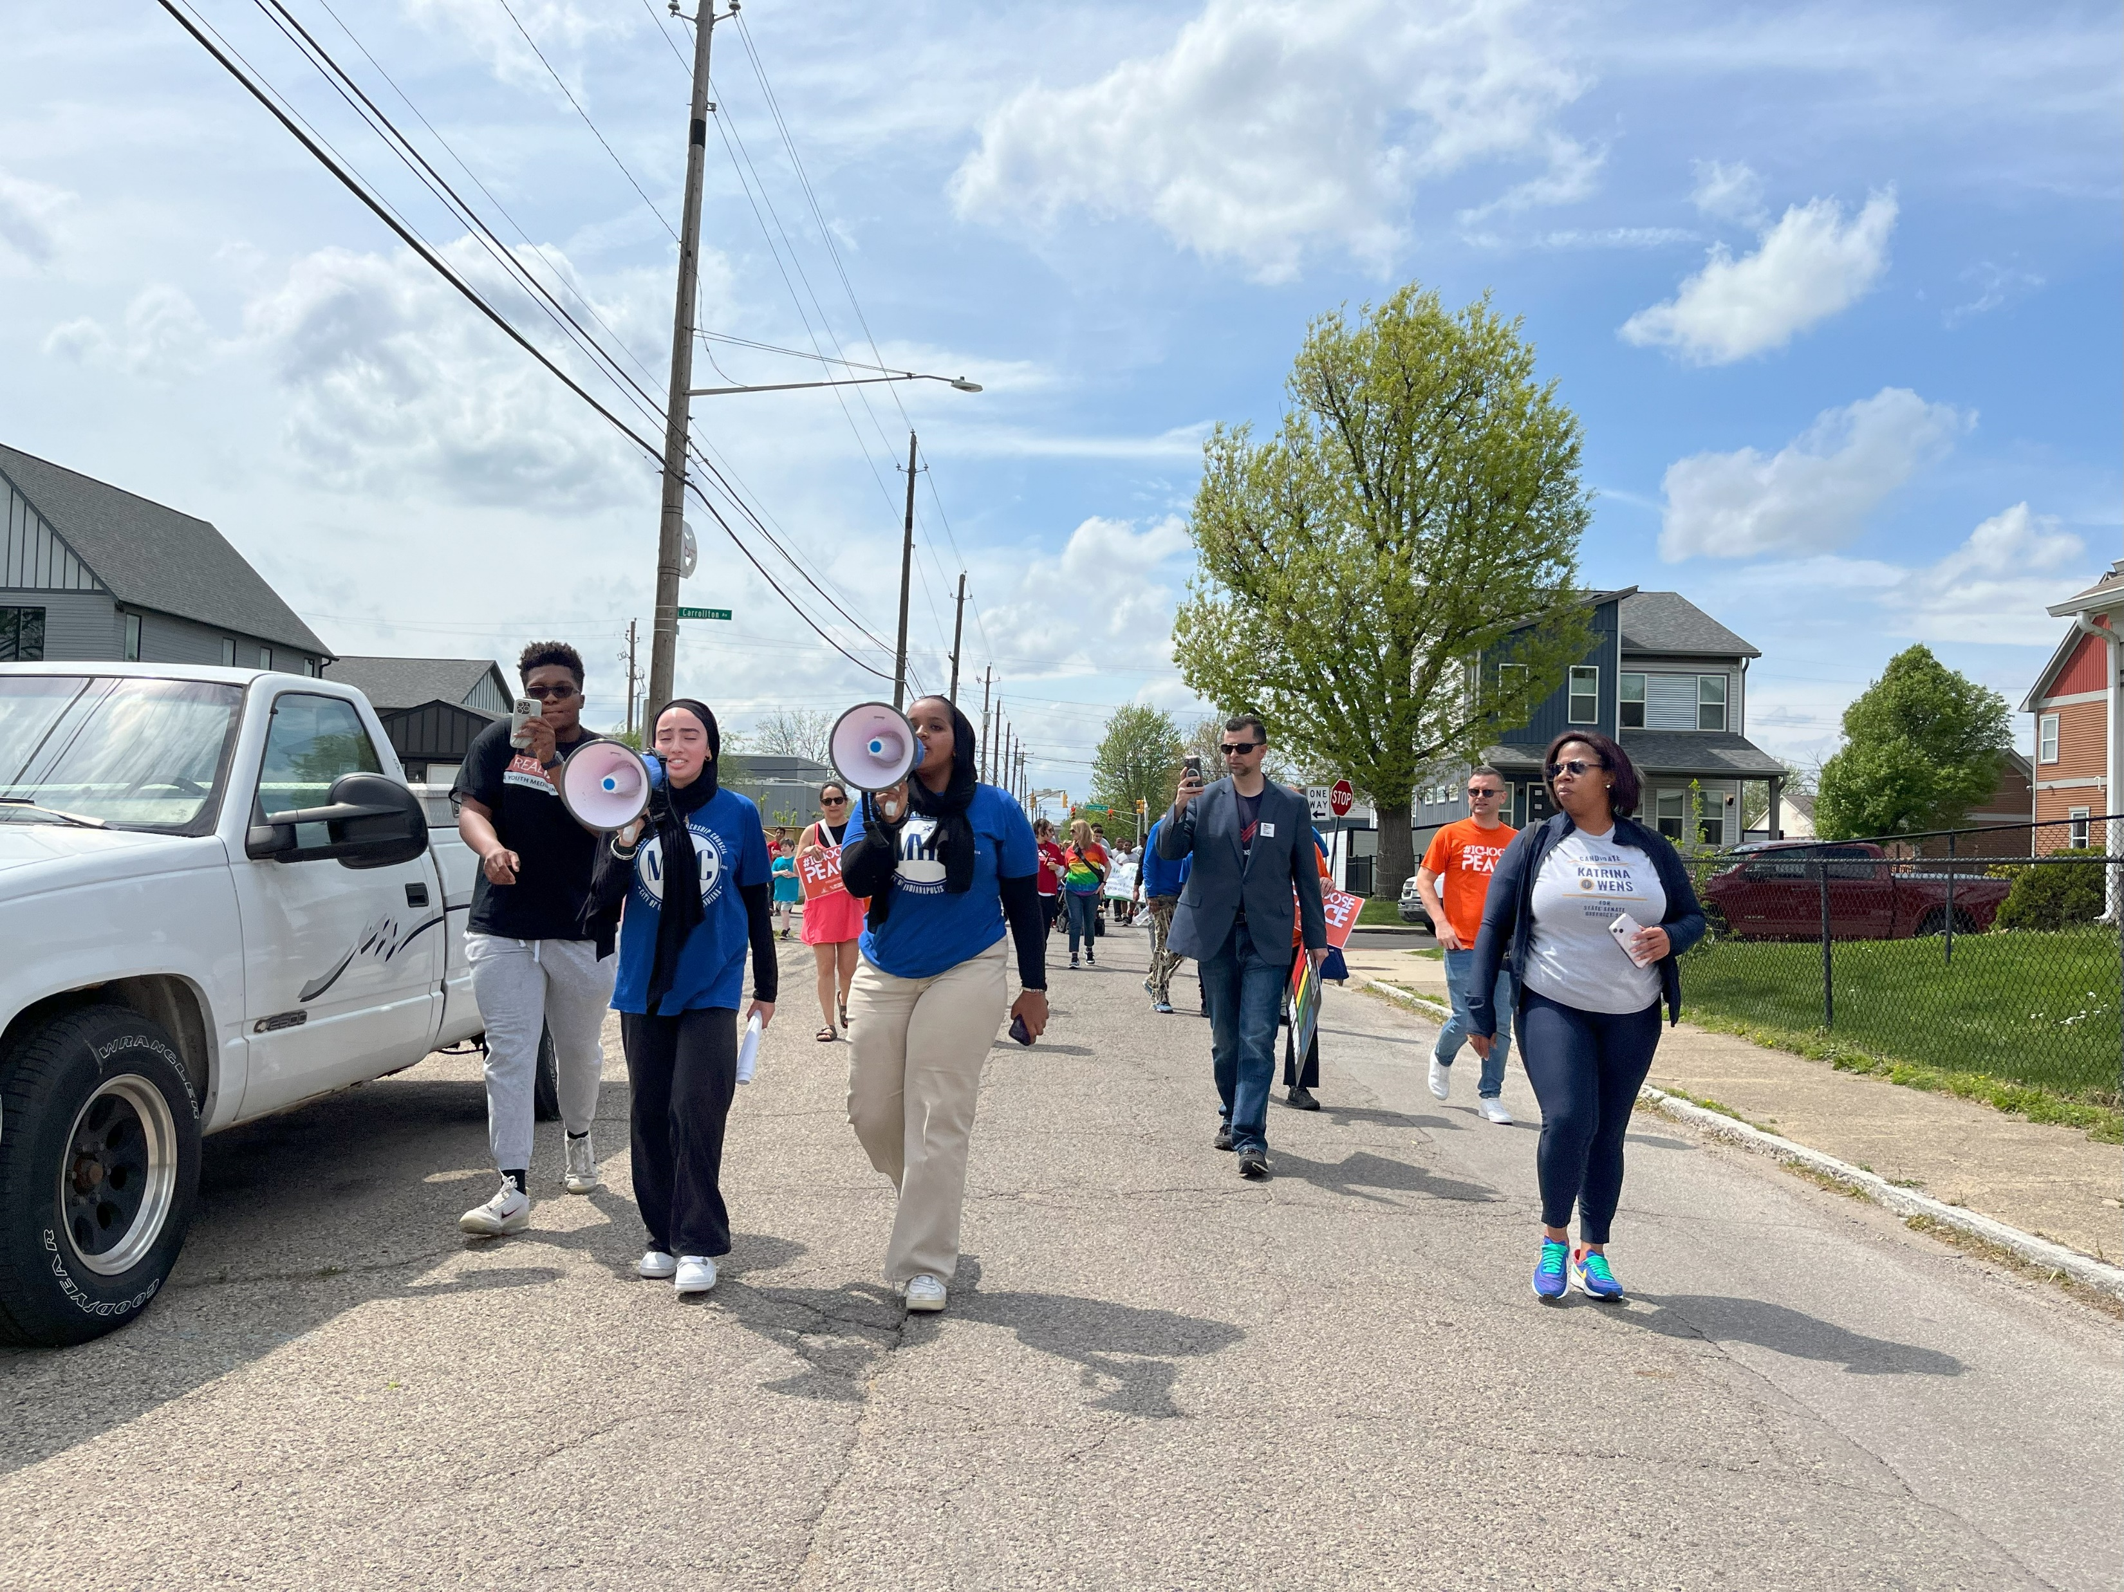
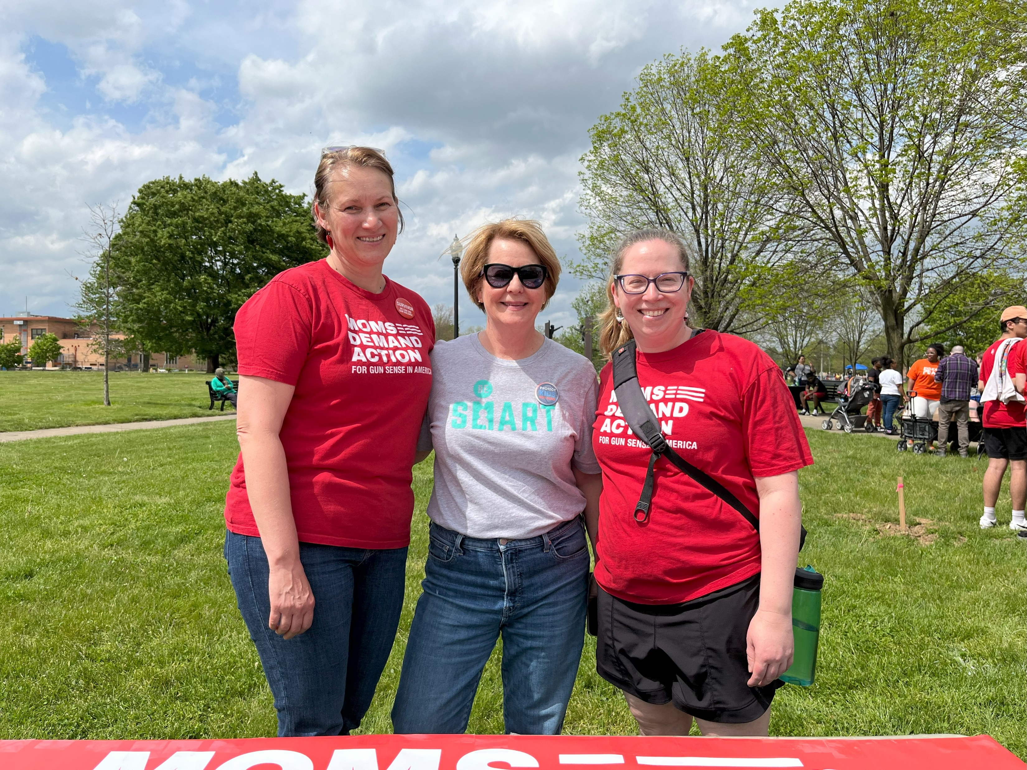
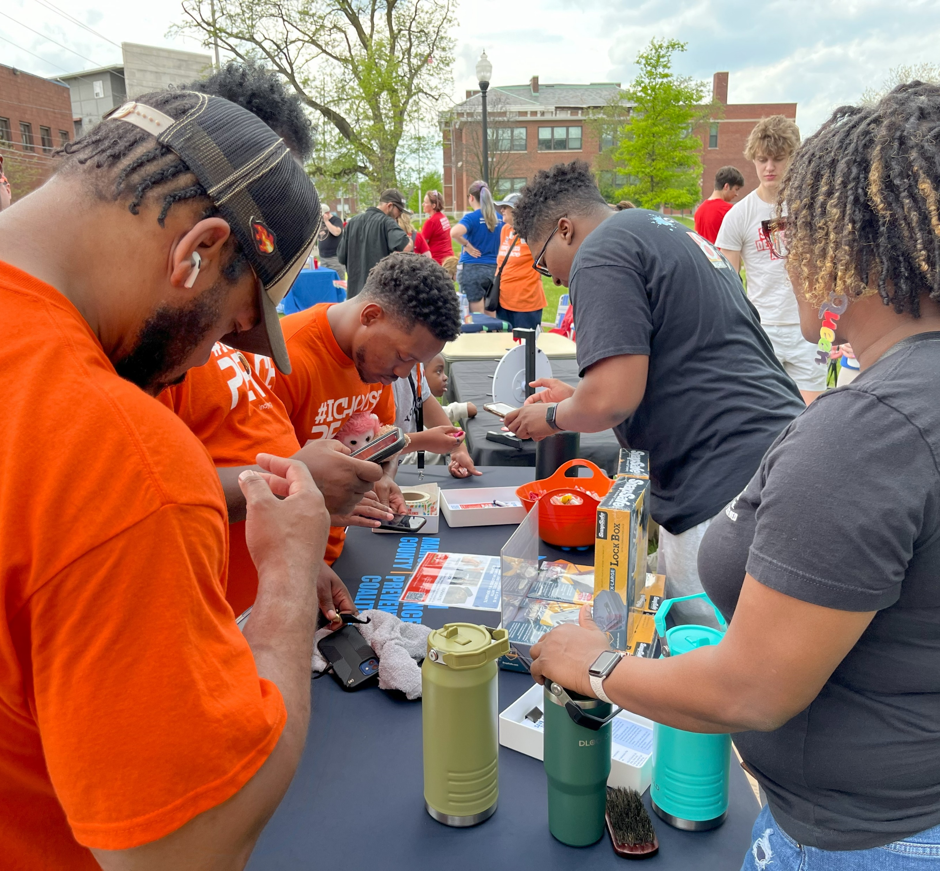
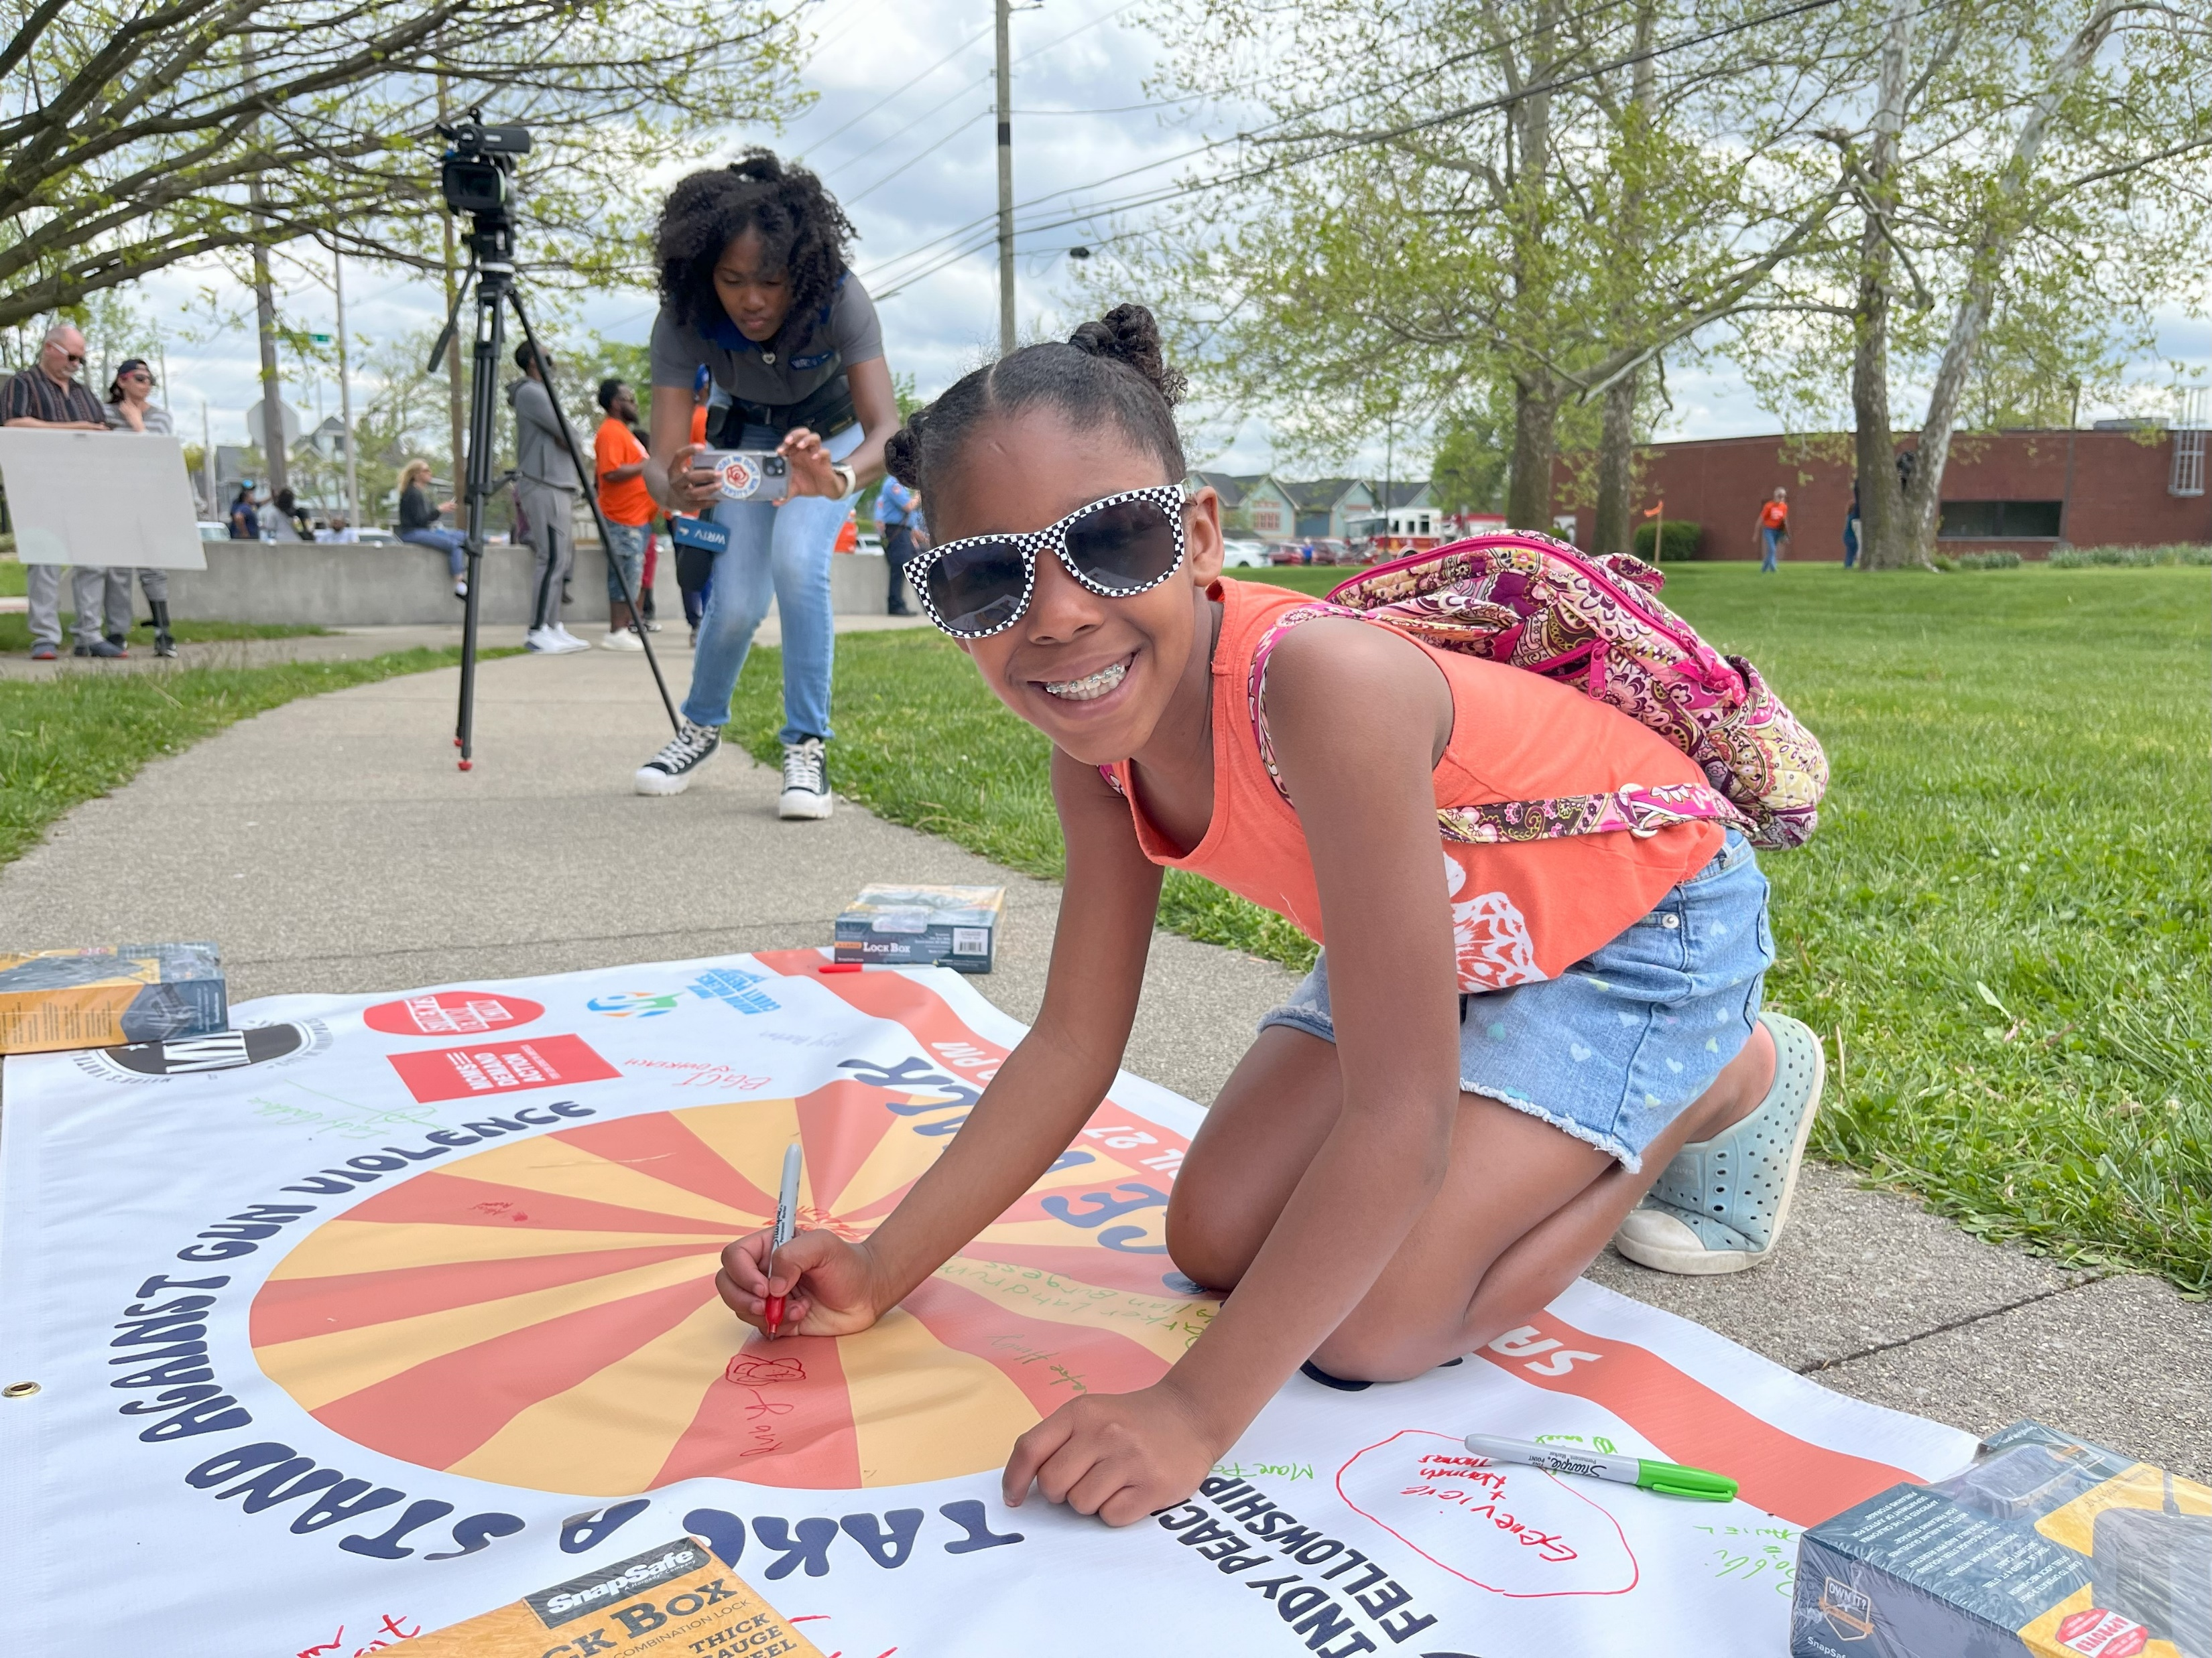
Peace Walk
We hosted a Peace Walk in honor of National Youth Violence Prevention Week with the Mayor's Youth Leadership Council, Hoosiers Concerned About Gun Violence, and others.

Slide 6
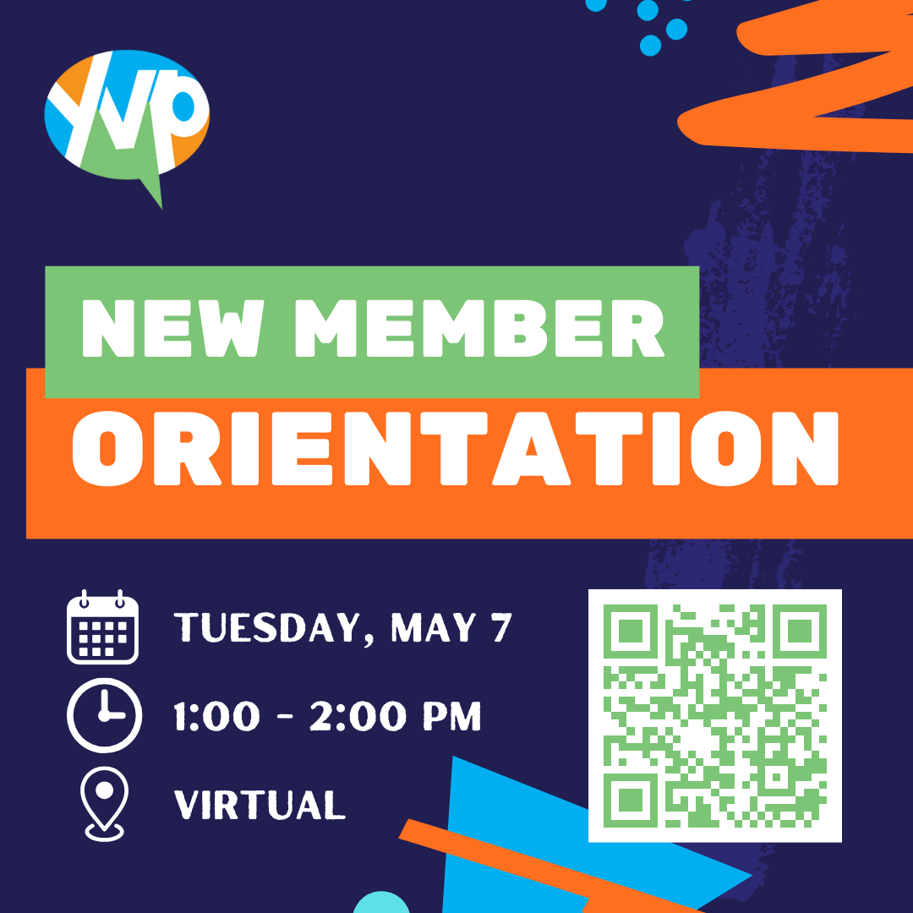
Member Orientation

Slide 7

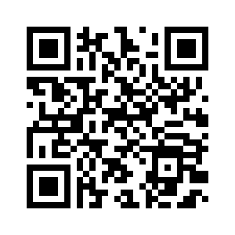
Gas Cards for Guns
We would like other organizations to be present at the event to offer more resources.

Slide 8
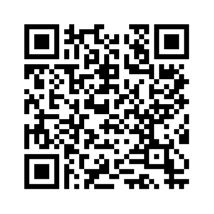

Indiana Black Expo
We were asked if we could have a booth on gun safety at Indiana Black Expo - June 28-30th.
Can you help?

Slide 9
Interns
We are hiring 21 interns (ages 16 – 25) to be paired with community partners to engage in a project relating to the mission of the Coalition.
Inner Beauty Program, Inc.
Genesys Solutions
Chin Community of Indiana
Mackida Loveal & Trip Outreach Center
VOICES Corp
We Bloom (Discovery Café)
Let Them Talk
Can We Ryde
Black & Latino Policy Institute

Slide 10
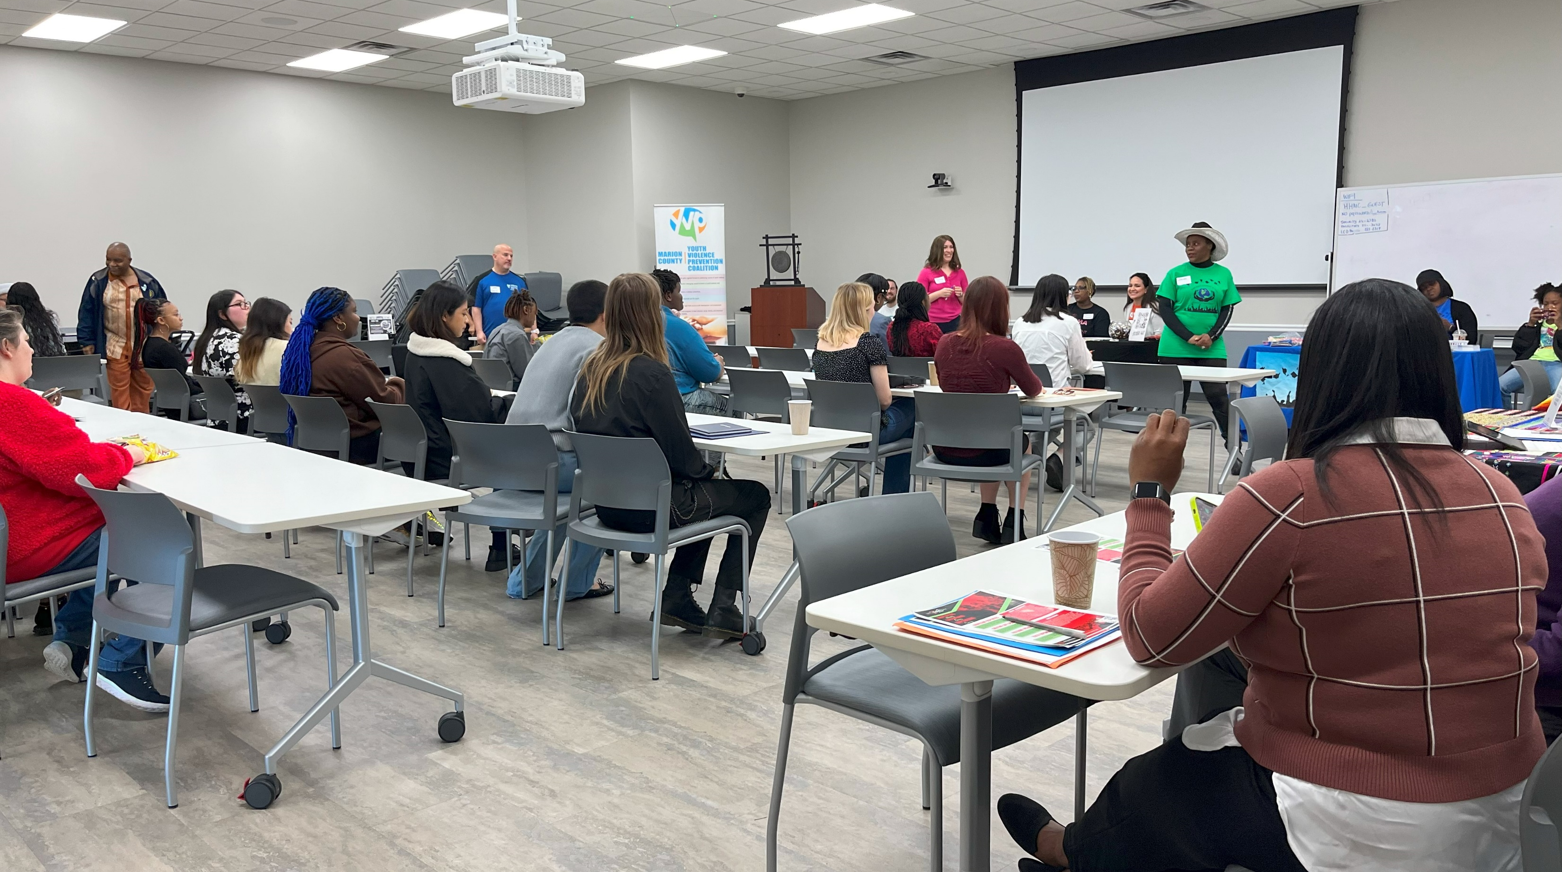
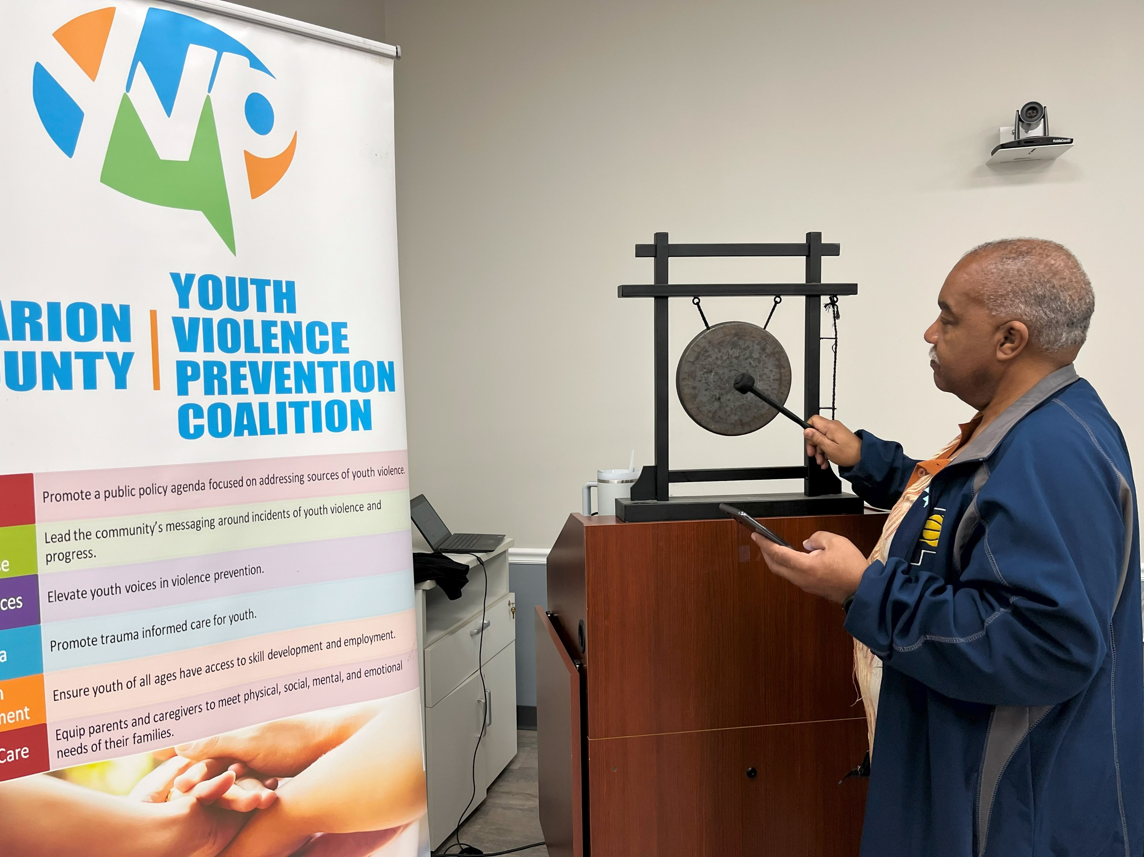
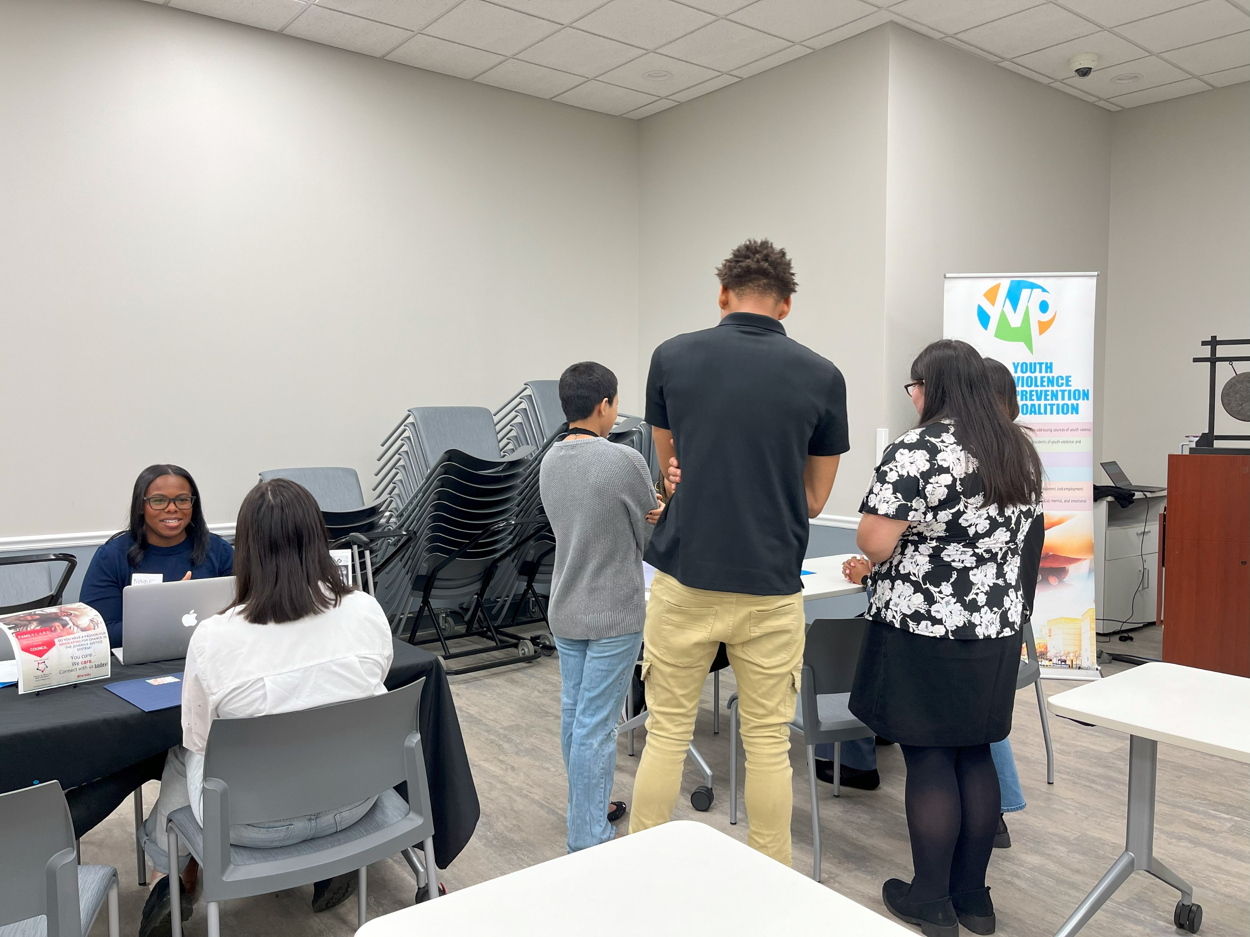
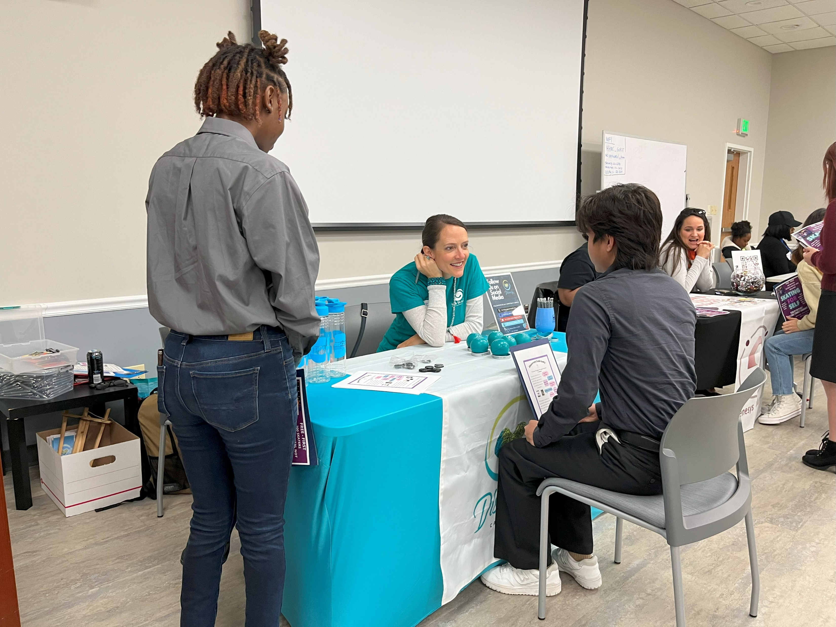
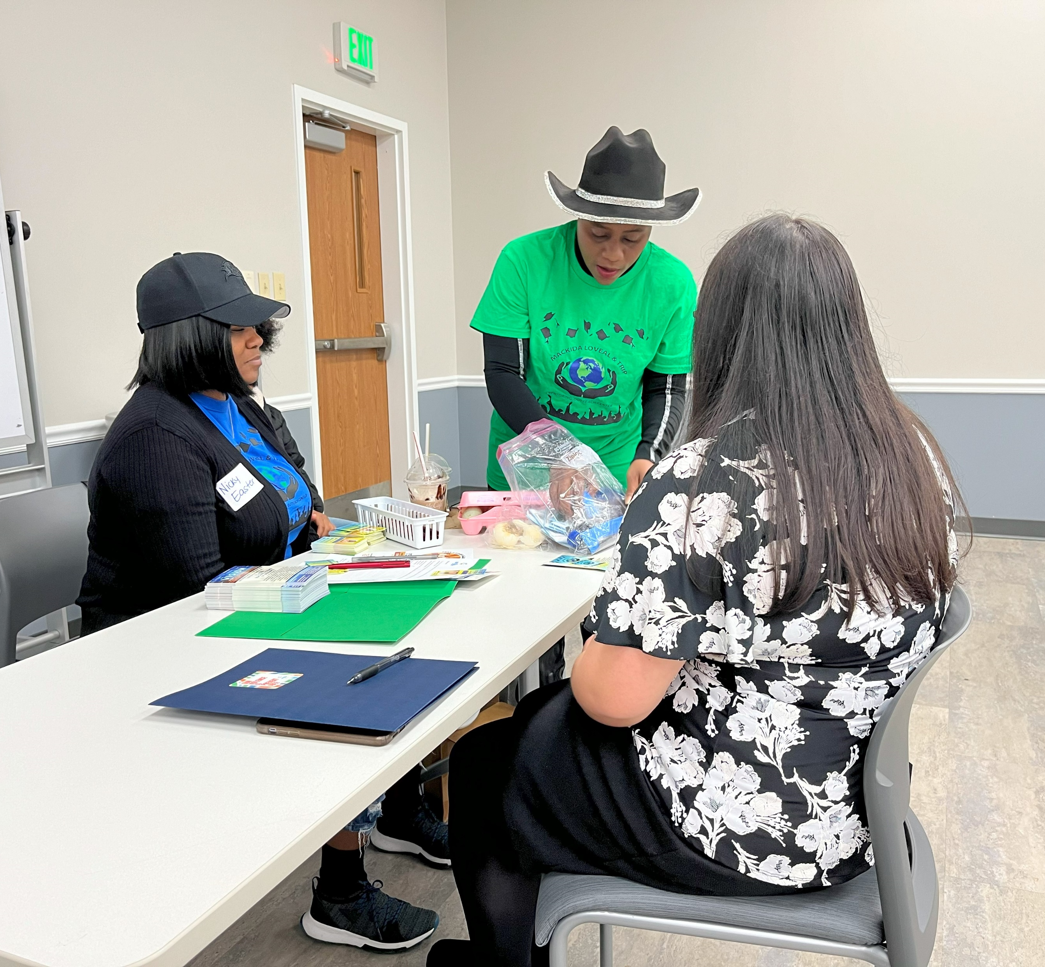
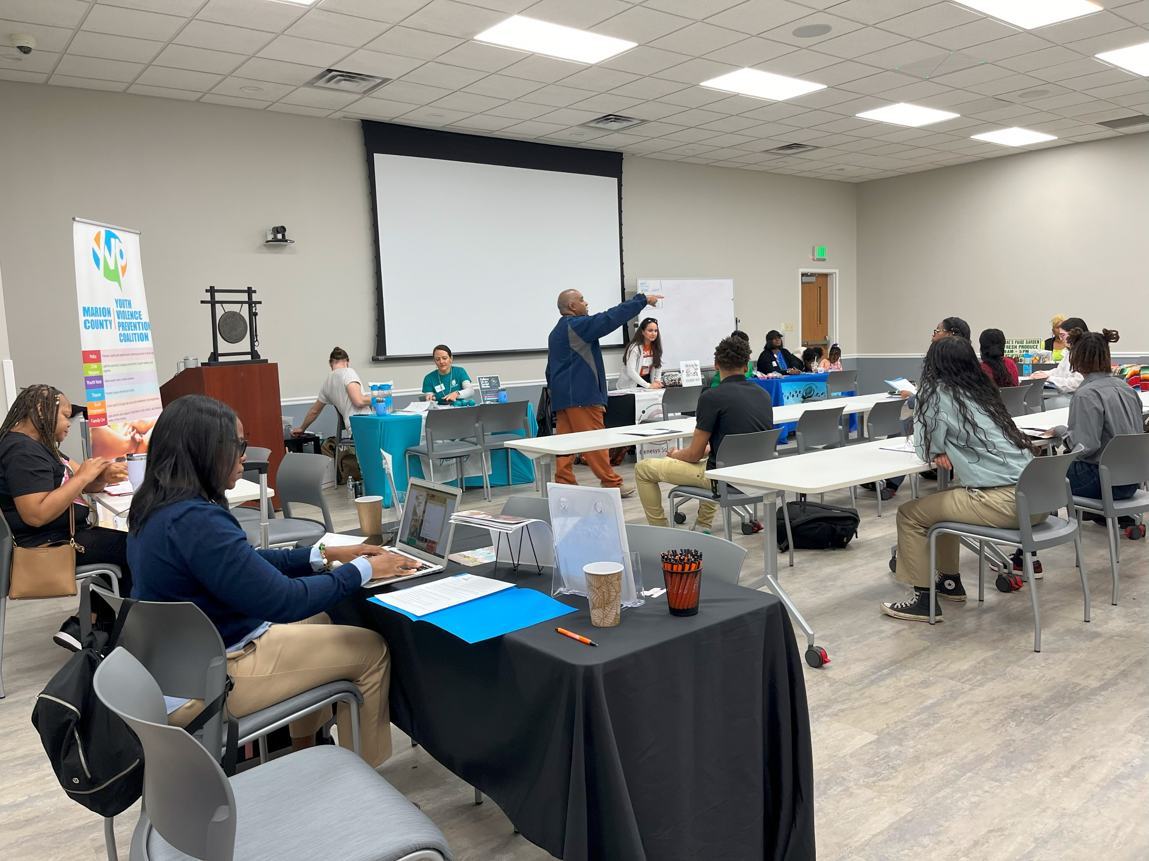
Summer 2024 Internship Interview Event

Slide 11
Speed Networking
Brief conversations with multiple people quickly
4 to a table
You have a few minutes to introduce yourself and converse with others at your table
When the time (10 minutes) is up, a buzzer sounds, and all the members except one move to a different table
You are encouraged to take notes and exchange business cards or contact information with those you are interested in connecting with further.

Slide 12
Networking: Example Questions
What does your organization do?
What is your mission?
Where is the organization located?
What hurdles is your organization currently facing?
What are potential collaboration opportunities?
What is the best way to stay in the know about your organization’s happenings?
What projects are you doing right now?

Slide 13
Task Force Break-Outs
Pick a task force to join for discussion.
Crisis Response: Lead the community's messaging around incidents of youth violence and progress
Family Care: Equip parents and caregivers to meet physical, social, mental, and emotional needs of their families
Policy: Promote a public policy agenda focused on addressing sources of youth violence
Trauma: Promote trauma informed care for youth
Youth Employment: Ensure youth of all ages have access to skill development and employment
Youth Voices: Elevate youth voices in violence prevention

Slide 14
Task Force Report-Outs
Crisis Response
Family Care
Policy
Trauma
Youth Employment
Youth Voices

Slide 15

E-mail: mcyvpc@gmail.com – “Coalition Connection”
Website: saferindy.com
Social Networks: @mcyvpc

