Slide 1
COALITION QUARTERLY MEETING
Snap the QR code to check-in

Slide 2
Mission Statement | Strategic Focus
The MCYVPC convenes community stakeholders, conducts research, provides leadership, and empowers people to create opportunities that build more peaceful homes, schools, neighborhoods, and workplaces.
The MCYVPC activates community partners to prevent youth violence in Indianapolis through 2 strategic initiatives:
Advocate for system-level change, and
Champion direct support for youth and families.

Slide 3
Steering team
Elected Co-chair: Tiffany Davis
Appointed Co-chair: Corey Davis
Member-at-Large: Brian Shobe
Crisis Response Task Force Lead: Della Brown
Family Care Task Force Lead: Damita Jefferson
Policy Task Force Lead: Tiera Howleit
Trauma Task Force Co-Leads: Beatrice Beverly, Julie Hayden
Youth Employment Task Force Lead: LaShauna Triplett
Youth Voices Task Force Co-Leads: Drew Neddo, Jake Brosius

Slide 4
Agenda
Check-in via the QR code
Welcome
MCPHD Call to Action Updates
Policy Task Force
Policy & Pizza recap
2024 Public Policy Agenda
What can you do?
Some Bills We Are Monitoring
2024-2027 Strategic Plan Voting
Panel Discussion
Task Force Break-Outs

Slide 5
Call to Action
Visit https://marionhealth.org/call-to-action/ to learn more about the efforts of the Marion County Public Health Department (MCPHD).
The MCPHD states that gun violence is a public health problem and a leading cause of premature death in the United States.
The MCPHD hosted a discussion about how we strategically approach the public health issue of youth gun violence.
Collaborative Approach / Respectful Partnership
The MCPHD is here to collaborate, not take over.
Partner to create a united front. Together, we can make a more profound impact.
The MCPHD is developing a website to centralize resources for families.
The MCPHD is actively hiring someone dedicated to focusing on combating youth gun violence in Indianapolis.

Slide 6
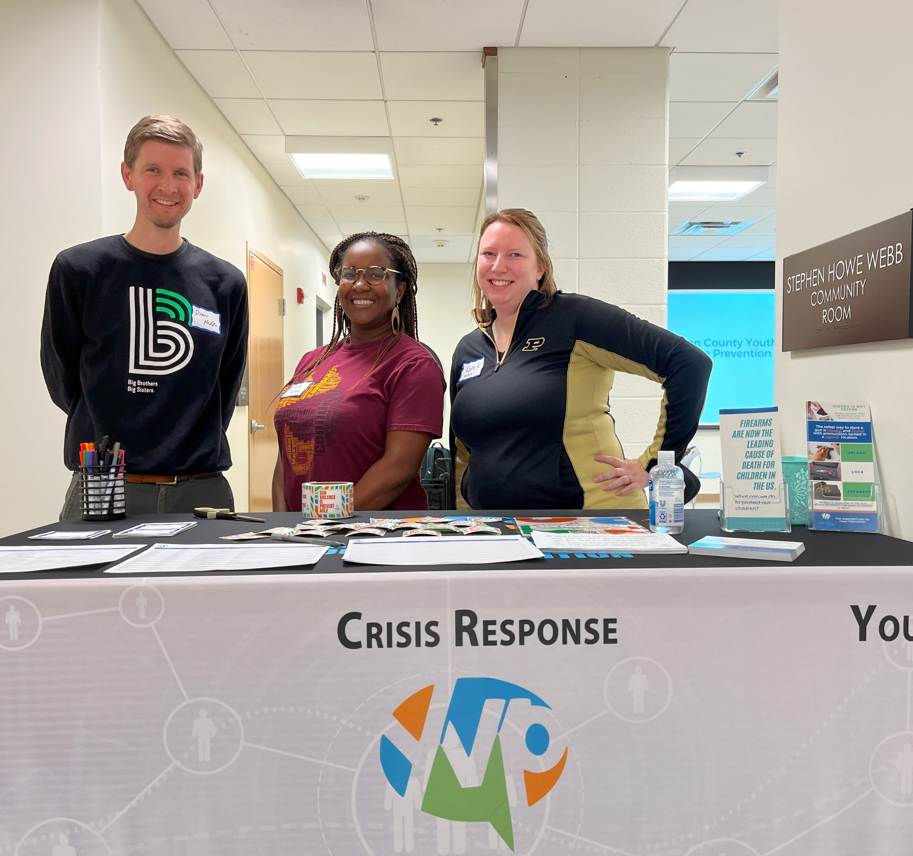
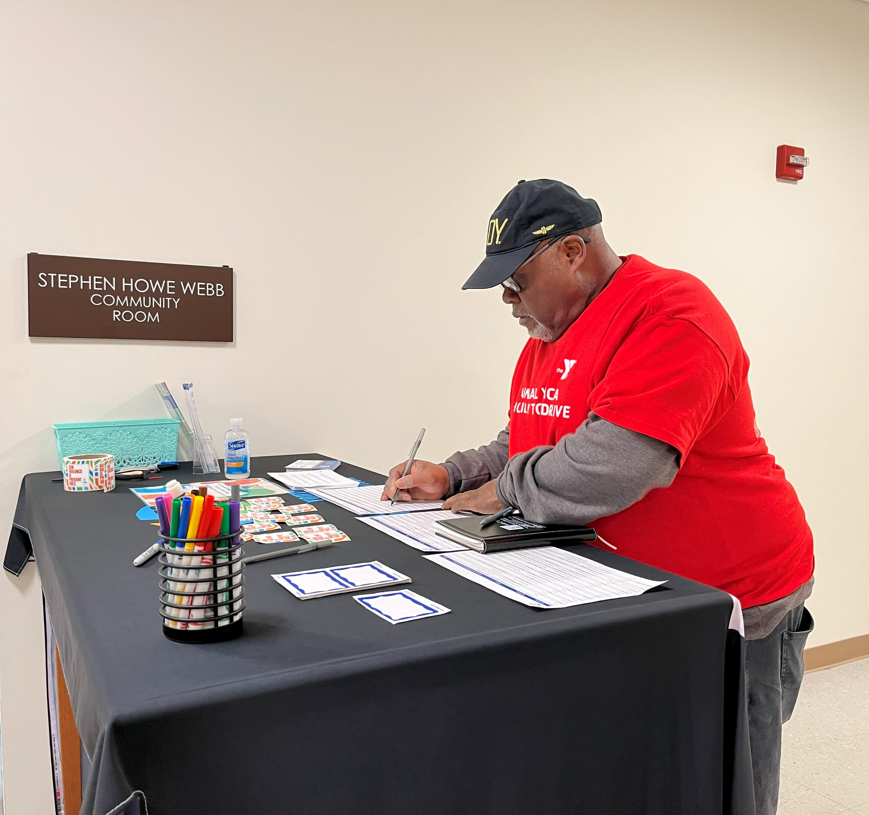
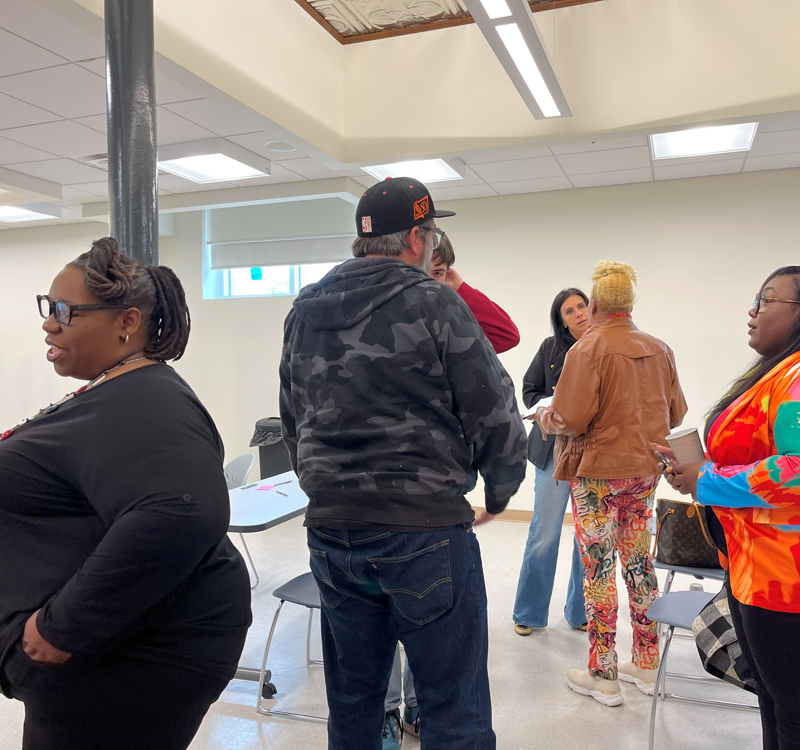
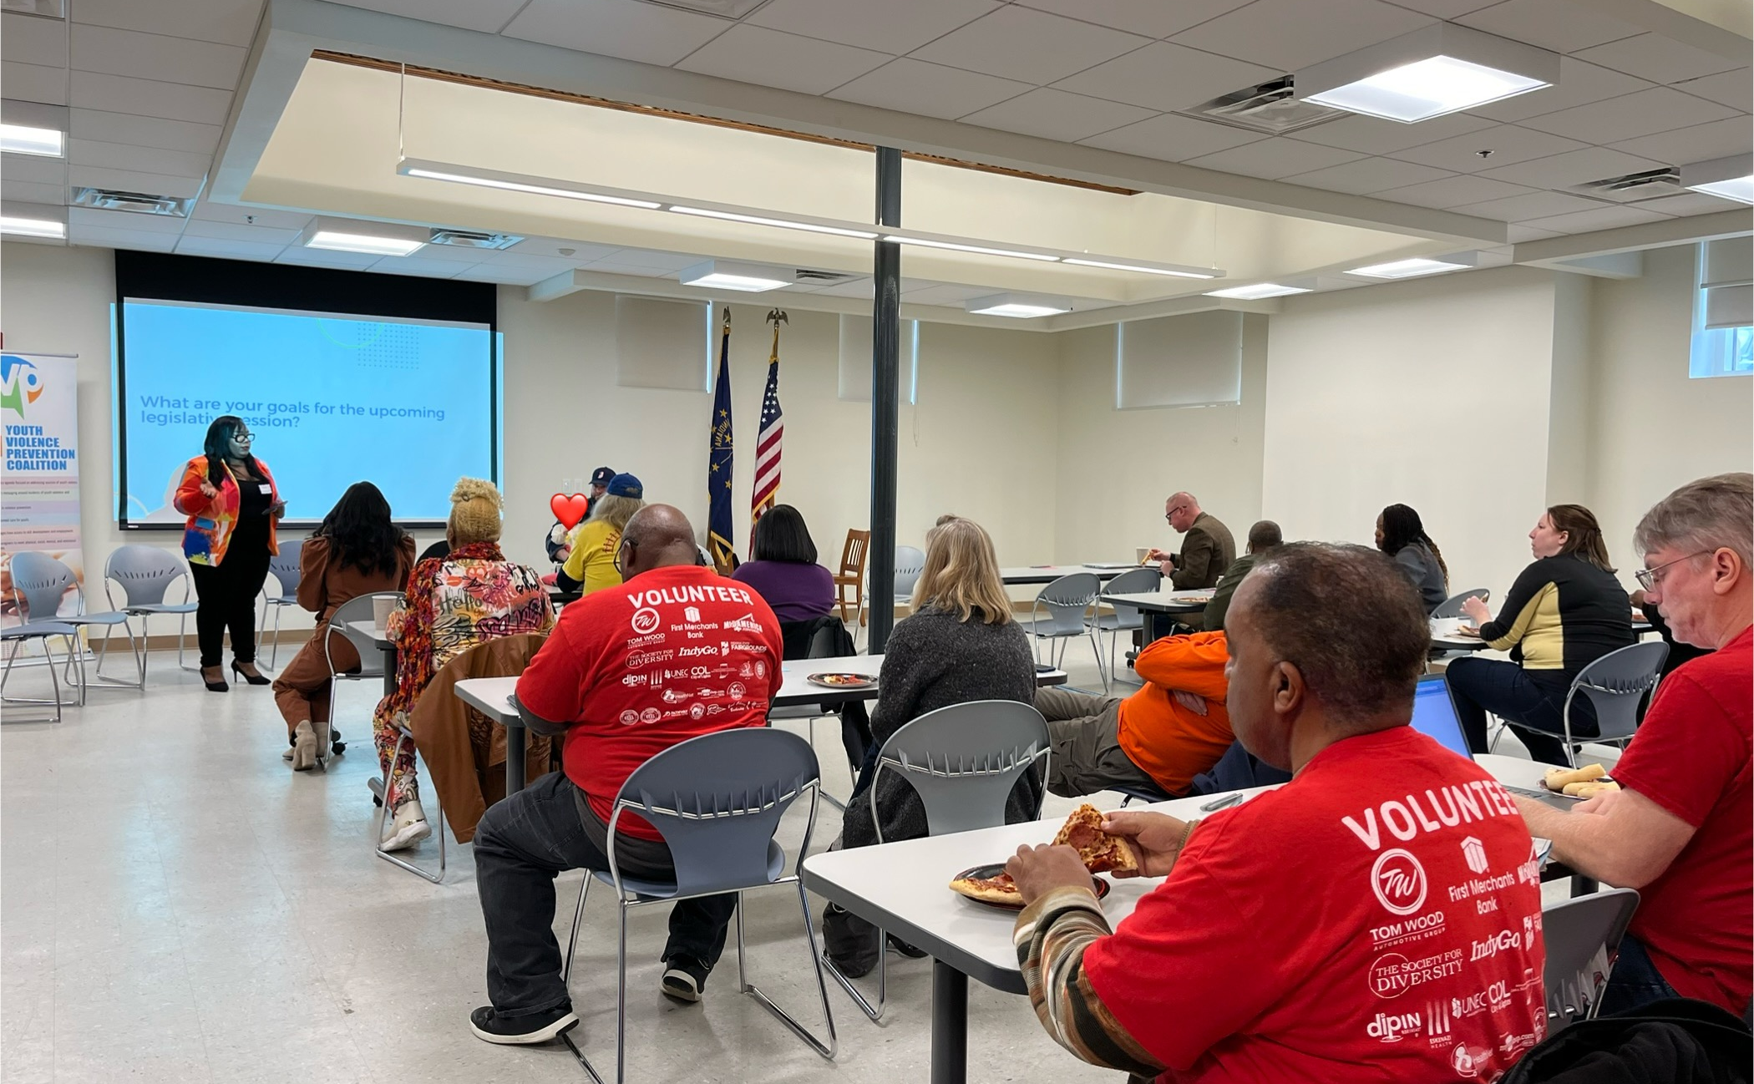
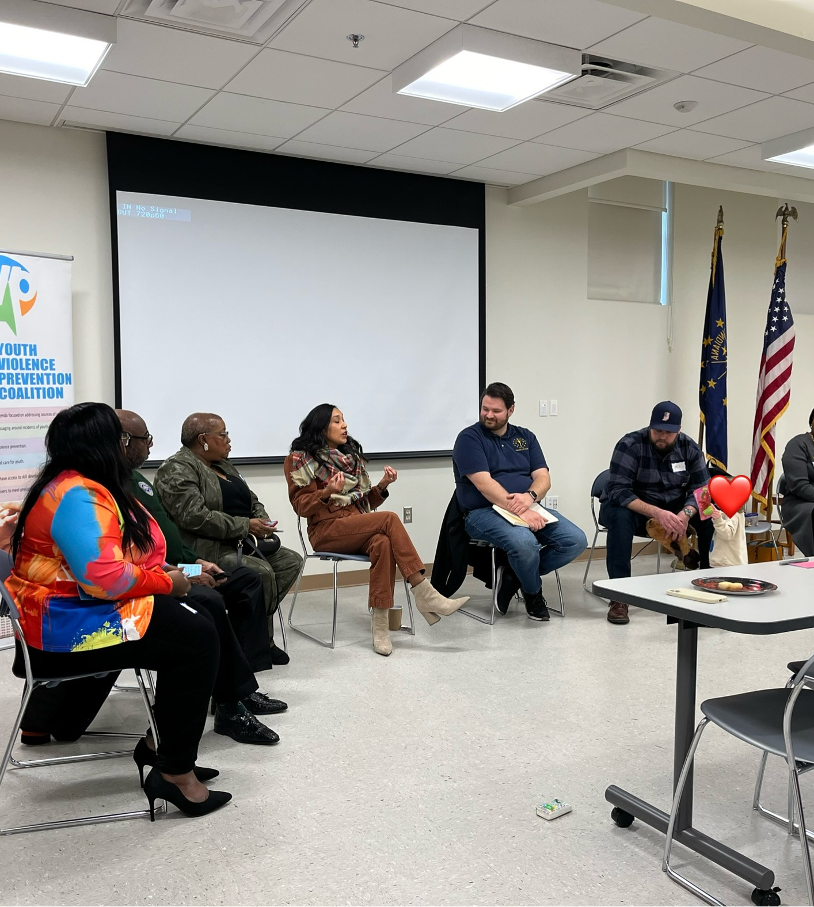
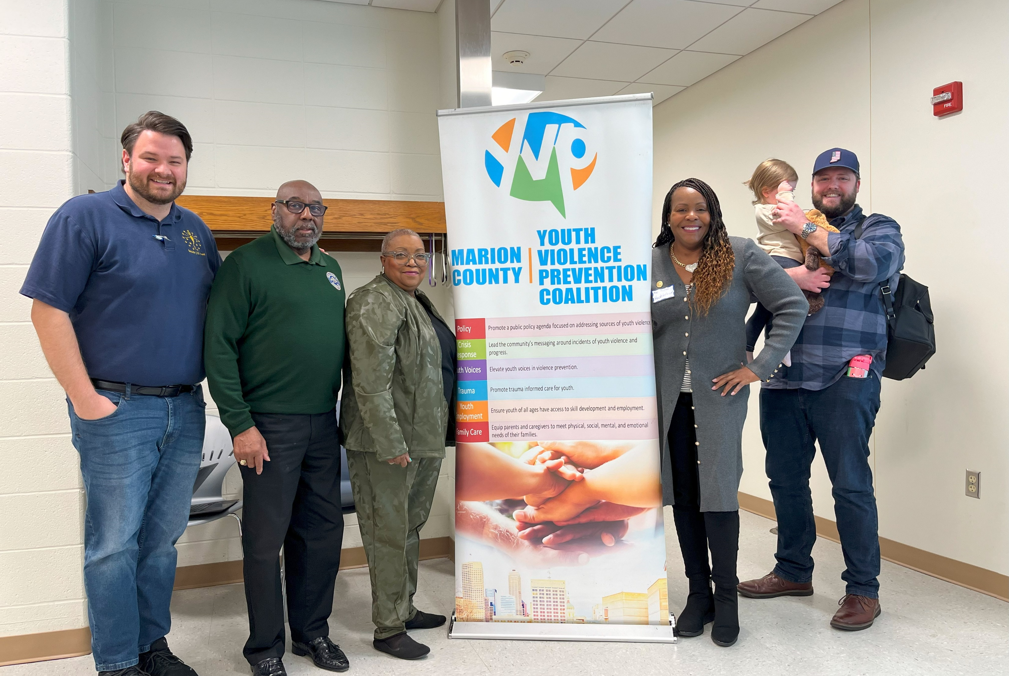
Policy & Pizza 2023

Slide 7
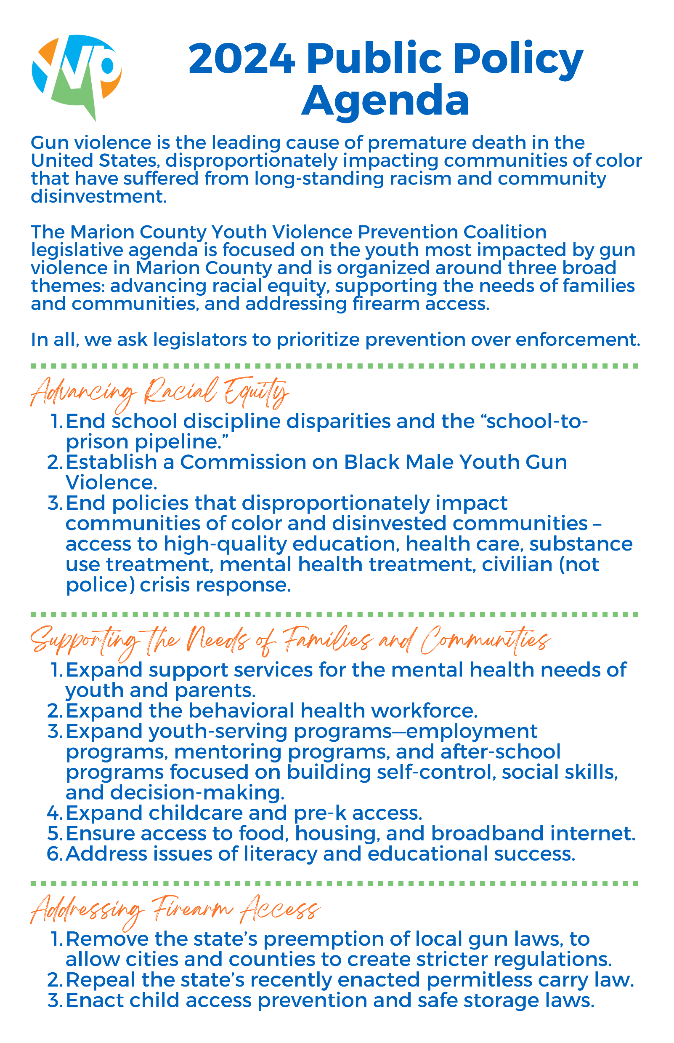
​Public Policy Agenda​

Slide 8
What can you do?
Check @MCYVPC social media to see what bills we are monitoring.
Check iga.in.gov for the latest information on bills, sessions, and legislative activities.
Reach out to your representatives to express your views on specific bills.
Attend Public Hearings and Meetings to voice your opinions directly or gather more information.
Join the policy task force.

Slide 9
Some Bills We Are Monitoring
Senate Bill 45 (Sen. Crider) - Requires an individual who holds an active license as a nurse to complete a trauma-informed care training program (program) at least once every two years.
House Bill 1044 (Rep. Errington) / Senate Bill 24 (Sen. Lonnie Randolph): Minimum age to purchase/carry a handgun to 21 years of age.
House Bill 1173 (Rep. Bauer) - Requires a school safety plan to include a plan to implement a classroom-based violence prevention program for students.
Senate Bill 1 (Sen. Rogers, Sen. Raatz, Sen. Buchanan) - Requires certain schools to offer summer school courses for students who are not reading proficiently, among other interventions to improve reading levels.

Slide 10
Youth Day at the Statehouse - Feb. 19, 2024 This is a great opportunity for young people to engage with the legislative process. Register your group at: https://secure.mccoyouth.org/a/youthdayatthestatehouse

Slide 11
2024-2027 Strategic Plan
After months of hard work and collaboration, it's time to vote and officially adopt this roadmap to a brighter future.

Slide 12
Panel Discussion
Shawn Bush, Director of Student Services at MSD of Lawrence Township
Beatrice Beverly, Senior Consultant at Genesys Solutions, LLC
Della Brown, Outreach Worker at Indy Peace
Anita Jackson, Director of Community CARE at Peace Learning Center

Slide 13
Current Initiatives / Long-Term Strategies
What measures are schools taking to proactively prevent violence?
What are the long-term goals and strategies for school-based violence prevention efforts?
Are students involved in shaping and implementing violence prevention measures? If so, how?

Slide 14
Mental Health Support / Trauma-Informed Approaches
How are schools addressing the mental health needs of students in response to incidents, as well as part of violence prevention?
Are there adequate mental health professionals in schools?
How are schools incorporating trauma-informed approaches to create safe and supportive environments?
What training or resources do educators need to implement trauma-informed practices?

Slide 15
Partnerships with Organizations
How can the community/organizations be actively involved in school-based violence prevention efforts?
Are there successful examples of partnerships that have positively impacted the school community?
How can organizations contribute to the adoption of innovative solutions in schools?

Slide 16
Task Force Break-Outs Pick a task force to join for discussion.
Crisis Response: Lead the community's messaging around incidents of youth violence and progress
Family Care: Equip parents and caregivers to meet physical, social, mental, and emotional needs of their families
Policy: Promote a public policy agenda focused on addressing sources of youth violence
Trauma: Promote trauma informed care for youth
Youth Employment: Ensure youth of all ages have access to skill development and employment
Youth Voices: Elevate youth voices in violence prevention

Slide 17
E-mail: mcyvpc@gmail.com – “Coalition Connection”
Website: saferindy.com
Social Networks: @mcyvpc

