Slide 1
New Member Orientation
Marion County Youth Violence Prevention Coalition
2024

Slide 2
Mission Statement | Strategic Focus
The MCYVPC convenes community stakeholders, conducts research, provides leadership, and empowers people to create opportunities that build more peaceful homes, schools, neighborhoods, and workplaces.
The MCYVPC activates community partners to prevent youth violence in Indianapolis through 2 strategic initiatives:
Advocate for system-level change, and
Champion direct support for youth and families.

Slide 3
Agenda
Welcome and Introductions
History of the MCYVPC
Coalition Bylaws – Hyper-overview
Coalition Strategic Plan – Current Goals
Member Expectations
Member Benefits
2024 Coalition Meeting Dates
Q & A

Slide 4
Who Is This Class For?
New and Current Members who have recently signed the Coalition’s Membership Agreement Form
Interested community members and/or organizations who have not yet joined the Coalition
Current Coalition members who have not yet signed the Membership Agreement Form and wish to learn more

Slide 5
Welcome and Introductions
Notes:
Have attendees introduce themselves and then go to the Steering Committee slide to present who those individuals are

Slide 7
History of the MCYVPC

Slide 8
Significant Historical Accounts
2015 Coalition founded – Marion County Public Health Department (Federal Grant)
Mission of the Coalition has never changed
Meetings were monthly with informal workgroups (relatively small)
Primary outcomes: networking and events sharing, informational meetings, annual anti-bullying poster contest in schools
2019: CICF enacted a requirement for its violence reduction grantees to join the MCYVPC
Membership grew overnight (over 60 organizations), but no description of what membership was, nor what the goals of the Coalition were
2020: Strategic Plan and Bylaws created – Enacted the first multi-disciplinary Steering Committee and provided a roadmap for the Coalition

Slide 9
Significant Historical Accounts Cont.
2021: CICF Capacity Building Grant - $25,000
2022: CICF Elevation Grant Program Round 2 – $95,454
Designated Marion County Commission on Youth (MCCOY) as fiscal agent
Hired a Coalition Coordinator
2023: MHAI Vitality Grant – $89,700 (Sept ’23 - August ‘24)
2023: CICF Elevation Grant Program Round 4 - $125,000 (Nov ‘23 – Oct ‘24)
Strategic Plan updated for 2024-2027 (approved January 2024)
Coalition Bylaws updated for 2024 (approved March 2024)

Slide 10
Coalition Bylaws

Slide 11
Articles
Name of the Coalition
Mission of the Coalition
Goals of the Coalition
Membership
Structure of the Coalition
Meetings of the General Coalition
Steering Committee
Task Forces
Coalition Procedures
Amending Bylaws
Notes:
Highlight:
Article 4: General membership in the Coalition shall consist of any community member or organization who adheres to the Coalition’s mission and is further defined as an “active member” or a “supporting member”. Only active members will be able to vote on Coalition-related business requiring a vote.
Article 5, Section 5.01: General Coalition Membership attends meetings of the General Coalition, participates in task force duties, and adheres to the Coalition’s mission
Article 5, Section 5.03: Task forces will be made up of an elected leader, a vice-leader, and volunteers from the General membership. They shall align their goals and action items to the approved strategic plan and collaborate internally and externally to do the work
Article 6, Section 6.01: The Steering Committee determines how often the Coalition meets. In 2024, we will be meeting bi-monthly. Three meetings will focus on Task Forces and three meetings will focus on overall collaboration and Coalition operations
Article 7, Section 7.03: We encourage members to take on leadership roles within the Coalition. Self-nominations will be accepted and one must be an active member to be on the Steering Committee to be nominated (2-year terms).

Slide 12
Coalition Strategic Plan

Slide 13
Operational Plan: To ensure the success of the strategic initiatives included in this plan, the Coalition recognizes the importance of adopting the following operational practices.
Communication of clear roles and responsibilities for all members
Update and adopt formal bylaws and strategic planning documentation clearly articulating the purpose and practices of the Coalition, the steering committee, and each task force (Policy, Crisis Response, Youth Voices, Trauma, Youth Employment, and Family Care)
Publish the bylaws and strategic plan in such a manner that each member and the community have easy access to them
Inclusive membership
Create an easily accessible Coalition member directory that is updated annually
Proactively engage and re-engage organizations that have been involved in the Coalition over time, inviting their active participation in task forces aligned with their work and communicating expectations for membership
Provide opportunities, and incentives where available and applicable, for youth and families (the community) to engage with the Coalition
Integrated systems and collaboration
Continue to structure Coalition meetings to focus on task forces and members sharing opportunities, challenges, and progress related to strategic initiatives
Provide central, easily accessible forums (in-person and/or online) where organizations working in this space can share and access resources, best practices, trainings, information about events, etc.
Leverage available Coalition funding to support youth violence prevention initiatives that meet the strategic goals of both the Coalition and its member organizations
Link Coalition members, task force efforts, and the community based on expressed needs

Slide 14
1A. Policy Promote a public policy position focused on addressing sources of youth violence
Objectives:
Provide opportunities to educate coalition members and the community on a) the legislative process, including how to connect with local government, and b) the coalition’s public policy agenda.
Connect directly with each coalition task force and with city and state systems leaders (such as City-County Council, state legislators, law enforcement, healthcare, education, and the Office of Public Health and Safety) to share the coalition’s public policy positions and identify opportunities for short- and long-term legislative advocacy.
Monitor City-County Council proposals and bills introduced in the Indiana General Assembly, considering each Task Force and the Coalition’s full strategic plan, to identify opportunities for advocacy (such as testifying before a committee).

Slide 15
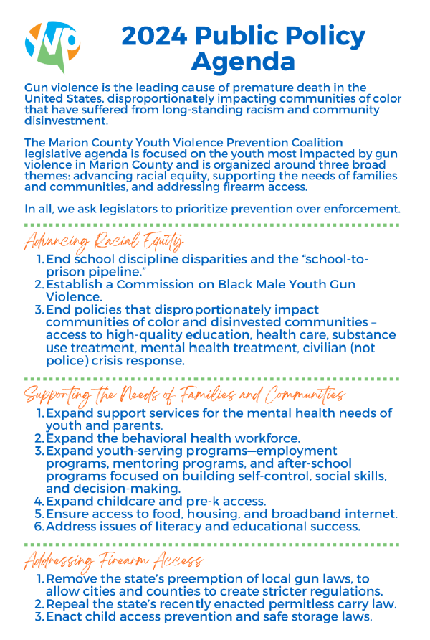

Slide 16
1B. Crisis Response Lead the community’s messaging around youth violence and progress
Objectives:
Connect organizations that provide crisis intervention and response to facilitate networking, collective impact, and improved support for families.
Gather direct accounts of the lived experiences of youth and families impacted by violence. Promote comprehensive and trauma-informed storytelling with coalition members and community stakeholders, including media outlets.
Gather and share community-level data around both violent injuries/deaths, but also delinquent behavior, social determinants of health needs, and barriers that families experience before, during, and after a crisis.

Slide 17
1C. Youth Voices Elevate youth voices in violence prevention
Objectives:
Engage youth ambassadors, affiliated with member organizations, to empower these young people as leaders in their communities. Working within the coalition’s network of organizations and resources to provide them with access to tools, education, and employment opportunities.
Focus on existing youth spaces (schools, community-based programs, churches, skating rinks, parks, sporting events, etc.) to receive youth voice.
Identify and share best practices to engage and empower youth voice.

Slide 18
2A. Trauma Promote trauma-informed care for youth
Objectives:
Provide all coalition members, including youth, with clear training and resources (in-person and online) on trauma-informed care, diversity and inclusion, culturally competent care, and racial bias/implicit bias.
Organize or endorse member-led trauma-informed education for educators, school administrators, youth employment and skill development program staff, families, and other young workers.
Create a youth advisory board to review and edit content for coalition-based and youth-focused social media. Educate youth on existing teen apps, resources, and opportunities around trauma.
Identify and address opportunities to provide direct trauma care to youth before they ever have to interact with the juvenile justice system.

Slide 19
2B. Youth Employment Ensure youth have access to skill development and employment
Objectives:
Identify and address existing barriers preventing youth from gaining employment opportunities.
Identify organizations that are actively seeking and employing youth. Provide a list for coalition members and assist in creating connections between coalition members and youth.
Take advantage of existing youth spaces and gatherings (schools, churches, service providing organizations, skating rinks and parks, sports gatherings, etc.) to link youth with meaningful training and employment opportunities.
Create synergy between youth-hiring agencies in an effort to be the place organizations can go to when they have youth opportunities and need support.

Slide 20
2C. Family Care Ensure parents and caregivers have access to the resources they need to meet the physical, social, mental, and emotional needs of their families
Objectives:
Collect and share direct feedback (with both coalition member organizations and the community itself) from community members/families of ways in which we can effectively meet their continued needs.
Create or identify a system (i.e., community calendar, Facebook group) that will effectively connect member organizations together to share events and services, then identify ways to share that information with the community (i.e. mailed newsletters, electronic app).
Encourage and empower community members/families to get involved in prevention-focused programs and initiatives by addressing barriers and uncertainties.

Slide 21
Member Expectations
Notes:
New Member Agreement Form

Slide 22
Active Member (Per the Bylaws)
An Active Member shall be a General Member that has been:
Represented at two of the previous four (50%) convened General Coalition meetings,
Has signed the Coalition Membership Agreement Form, and
Shall have voting power in General Coalition meetings.

Slide 23
Additional Member Expectations (includes but is not limited to…)
Maintain active involvement in one or more Task Forces,
Promote the Coalition in the community and seek out new members to join,
Contribute to Strategic Planning process, and
Provide leadership in the prevention of youth violence in Marion County.

Slide 24
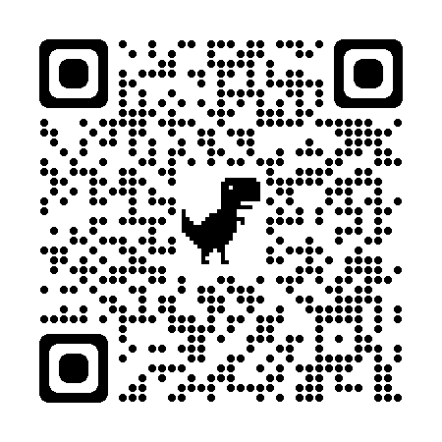
Membership Agreement Form
http://www.saferindy.com/MCYVPC/join-the-coalition/
Notes:
The presenter should pull up the membership agreement form and skim through it, highlighting the Responsibilities of the Parties section.

Slide 25
Member Benefits

Slide 26
Collaboration and strength building
Notes:
Networking during meetings
Peace Walk with other coalitions/organizations
Advocacy-related sign-on letters during legislative session
Etc.

Slide 27
Community Engagement and Education
Notes:
Briefly describe lock box distribution, fuel cards for guns event

Slide 28
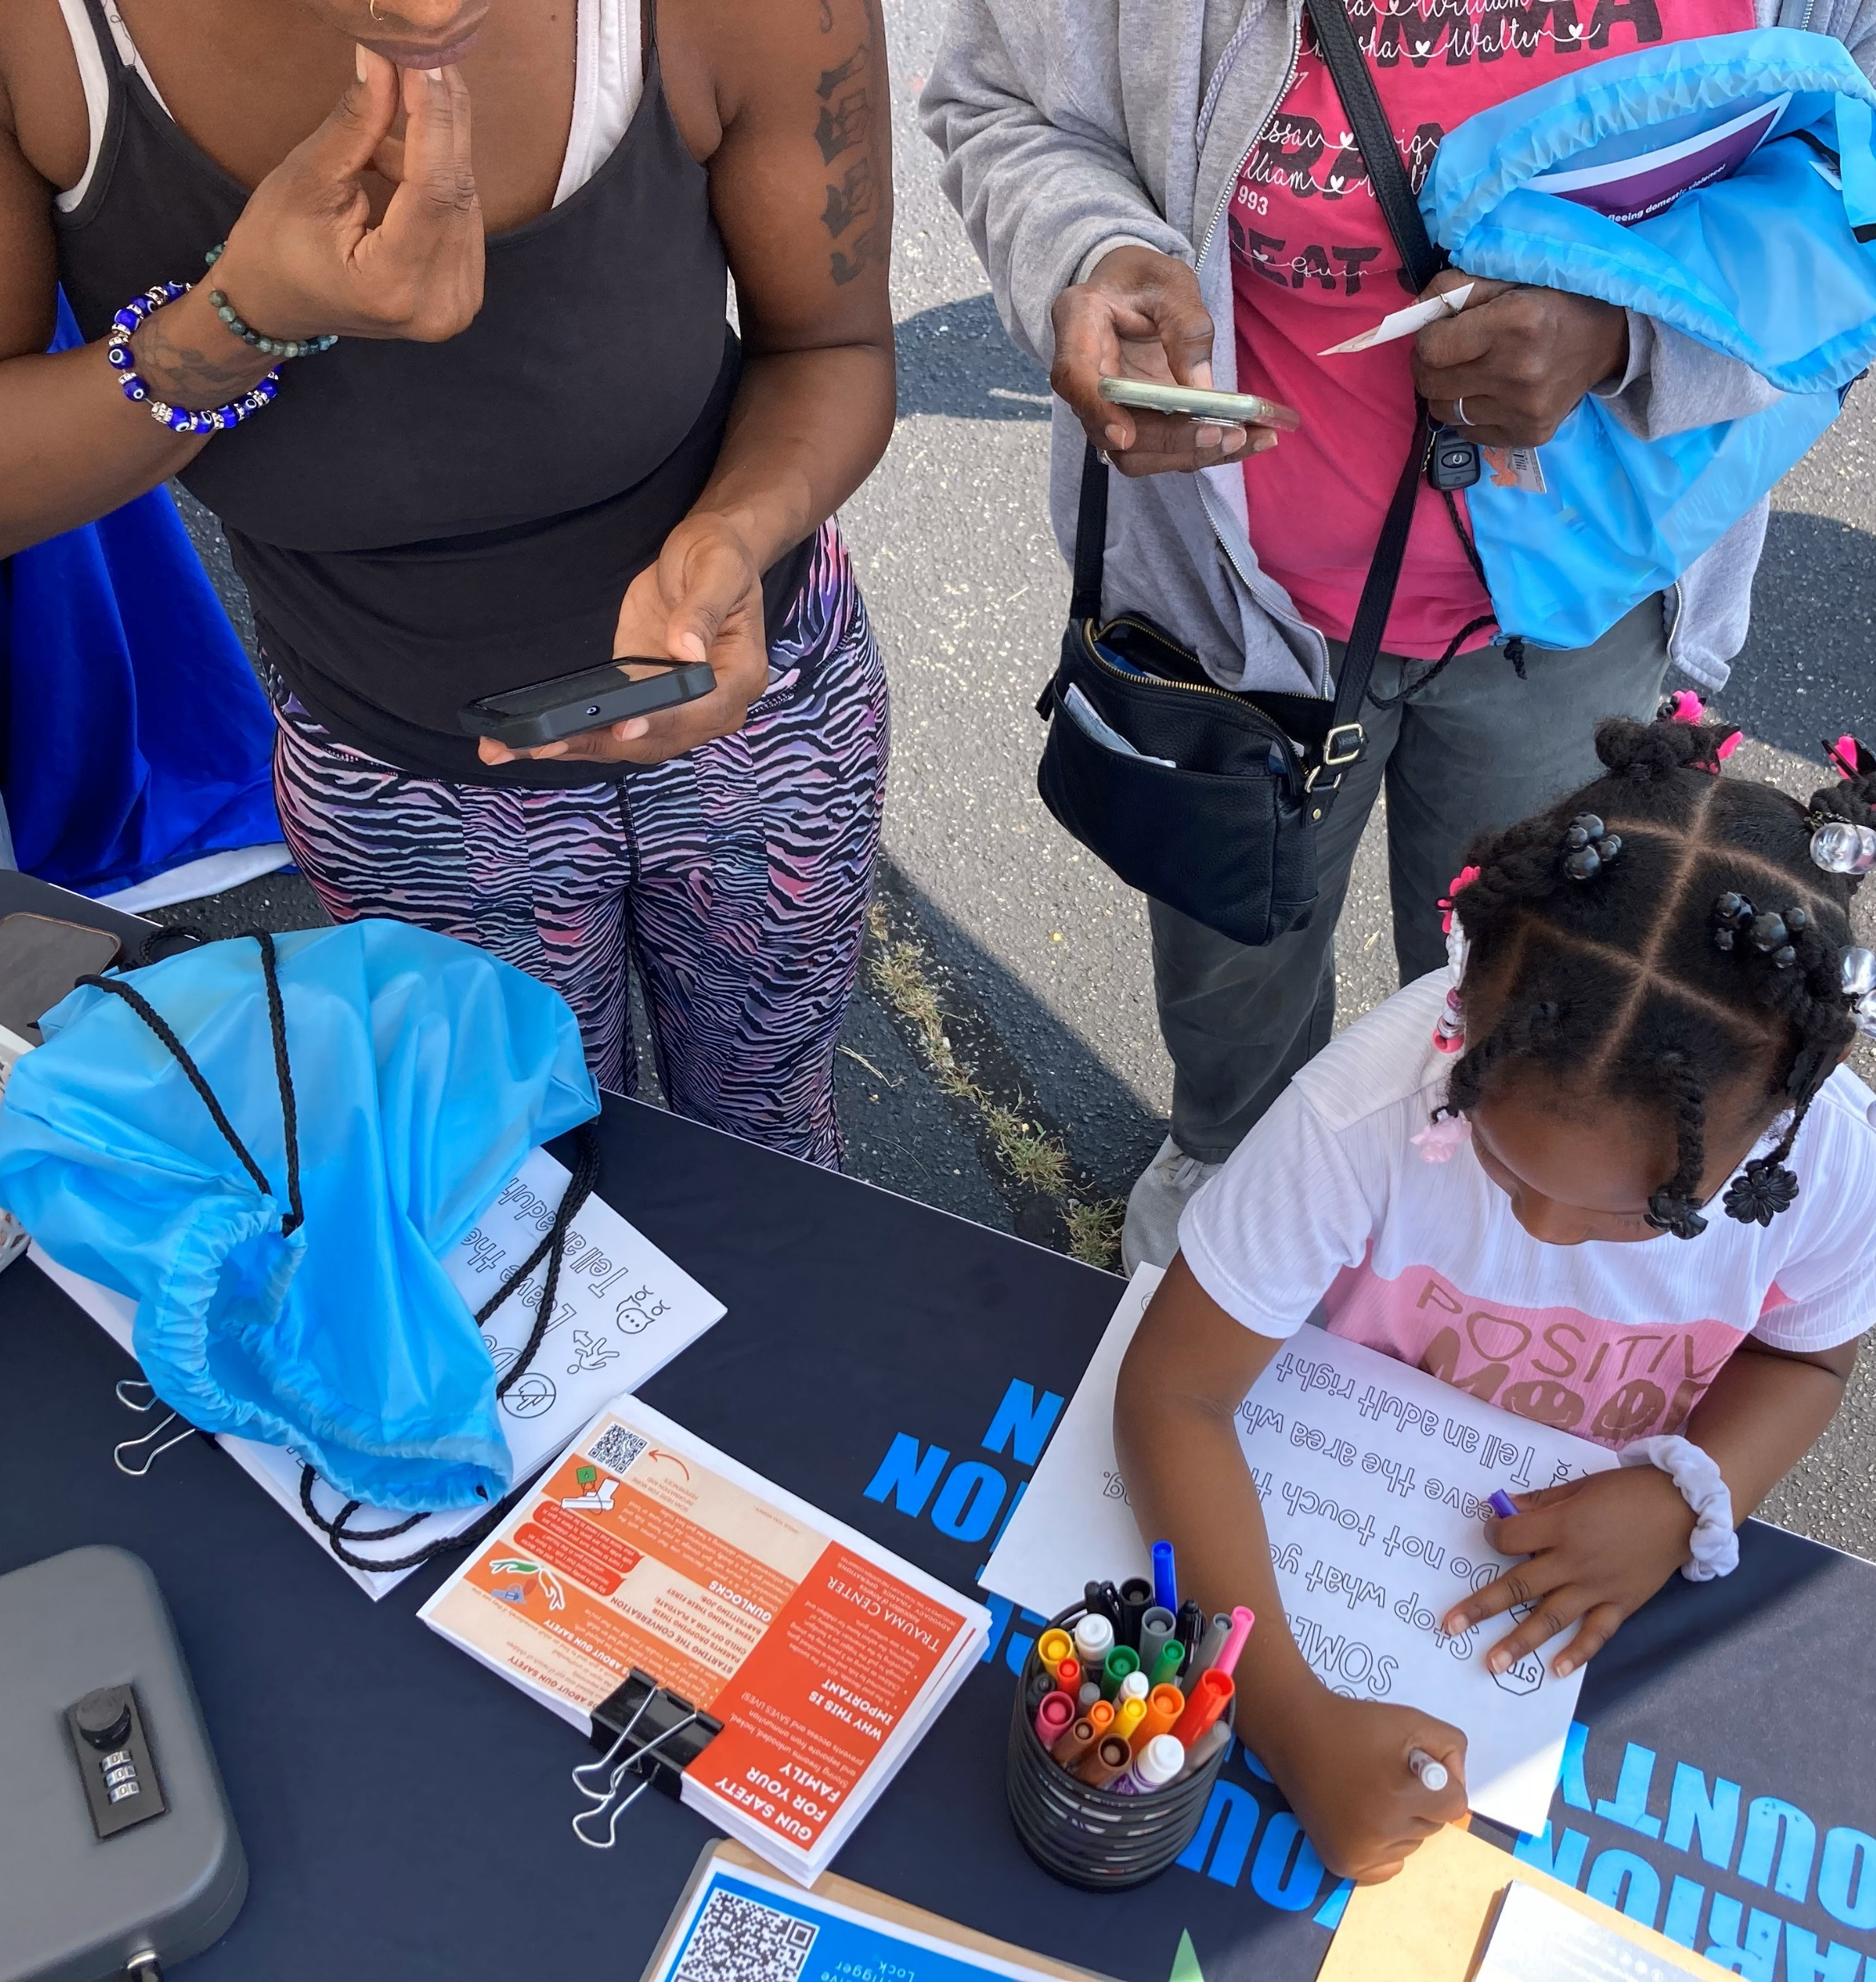
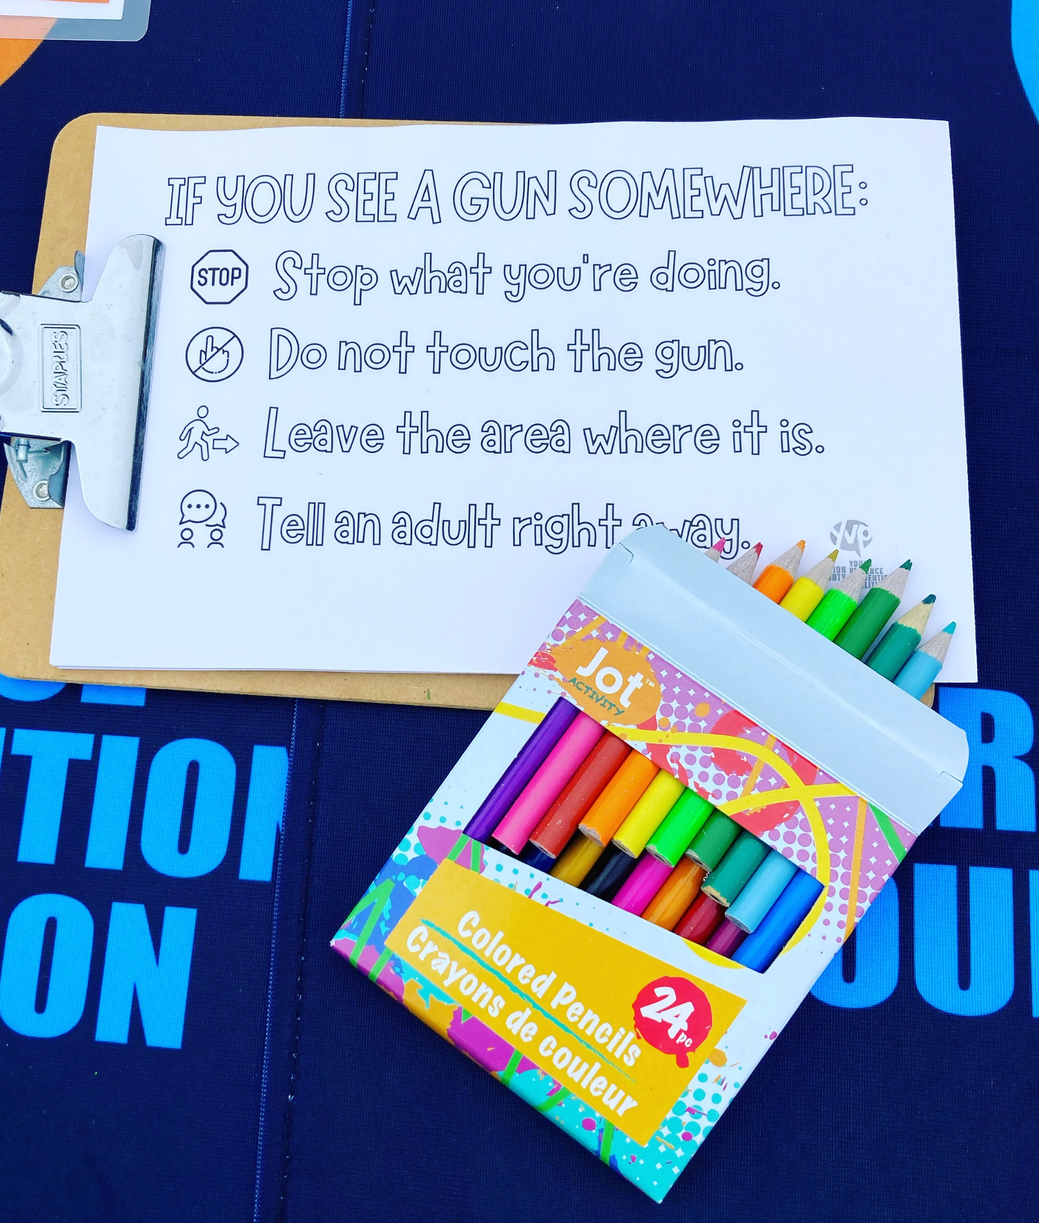
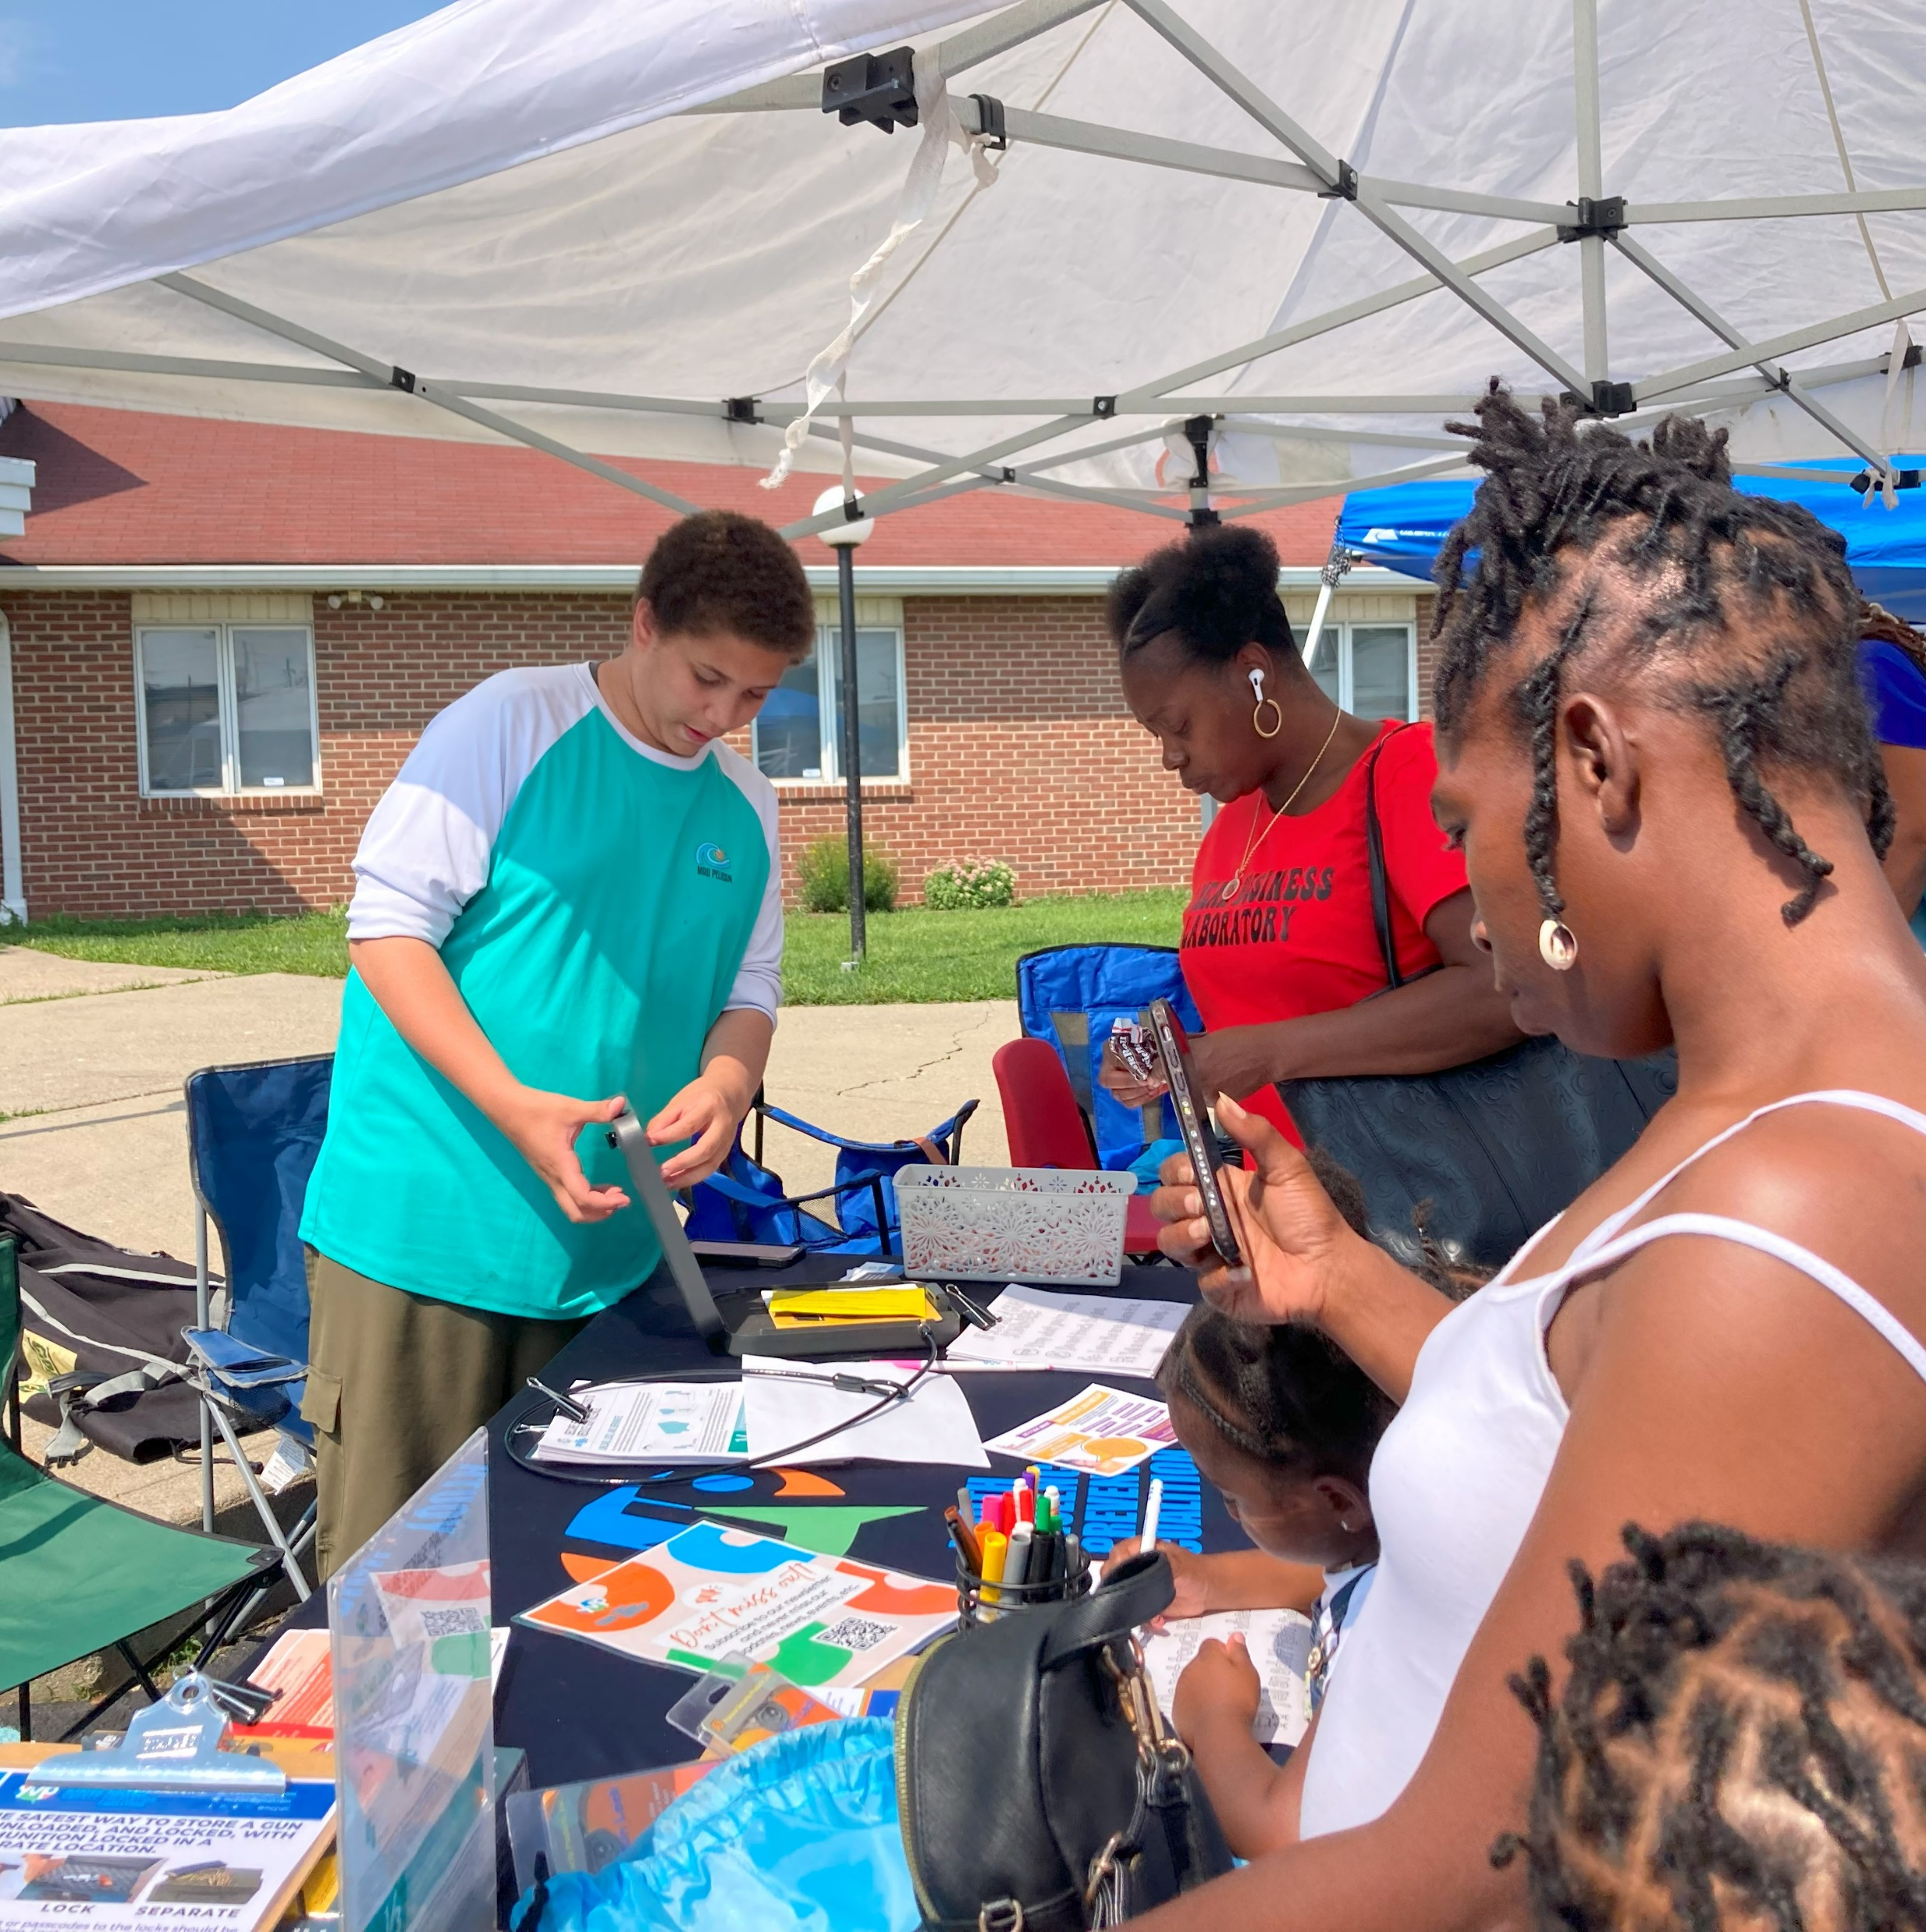
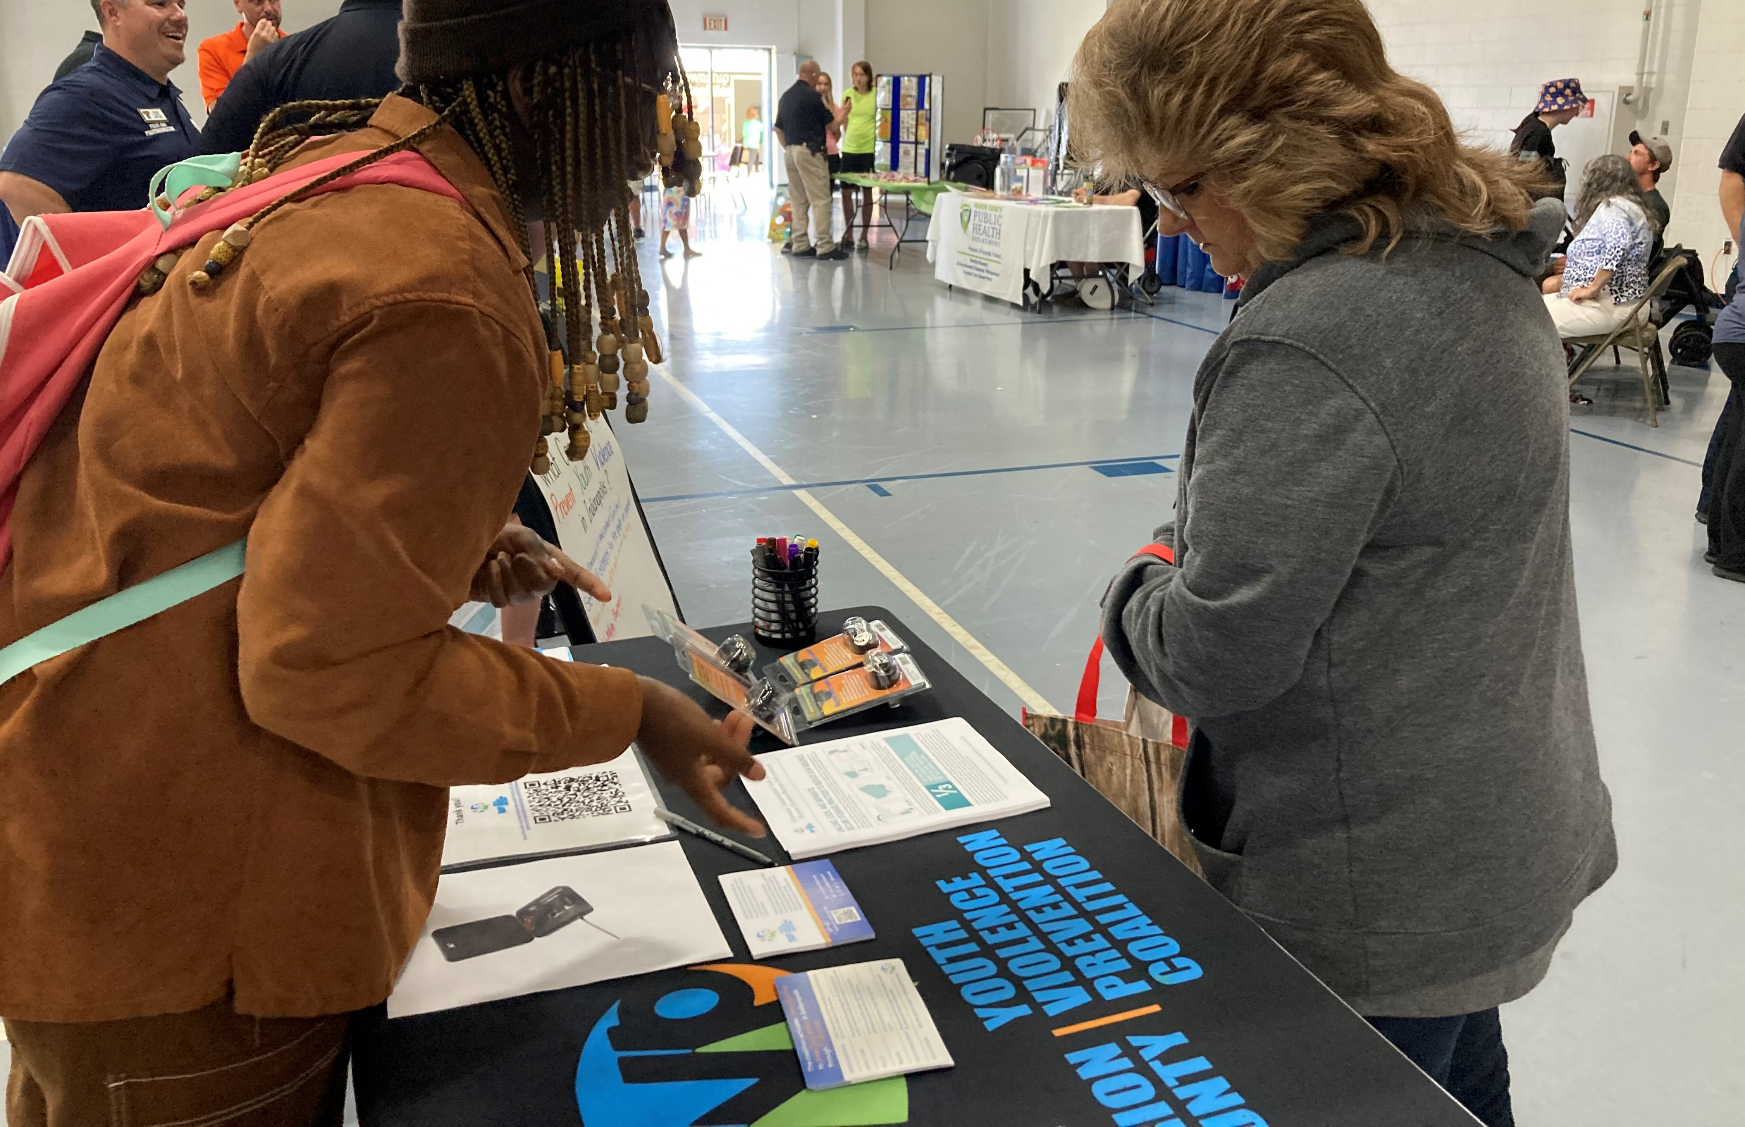
SaferINDY
Many families keep a gun in the home to protect their family from an intruder. Unfortunately, a gun in the home is more likely to hurt or kill a member of the household or a friend than an intruder. Secure storage of firearms can greatly reduce injury and death.
Notes:
Make sure to explain what is expected of members if they table at an event

Slide 29
Funding
Notes:
Highlight:
Youth engagement opportunities
Collaborative Project opportunities
Event sponsorship
Firearm lock boxes – community events

Slide 30
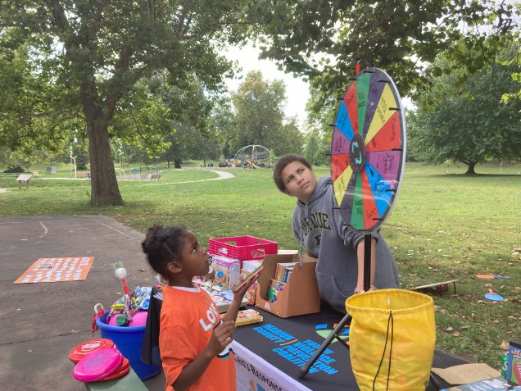
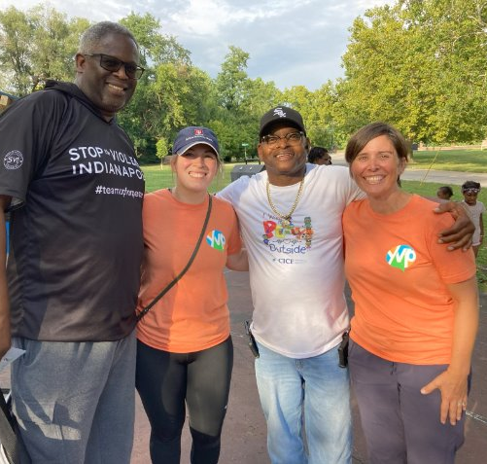
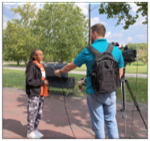
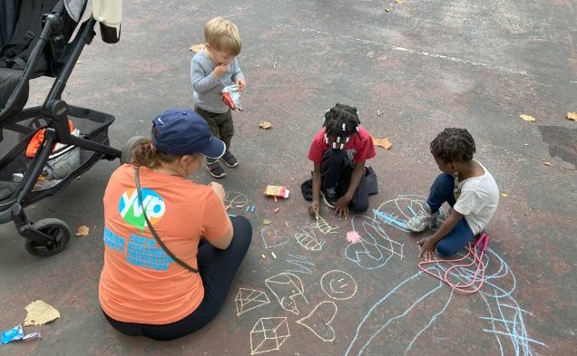
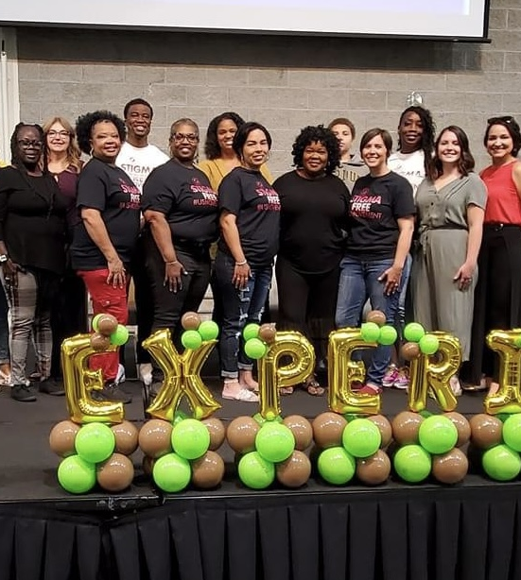
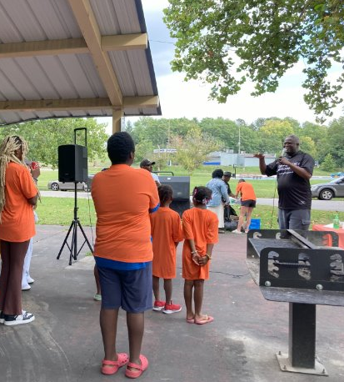
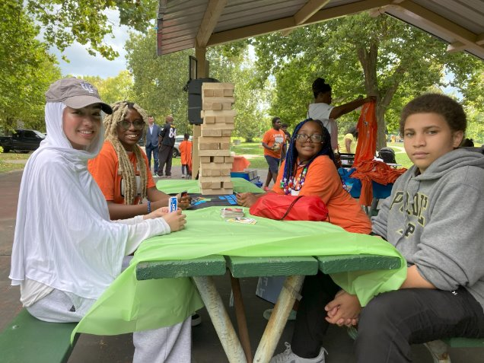
“Love Is” Campaign
Love Is ... Family Fun Day with He Cares Inc. and Stop the Violence Indianapolis, Inc.
Notes:
These are past projects/events we either helped plan and coordinate, or we sponsored financially, AND/OR we funded youth with the opportunity to engage with them
We didn’t “own” all of these initiatives. Our Steering Committee advocates for supporting the work that Coalition members are already doing.

Slide 31
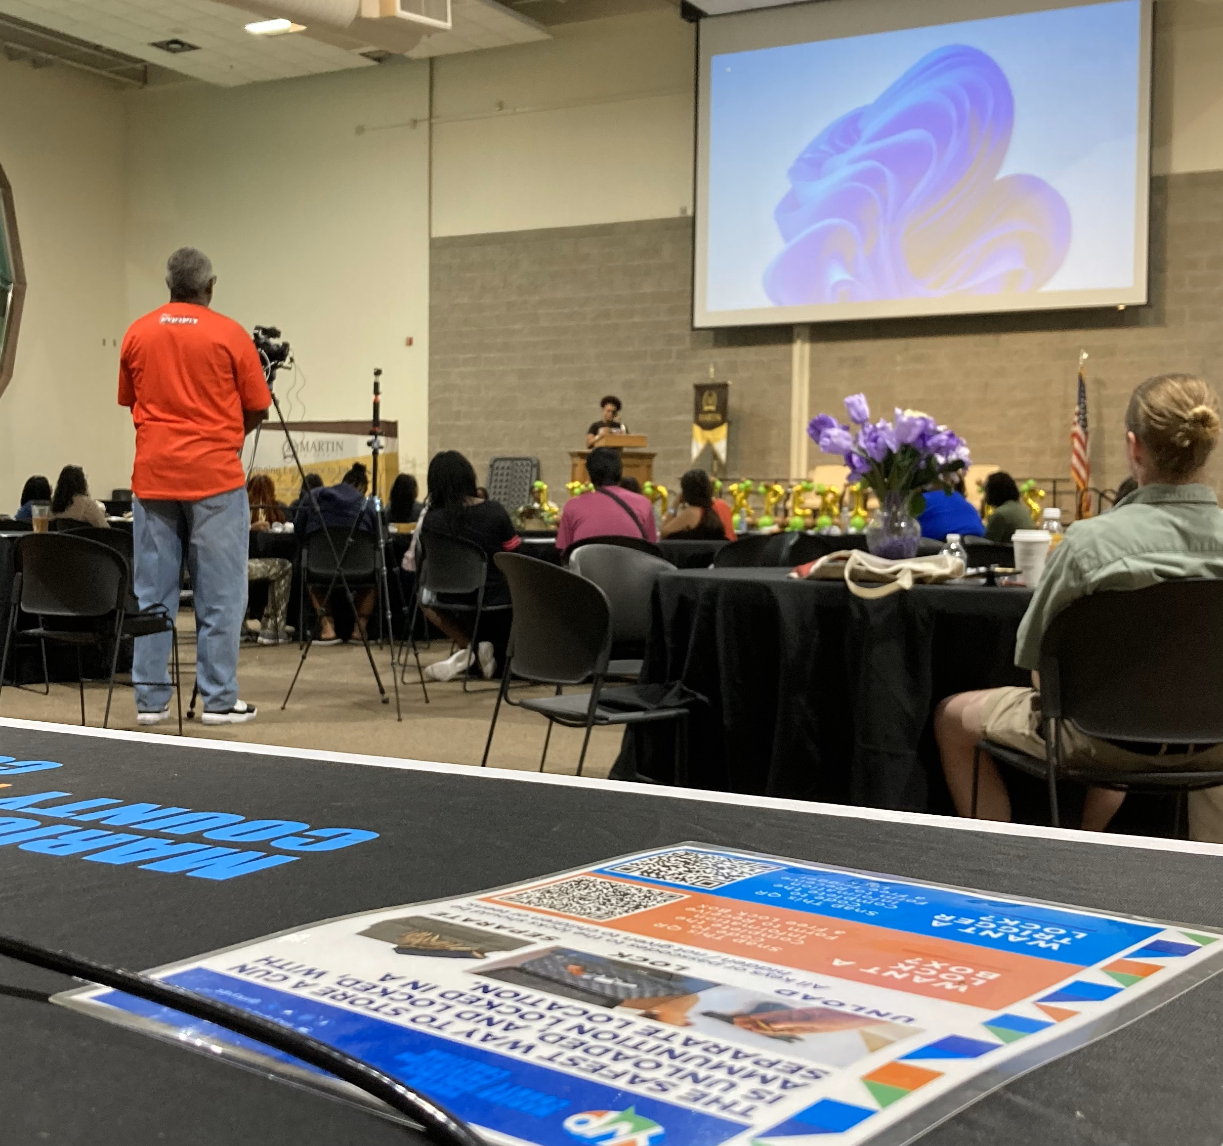
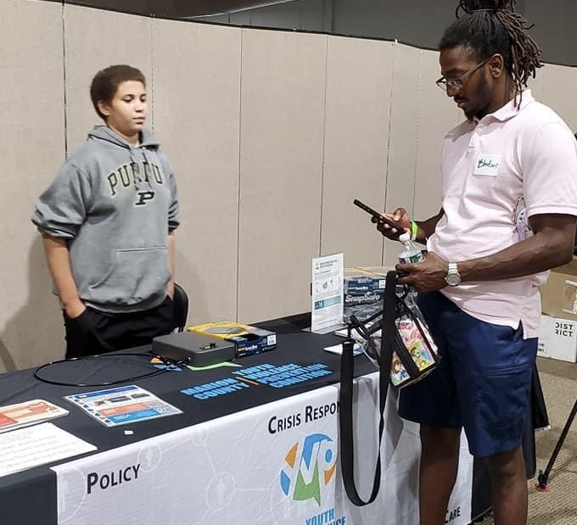
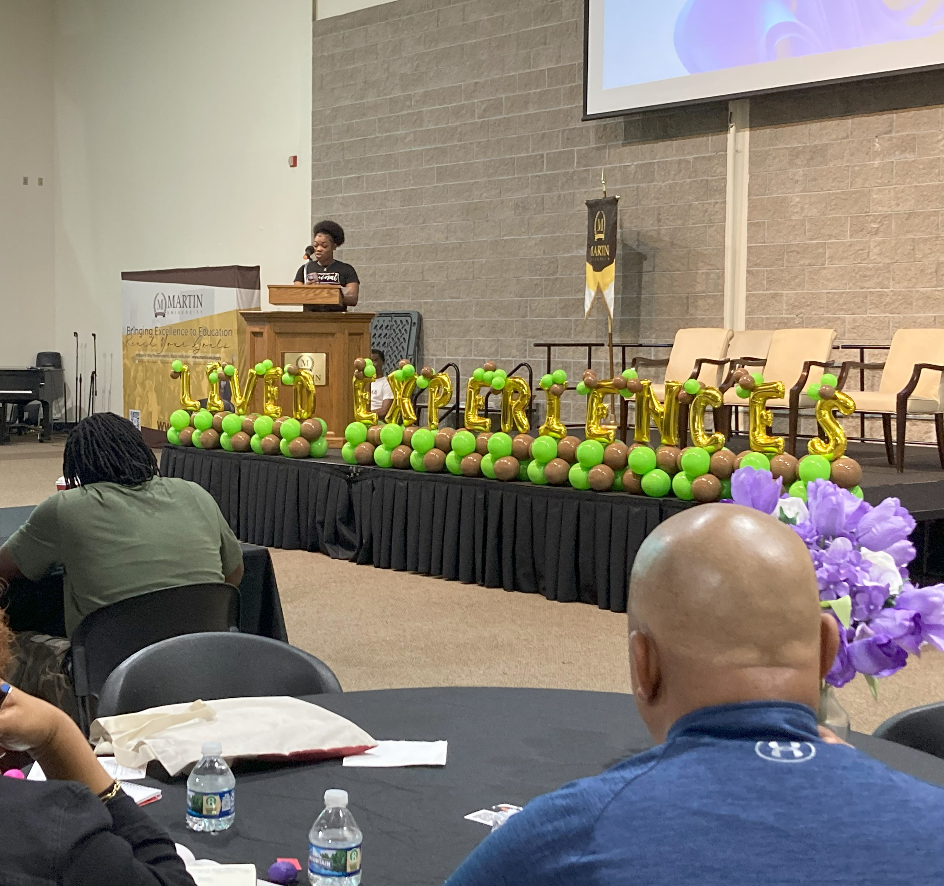
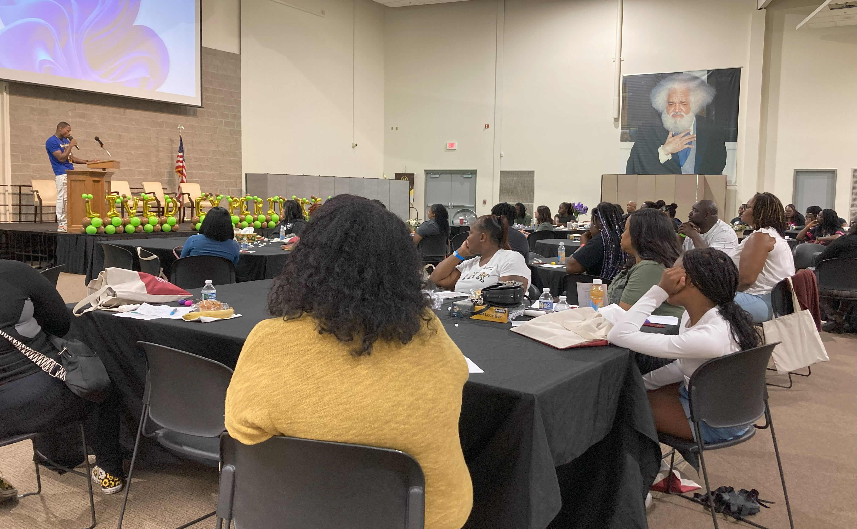
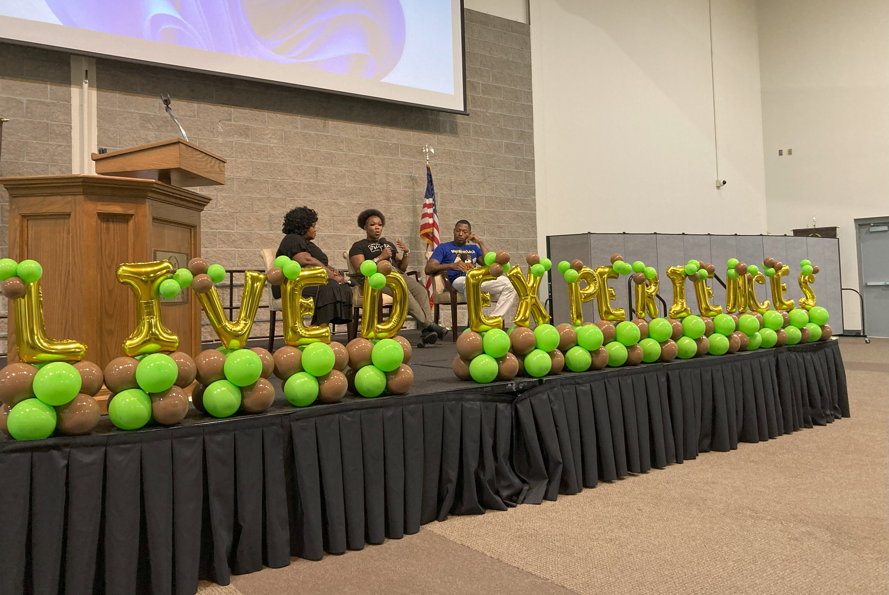
Lived Experience Trauma Informed Response Conference
The Lived Experience Trauma-Informed Response Conference was an empowering and insightful event that shed light on trauma and its impact on youth and parents/caregivers.
Notes:
These are past projects/events we either helped plan and coordinate, or we sponsored financially, AND/OR we funded youth with the opportunity to engage with them
We didn’t “own” all of these initiatives. Our Steering Committee advocates for supporting the work that Coalition members are already doing.

Slide 32
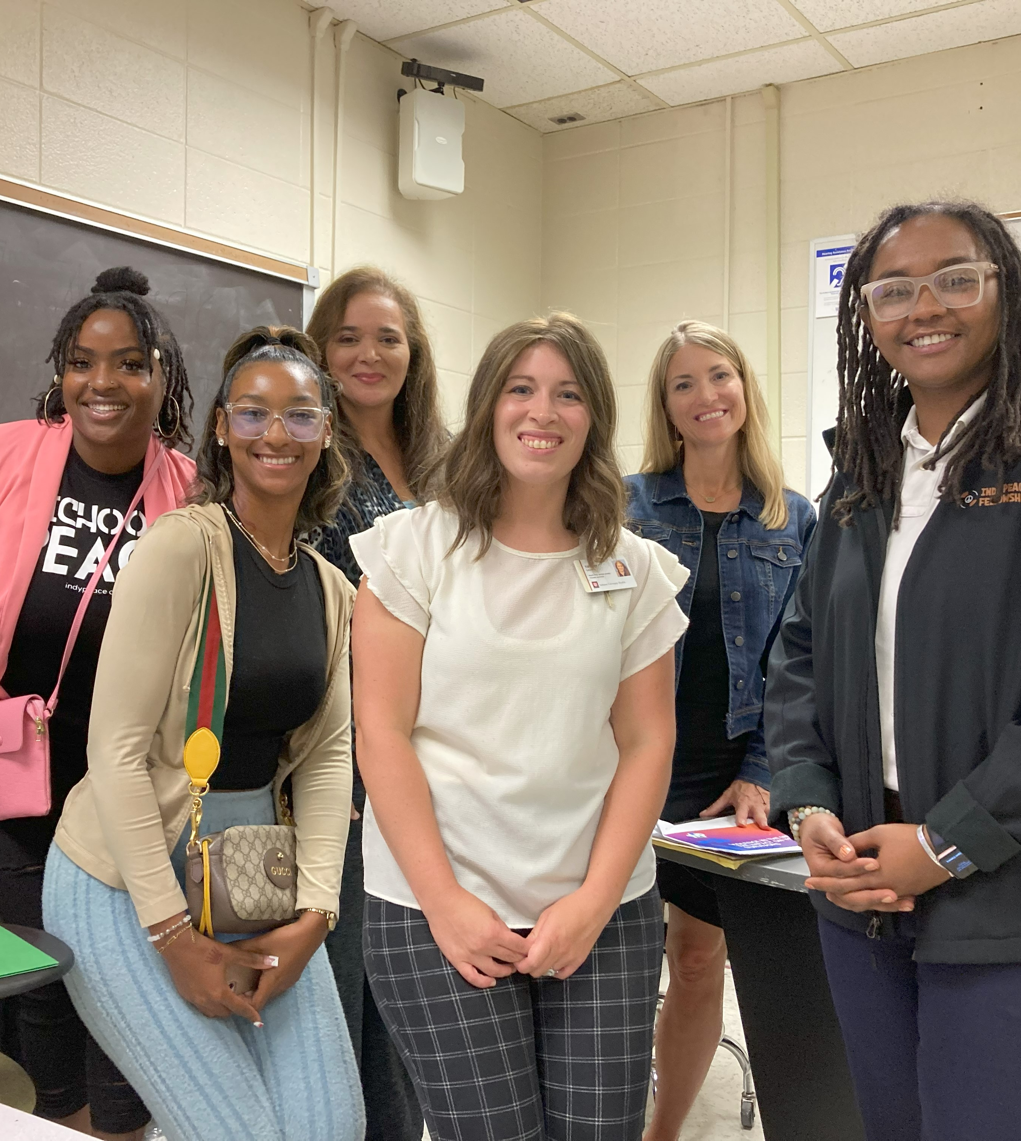
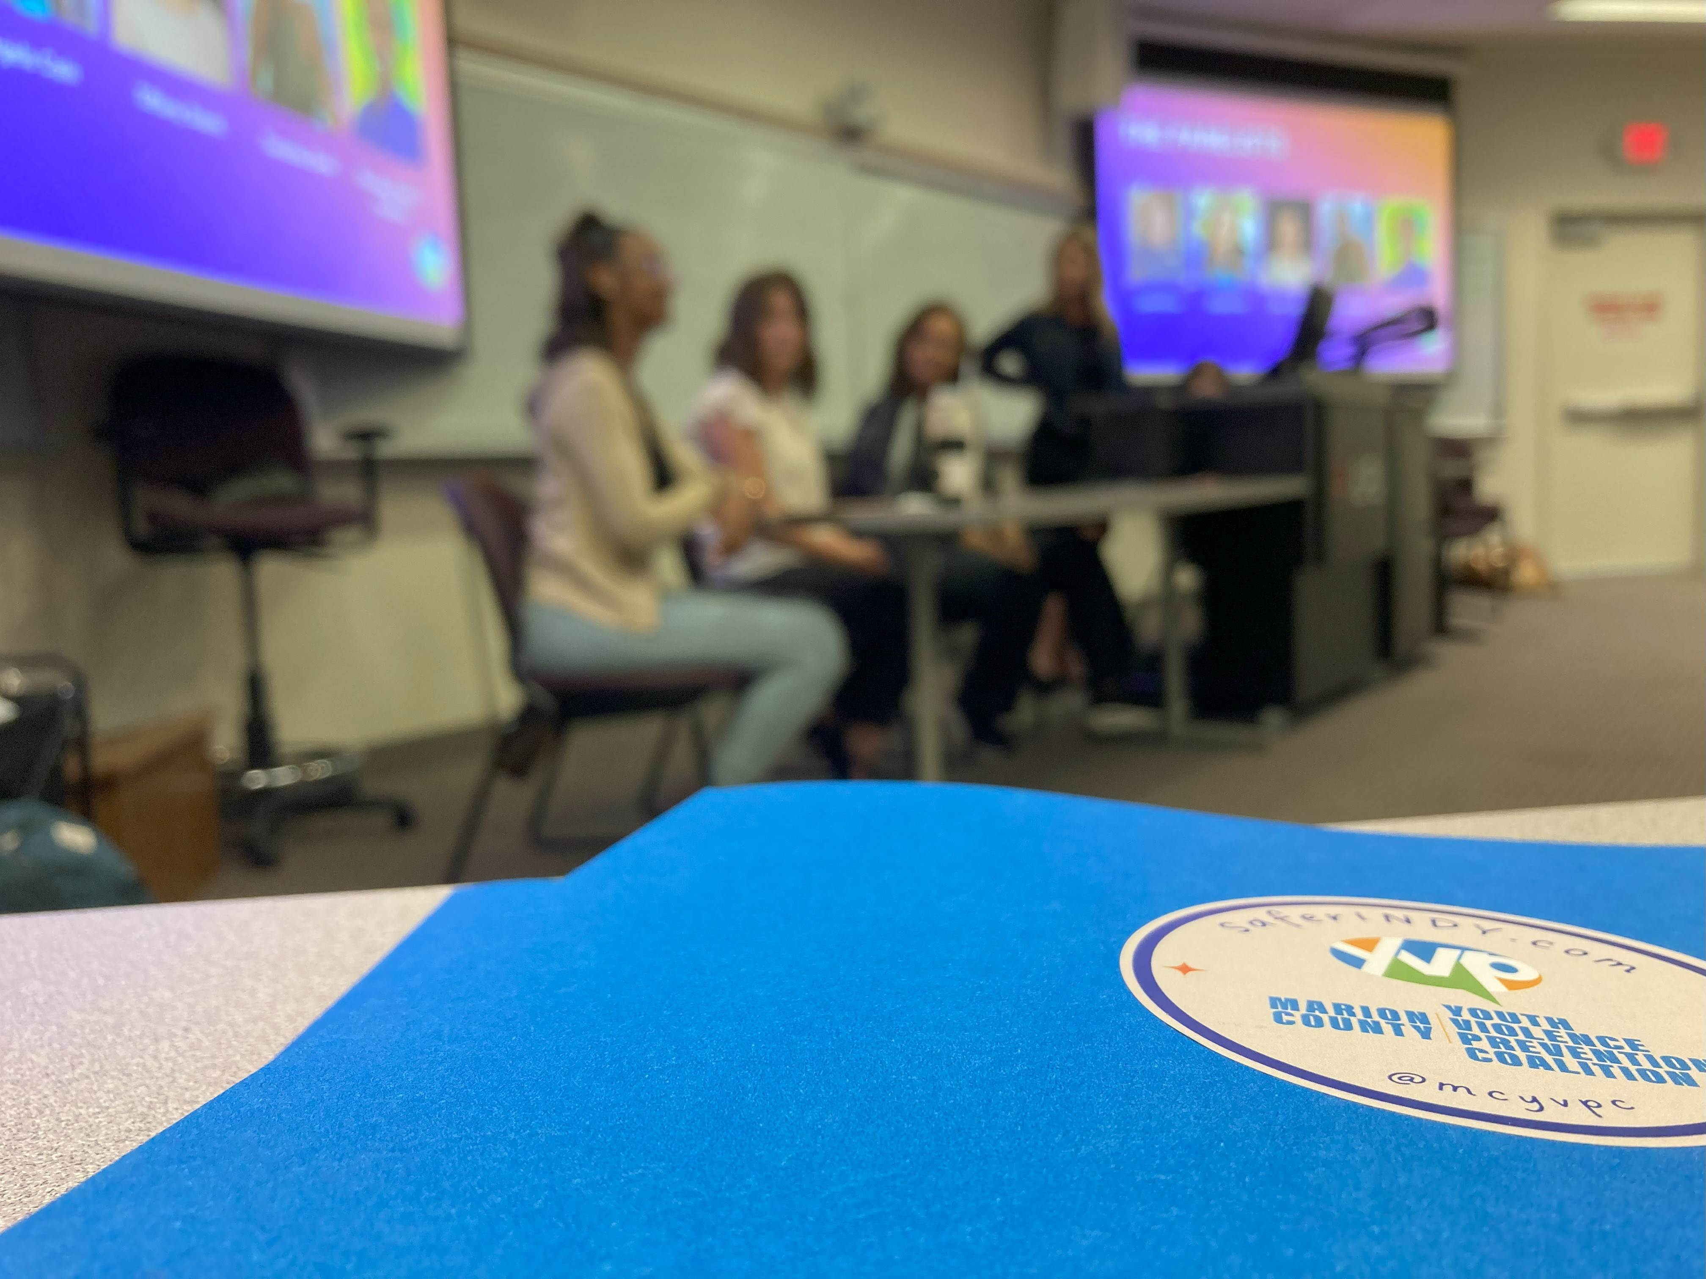
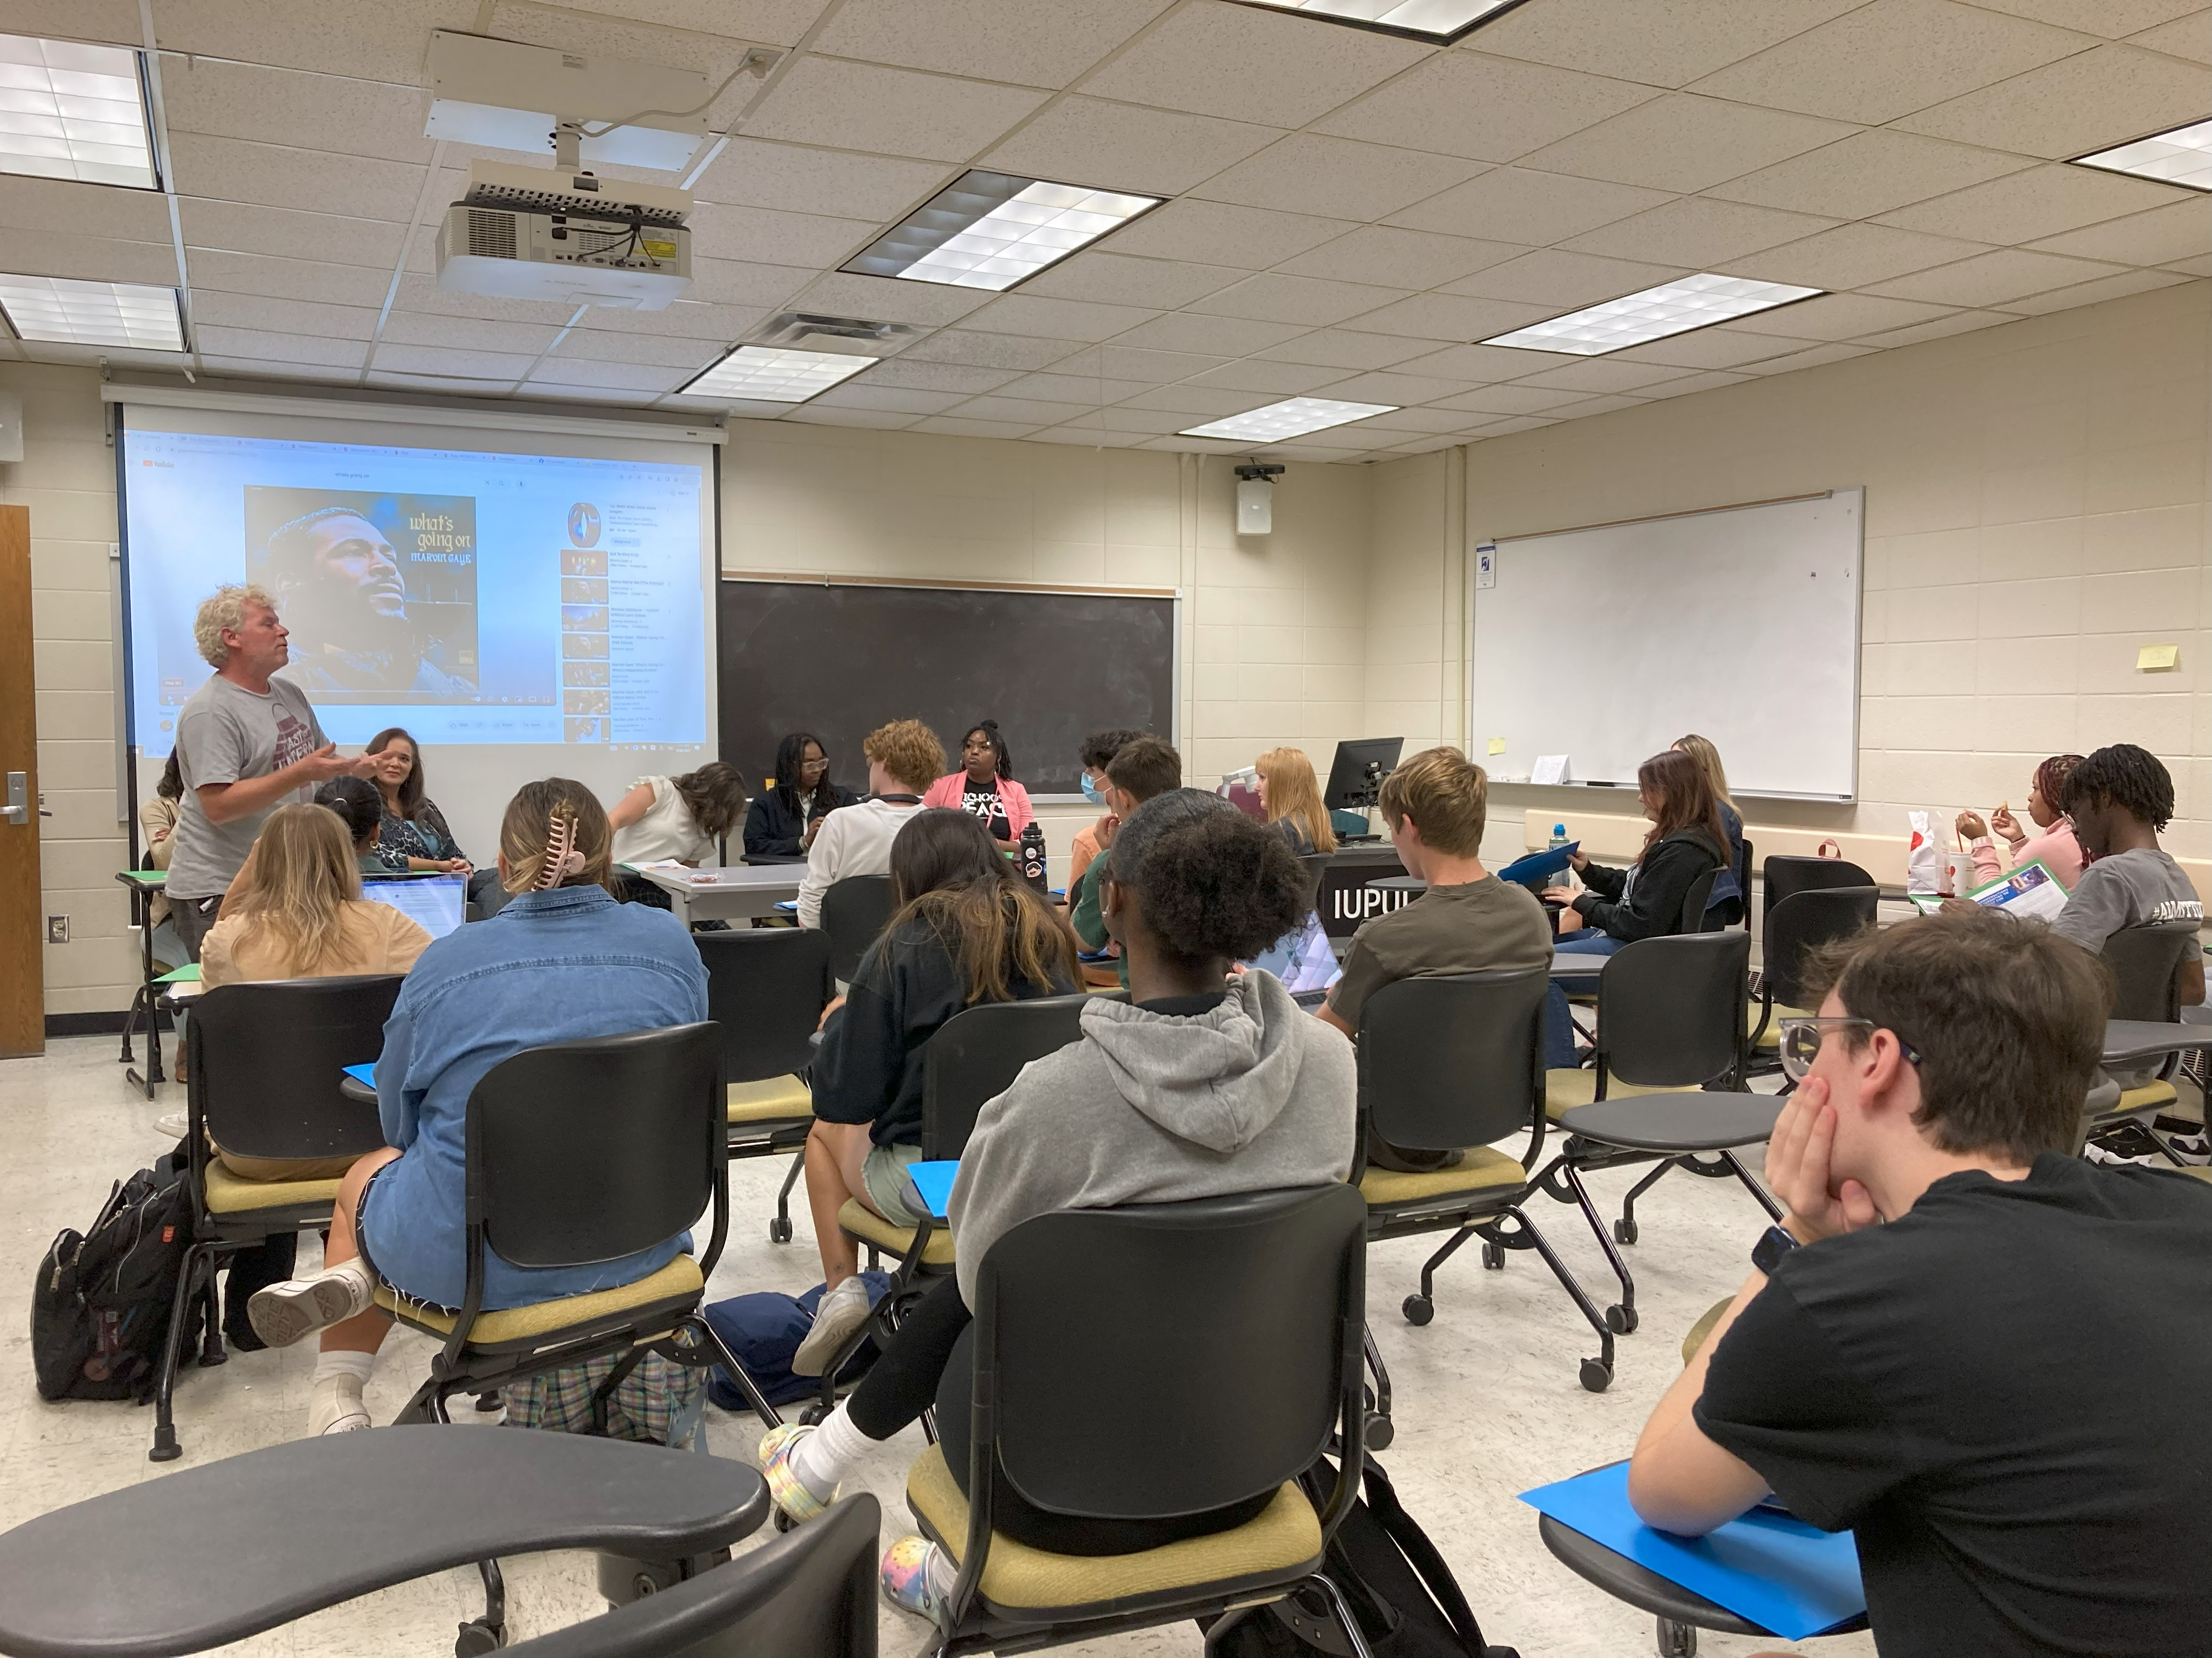
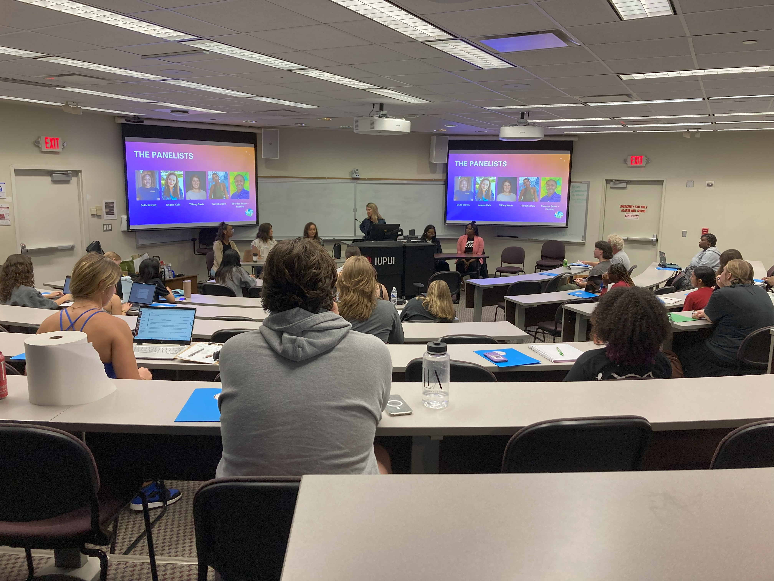
Educational Seminar
Media organizations can play a critical role in gun violence prevention.
Carey Haley led a media and community violence panel discussion with Tiffany Davis, Della Brown, Angela Cain, Tamisha Dew, and Shardae Hoskins at IUPUI.
Notes:
These are past projects/events we either helped plan and coordinate, or we sponsored financially, AND/OR we funded youth with the opportunity to engage with them
We didn’t “own” all of these initiatives. Our Steering Committee advocates for supporting the work that Coalition members are already doing.

Slide 33
Notes:
These are past projects/events we either helped plan and coordinate, or we sponsored financially, AND/OR we funded youth with the opportunity to engage with them
We didn’t “own” all of these initiatives. Our Steering Committee advocates for supporting the work that Coalition members are already doing.

Slide 34
2024 Student Internships
VOICES, Corp
Inner Beauty
Chin Community of Indiana
Mackida Loveal and Trip Outreach Center
Genesys Solutions
Can We Ryde, Inc
Let Them Talk
We Bloom (Discovery Café)
Black and Latino Policy Institute

